Slide 1
Door Step School Foundation – Project Foundation, Pune
Annual Review for April 2024 - March 2025
Budget Proposal for 2025-26 (Year X/Y)
Asha Projects
April 06, 2025

Slide 2
Part 1

Slide 3
Overview
Please provide a high-level overview
Focus area - Direct education, school readiness, childcare, and primary education support for the children of the workers at various construction sites.
Geographical area - Mumbai and Pune, Maharashtra; Asha-supported work is in Pune.
NGO inception, history - Founded in 1989; Pune branch started in 1993; Project Foundation operations in Pune started in 2003.
Asha engagement start
Chapter engagement start - 2005
Other chapters involvement – Silicon Valley, CA
Projects Page - https://admin.ashanet.org/project/659

Slide 4
Mission and Vision
Mission of the Project Partner – The mission is to take Education to the door step of every child and empower children with Foundational Literacy and Numeracy thus enabling them towards lifelong literacy and learning
Vision over the next 5 years - To address three major problems of public education system through various innovative programs:
•Non-enrolment i.e. children are not enrolled in schools for a variety of reasons.
•Children drop out of school at an early age.
•Even if children are enrolled in schools, their quality of education is low and children suffer from low learning levels

Slide 5
Strengths
Please provide a summary of the strengths of the organization - DSSF shows long-term project continuity and strong field delivery in Pune
Project delivery - Operates EACs for 8 hours a day, 6 days a week; works across 70+ construction sites with reach of nearly 6,500 children
Fundraising - Operational cost is shared between funders/CSR and builders
Team - Expanded programs over time and launched in-house training support such as Parivartan

Slide 6
Weaknesses
Please provide a summary of the weaknesses of the organization
Project delivery
Fundraising
Team
Please update on how they plan to improve

Slide 7
Project Updates
School/ project partner updates for the entire school year
Please provide link to photos and documents (newsletters, annual reports)
What went well, and what did not
Challenges

Slide 8
Primary Activities
Balwadi Class – Monthly scheduled activities included To string, Sewing Board, Matching pairs and Differences, Twisting fingers in rangoli, Pair according to use, Pattern, Picture reading, Organ strips. School readiness – 2 children
Study Class (120 days language skills program) according to the learning levels of each child.
Reference Class – Paragraph reading, Science experiments, Educational language games, puzzles, essay writing, paragraphs writing.
School Enrolment – 5 children enrolled from June 2025 to Mar 2026
Tracking of Migrated children – All 18 migrated children could be tracked; They are all attending schools regularly

Slide 9
Support Activities
Monthly Projects : Summer, Monsoons, Vegetables, Animals, Festival & Family, Fruits & Flowers, Birds, Your helper
Science activities : Color dispersion of light, Air pressure, Volume of liquids, Beam Balance, A self-blooming paper flower, Playing with sticks, Combustion requires oxygen, Float-sink, Making a lung model, Observation of acids & acidic substances
Events & Celebrations – Labor Day, Environment day, Independence Day, Rakshabandhan, Janmashtami, Children’s day, Diwali, Christmas, Republic Day, Science Day
Creches activities – Daycare, Listening to instructions and following them, Action songs, Picture identification, Beads weaving,
Parents Meetings Safety precautions at construction sites, RTE Act rules & Importance of education & parents’ involvement how to communicate with children, Homework), Health related awareness during Summer, monsoon and winters. Financial planning, Women’s Health and family Planning, Importance of annual examination, Chavdi reading

Slide 10
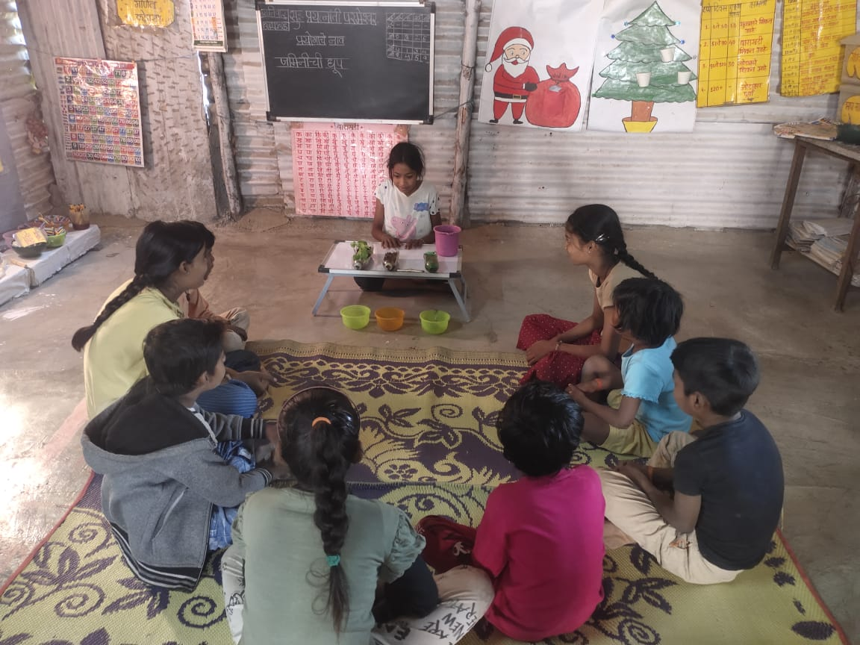
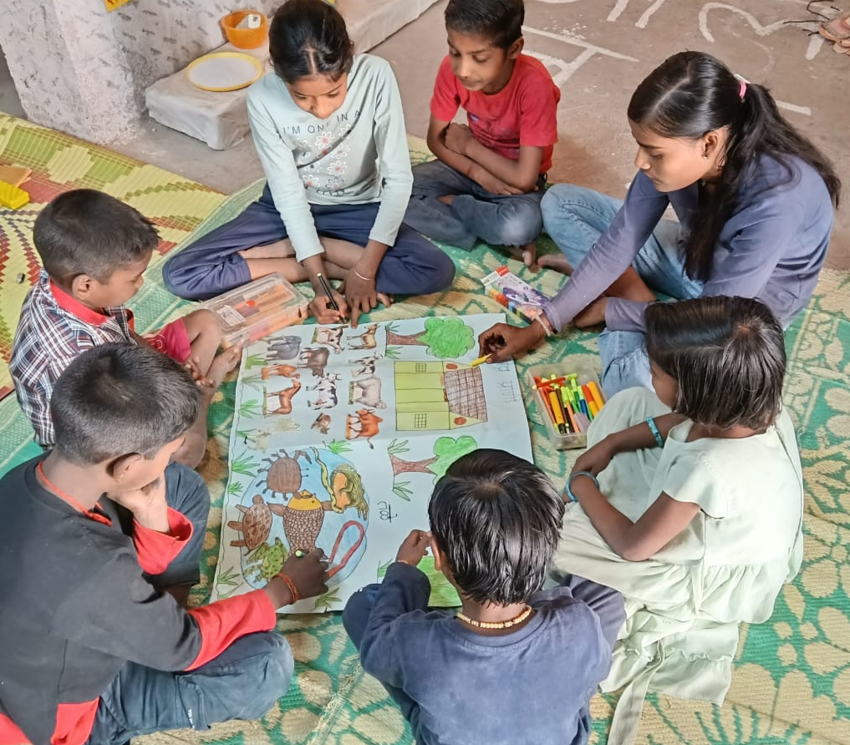
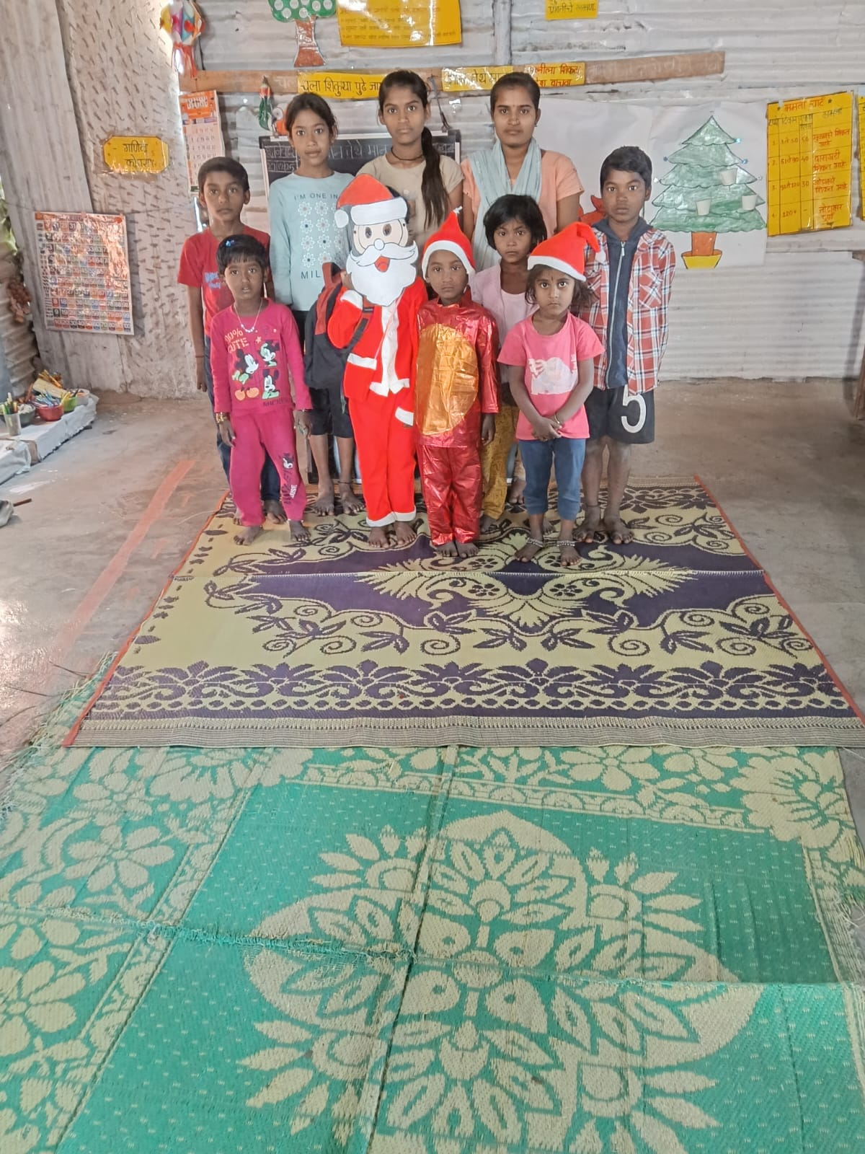
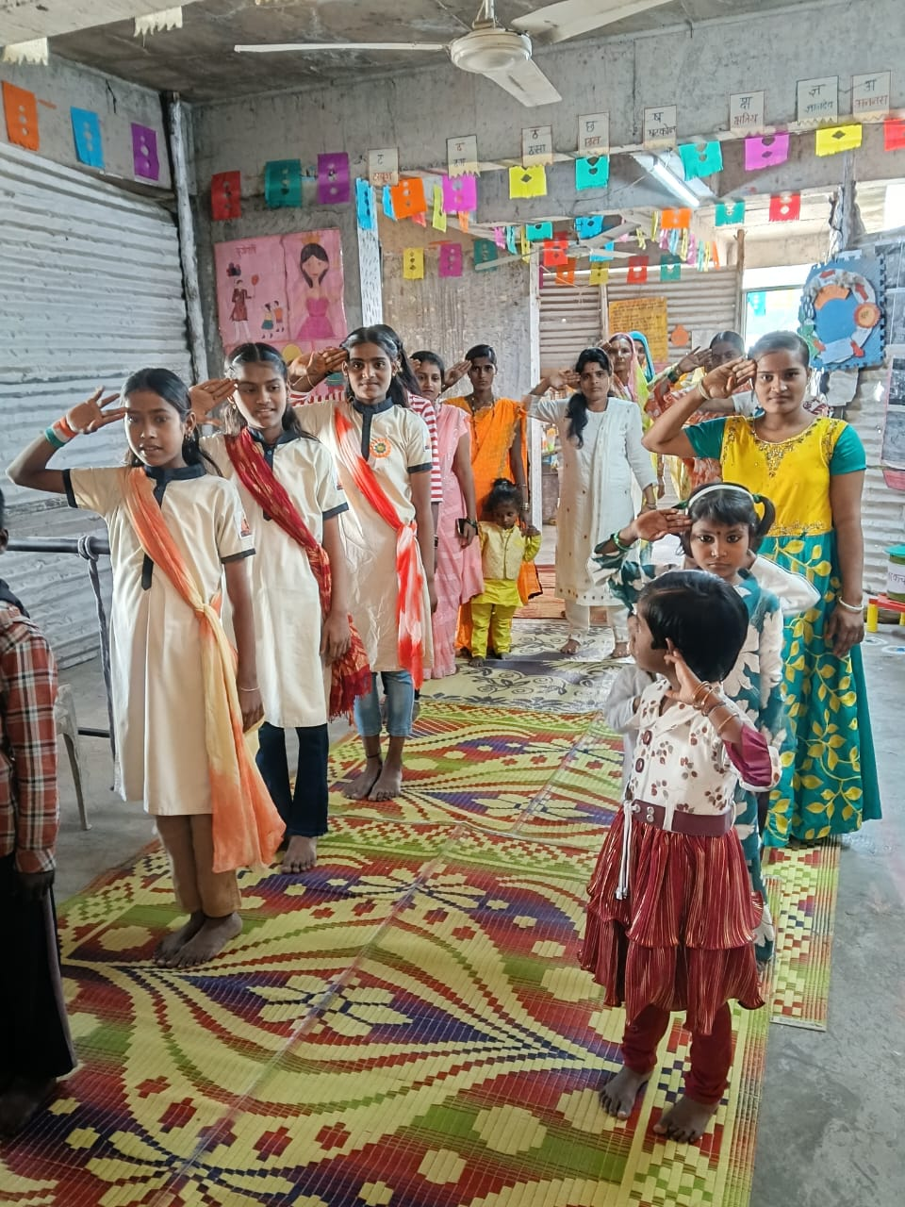
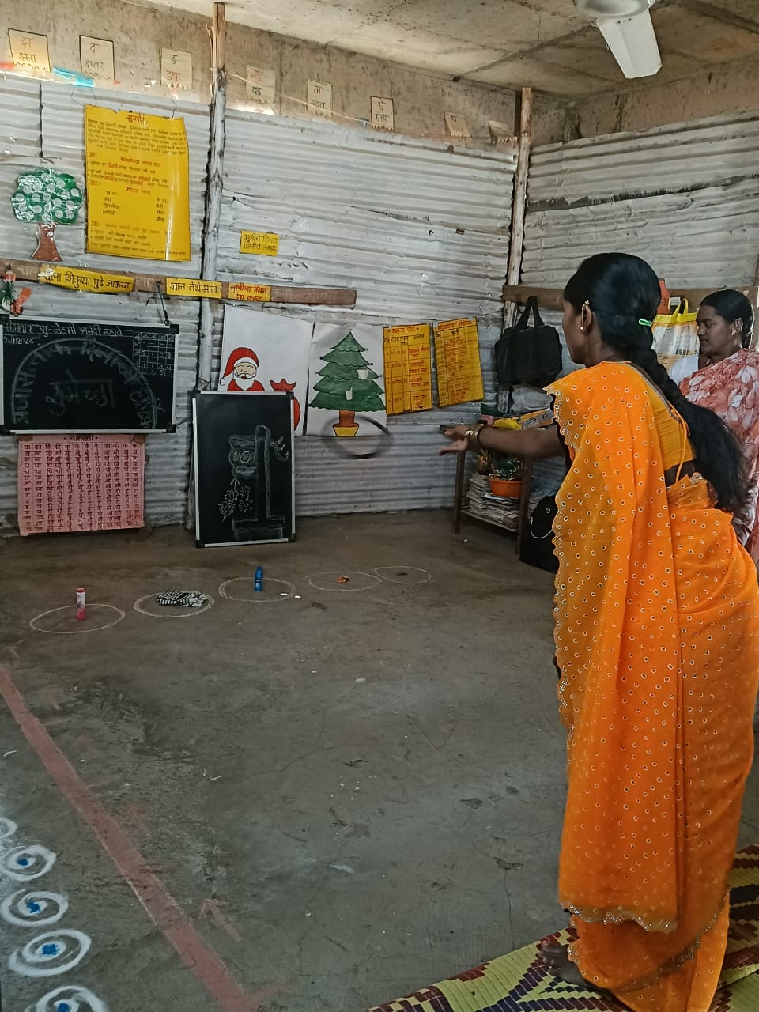
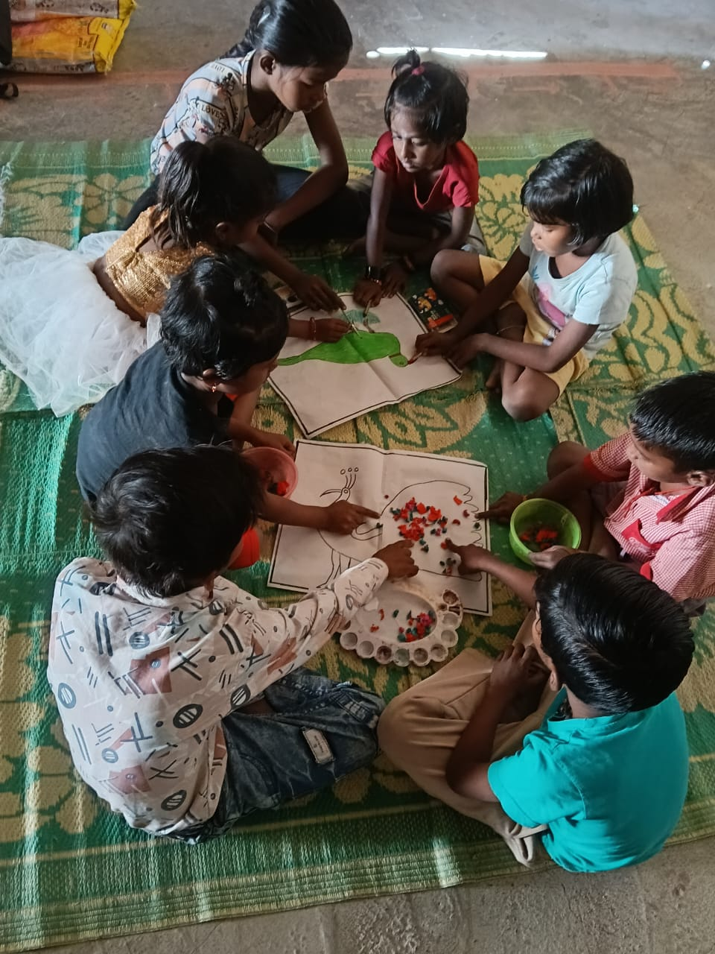
Some Glimpses

Slide 11
Site Visit Compliance
Site visit update
In-person only – Yes, By Deepali Bhagwat on May 4th 2025
Who - Background and experience of site visitor
Request for site visit in projectsgroup@ashanet.org
Request for site visit here - will be shared with Asha India volunteers
Chapter to cover cost of travel+boarding and honorarium as part of budget requirements
Site visit from other organization volunteer (if applicable) - who and when, please link report
Please ensure site visit report does not have photos with privacy concerns
e.g. photos of students in their homes
Is the site visit valid ?
18 months for urban, 24 months for rural
You cannot disburse funds with an invalid site visit

Slide 12
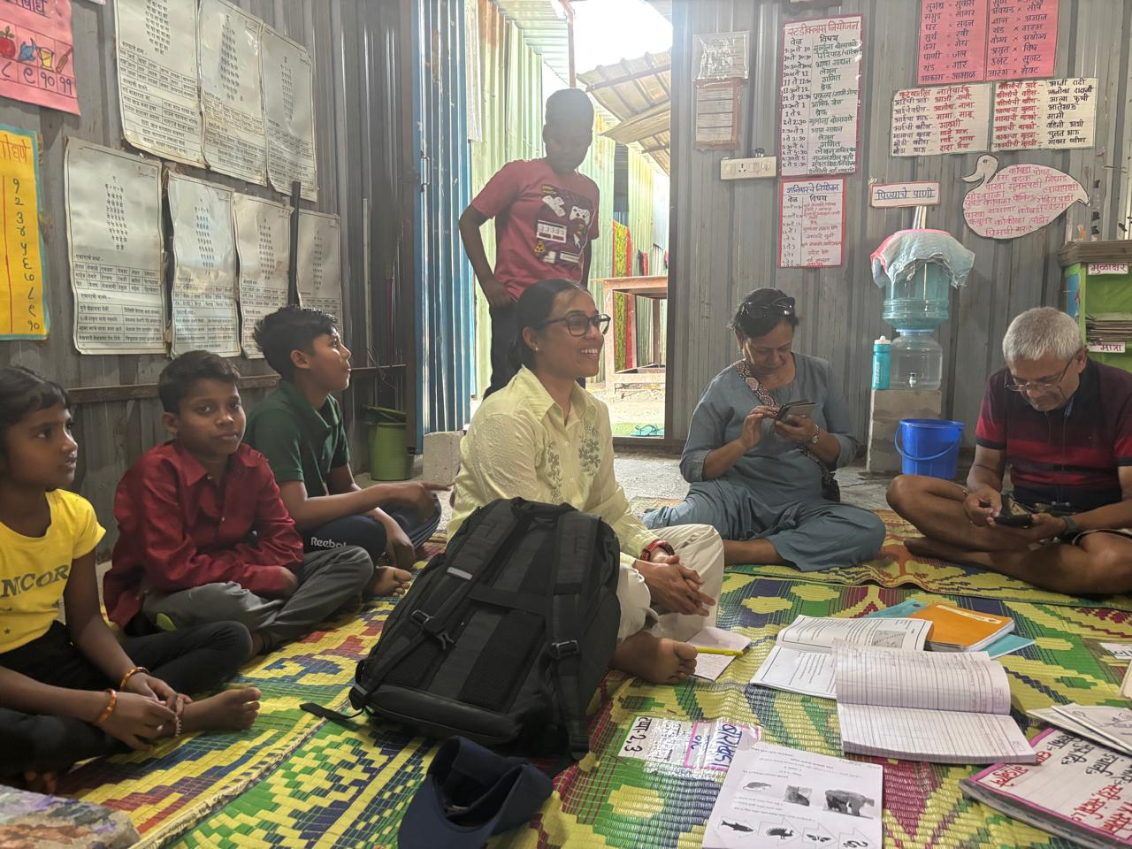
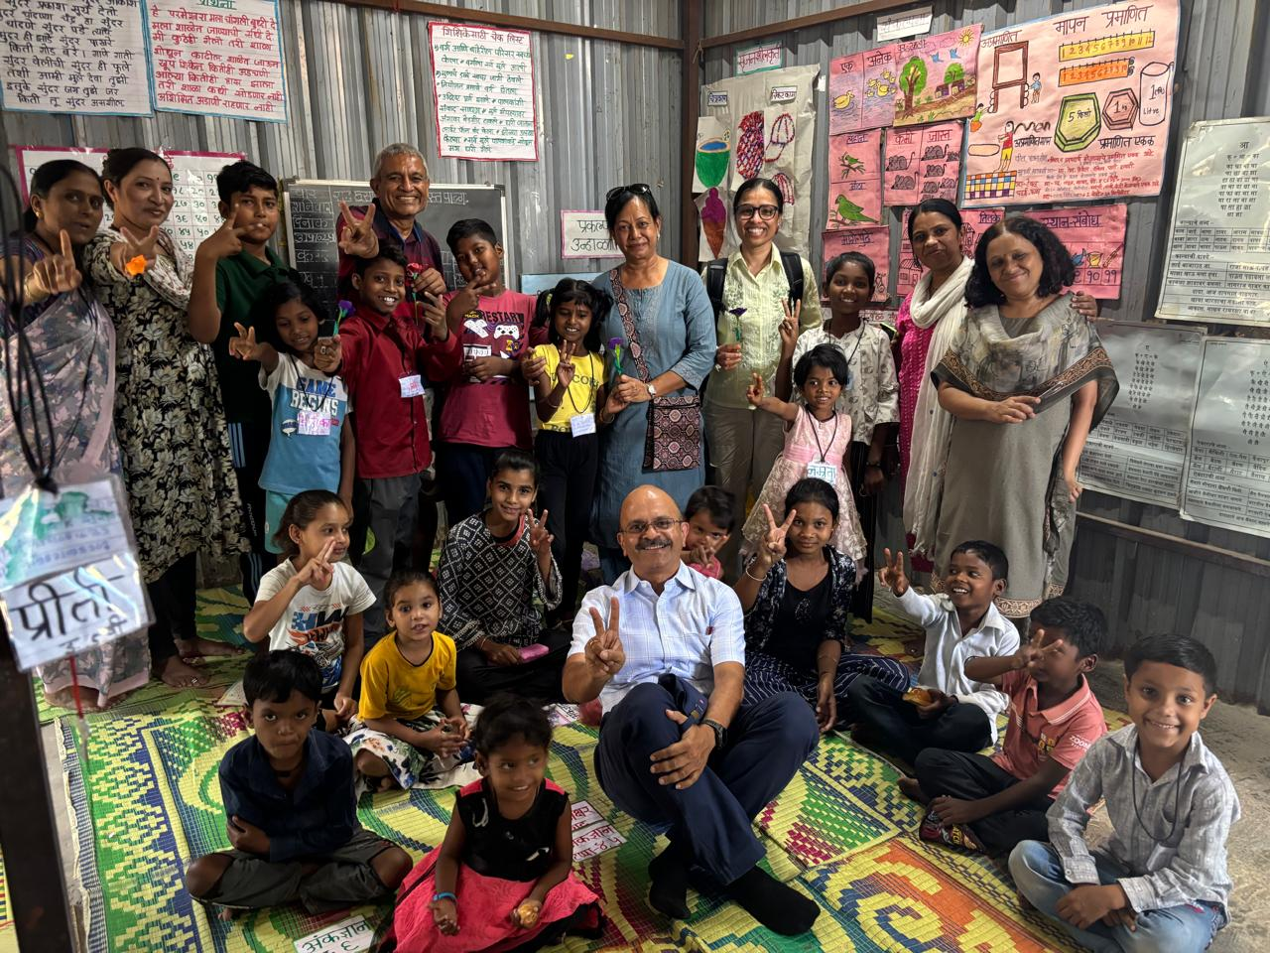
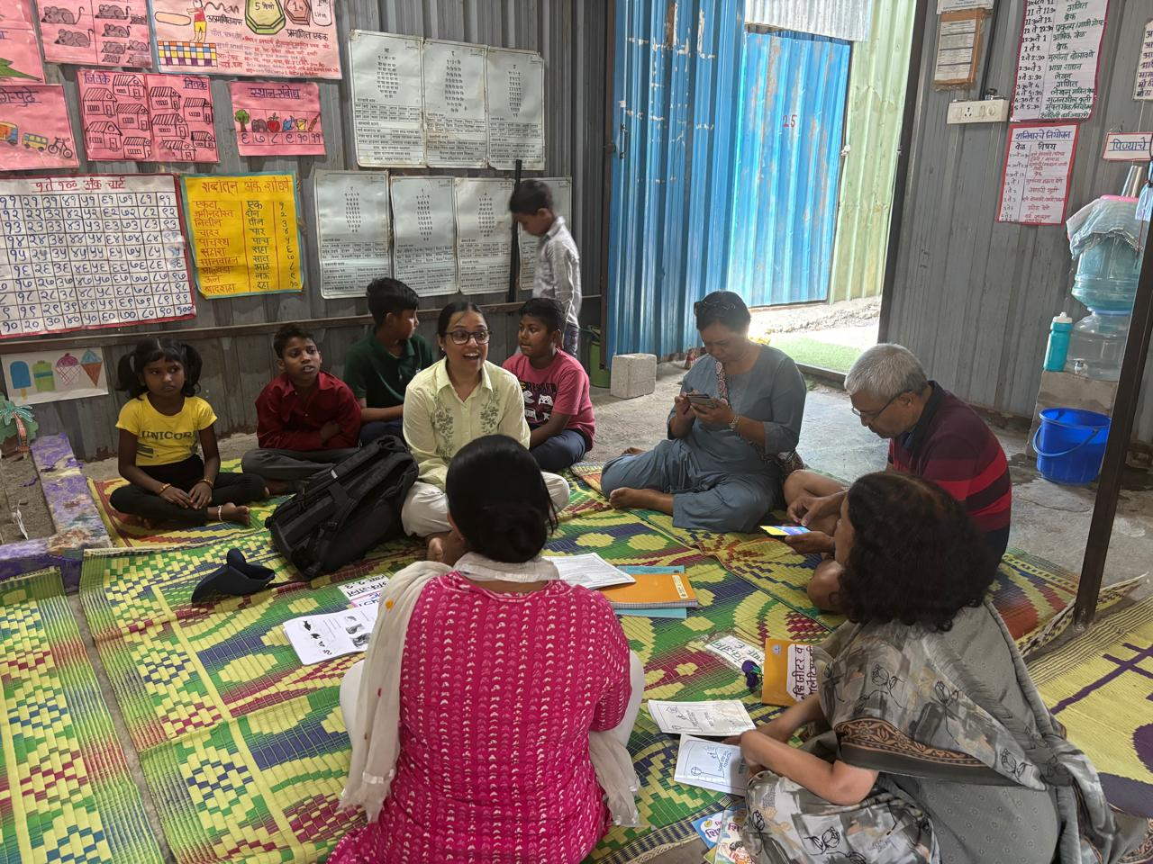
Site Visit on 4th May 2025
VISIT OF DEEPALI BHAGWAT KARNICK AT 24 KE SERENO, BANER

Slide 13
Beneficiaries
Student list
Student list (restricted to chapter internal restricted wiki/ projects drive)
Dropouts/attrition and incoming students
Plan for growth
Well-being
Nutrition
Social and emotional development
Health and hygiene

Slide 14
Asha Seattle Funded EACs
EAC Site | Builder | Pune Locality | Opened | Closed
Manjri Green Annexe | K & B Associates | Hadapsar, Pune | Sep 22 | -
Forest Trail | Paranjape Schemes | Bhugaon | Apr 25 | -

Slide 15
Data for Asha Seattle Funded EACs
Site name | Crèche | Balwadi | Literacy class | Study class | Reference class | Grand total
MANJRI GREEN ANNEXE | 3 | 4 | 0 | 8 | 4 | 19
FOREST TRAIL | 17 | 28 | 3 | 11 | 0 | 59
TOTAL | 18 | 32 | 3 | 11 | 4 | 78
Type of class | Boys | Girls | Grand Total
CRÈCHE | 10 | 10 | 20
BALWADI | 20 | 12 | 32
LITERACY CLASS | 2 | 1 | 3
STUDY CLASS | 10 | 9 | 19
REFERENCE CLASS | 0 | 4 | 4
TOTAL | 42 | 36 | 78

Slide 16
Staff
Staff List with Payroll as appropriate – Approximately 650 staff members; that include nearly 450 teachers besides Supervisor, Coordinators and other office personnel
Please do not put up names with salaries on the projects page; Use internal Wiki repository
Use positions and salaries for budget
Staff Trainings – Internal training facility for new and old teachers and other staff exists.
Compensation
Health insurance, provident fund ? – All necessary compliances adhered to including Mediclaim and Provident funds etc
Any other perquisites

Slide 17
Funds Utilization
Funds utilization of 2024-25 funding cycle from Asha Chapter(s)
Please note Asha funding is restricted and for line-items of support
Have they utilized as per the budget proposal?
If deviation, was it with prior approval of chapter?
Please provide funds utilization report for the cycle
Please provide latest available audit utilization report
Recommended for 2024-25 funding cycle
Mandatory from next year

Slide 18
Funds Expense Statys – 2025-26
Final A/c Head for Budget 2025-2026 | Unit Cost | Apr-25 | May-25 | Jun-25 | Jul-25 | Aug-25 | Sep-25 | Oct-25 | Nov-25 | Dec-25 | Jan-26 | Feb-26 | Mar-26 | Total Expenses
Program Personnel Cost(Salary+conveyance+Staff welfare+Mediclaim
Reporting and Communication | 28587 | 2,519 | 2,519 | 2,465 | 2,465 | 2,465 | 2,806 | 2,465 | 2,465 | 2,832 | 2,465 | 2,465 | 2,524 | 30,455
Quality Assurance staff | 32627 | 2,500 | 2,500 | 3,067 | 2,667 | 2,667 | 2,973 | 2,667 | 2,667 | 3,067 | 2,667 | 2,667 | 2,667 | 32,776
Supervisor | 56700 | 4,050 | 4,050 | 4,690 | 4,000 | 4,000 | 4,498 | 4,000 | 4,000 | 4,375 | 4,000 | 4,000 | 4,700 | 50,363
Teacher | 421582 | 24,857 | 24,857 | 31,329 | 26,829 | 28,759 | 31,354 | 28,036 | 15,500 | 31,423 | 51,566 | 56,101 | 59,129 | 4,09,740
Support staff | 31512 | 4,000 | 4,000 | 2,300 | 2,300 | 2,300 | 2,578 | 3,375 |  | 7,555 | 1,050 | 850 | 1,525 | 31,833
Picnic, Events and Mediclaim | 3,386 |  |  |  |  |  |  |  |  | 1,220 |  |  |  | 1,220
Training | 12,294 |  |  | 1,076 | 1,617 | 1,561 | 1,732 | 777 | 765 | 890 | 645 | 1,740 | 2,270 | 13,073
Total 1 | 5,86,688 | 37,926 | 37,926 | 44,927 | 39,878 | 41,752 | 45,941 | 41,320 | 25,397 | 51,362 | 62,393 | 67,823 | 72,815 | 5,69,460
Implementation/Project cost
Teaching & Educational Material | 35,000 |  |  | 3,525 | 23,203 | 3,958 | 1,089 |  |  |  |  | 11,658 |  | 43,433
Miscellaneous Expenses | 1,000 | 700 |  |  |  |  | 240 |  |  |  | 240 |  |  | 1,180
Transport | 7,000 |  |  |  |  |  |  |  |  |  | 800 |  |  | 800
Programe Rent and Maintainance | 8,490 | 582 | 582 | 582 | 582 | 582 | 582 | 582 | 1,082 | 582 | 1,152 | 1,364 | 582 | 8,836
Picnic and Events | 5,100 |  |  |  |  | 1,140 |  | 1,200 | 1,380 |  | 540 | 296 |  | 4,556
Total 2 | 56,590 | 1,282 | 582 | 4,107 | 23,785 | 5,680 | 1,911 | 1,782 | 2,462 | 582 | 2,732 | 13,318 | 582 | 58,805
Total Program Cost (1+2) | 6,43,278 | 39,208 | 38,508 | 49,034 | 63,663 | 47,432 | 47,852 | 43,102 | 27,859 | 51,944 | 65,125 | 81,141 | 73,397 | 6,28,265
Fixed Assets | 3,000 |  |  |  |  |  |  |  |  |  |  |  |  | -
Admin Expenses(6% of Total Cost) | 38,597 |  |  | 5,713 | 5,712 | 2,846 | 2,871 | 2,586 | 1,672 | 1,740 | 6,328 | 3,124 | 5,143 | 37,735
Grand Total | 6,84,875 | 39,208 | 38,508 | 54,747 | 69,375 | 50,278 | 50,723 | 45,688 | 29,531 | 53,684 | 71,453 | 84,265 | 78,540 | 6,66,000

Slide 19
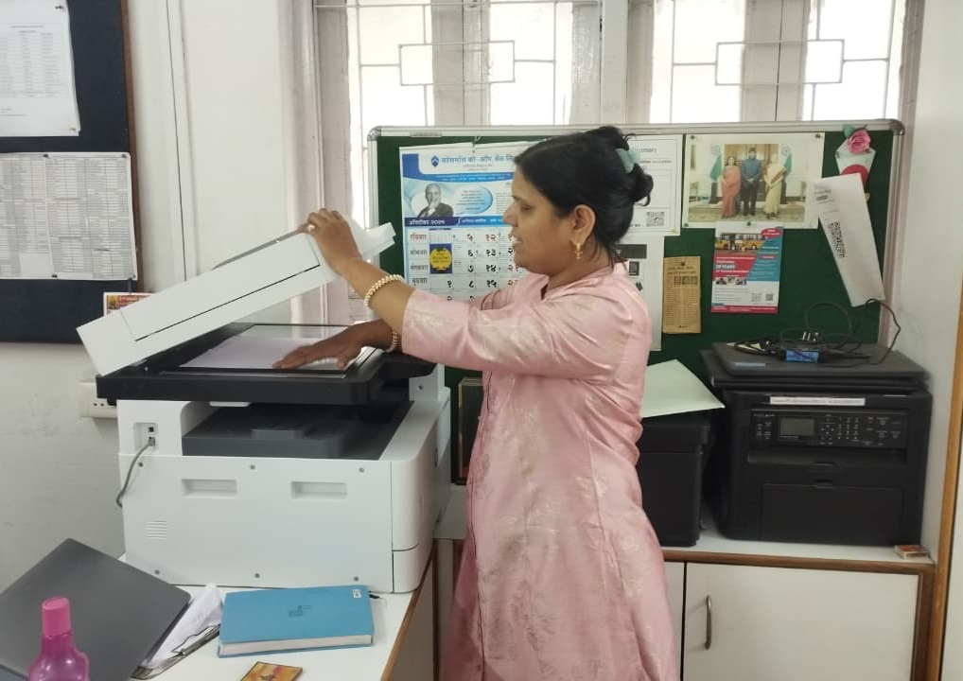
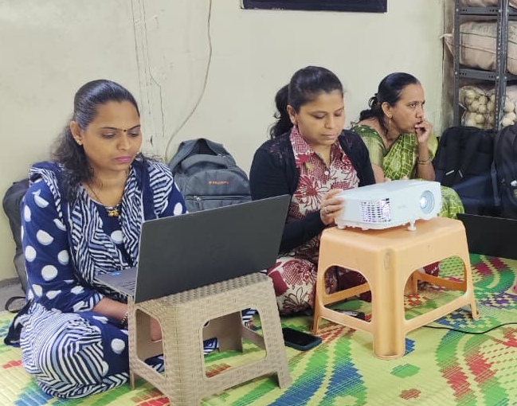
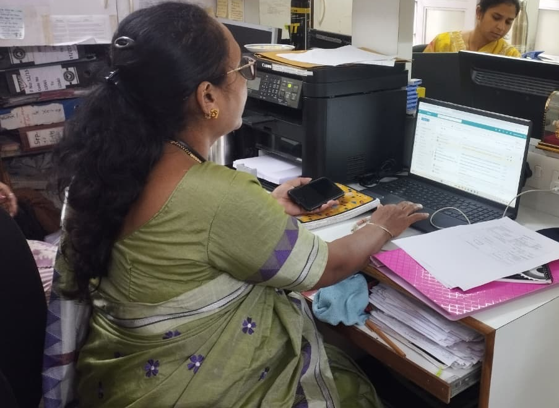
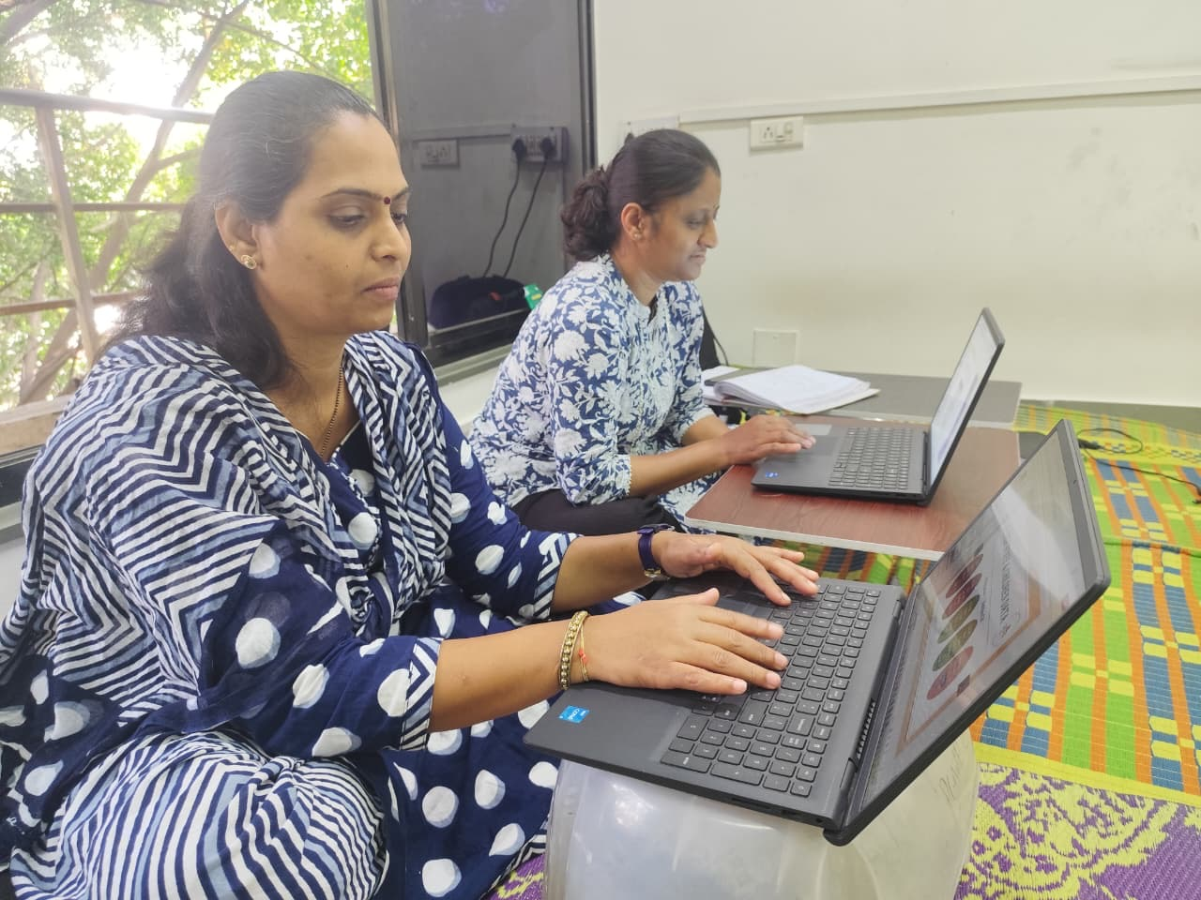
Funds Expense Status – fixed assets – 2025 - 26
Received Funds | 2,80,000
Fixed Asset | Amount Expended
Computer / Laptop (04) | 1,87,001
Printer (01) | 58,750
Projector (01) | 34,050
Total Expenses | 2,79,801

Slide 20
Part 2

Slide 21
FCRA Compliance
Is their FCRA valid ? – Yes
Please provide validity date – FCRA Registration # 08390787 Validity till 03-11 -2028
Please check that
All required approved registration forms - FCRA, 80G, 12A, etc. with Asha-wide Treasury
No internal routing from one organization to another - part of Asha Project Reviews
Cashless or restricted to less than INR 2000/ day - part of metrics form
Funds utilization of FCRA - part of Asha Project Reviews

Slide 22
Audit Reports
Please provide link to latest available audit reports
2023-24 (should be available)
2024-25 (usually comes in June to September) -
India Financial Year April 2024 to March 2025 - https://ashadocserver.s3.amazonaws.com/659_FinalFinancials-FY-01042024-31032025.pdf
Audit Reports finalized in June to September 2025 timeframe
Please have them provide an audit utilization report

Slide 23
Fundraising Model
Diversified sources of funding ?
Funding partners
Crowdfunding
Do they have a website ?
Give India/ Ketto campaigns ?
Distributed and variable donation amounts ?
Concerns

Slide 24
Financial Health
WCR ?
Do they have a corpus fund ? No
Income over Expenditure ? Yes
Liquid reserves in cash, deposits, mutual funds and other equivalents ? Yes
% OPEX ?
What % of OPEX does Asha support (please track over the years) ? Less than 1%
Includes other chapters, Asha general funds, and Asha Chapter
What % of OPEX does Asha <Chapter> support (please track over the years) ?

Slide 25
Budget Overview
Budget for 2025-26 vs. 2026-27
Funds utilization in line with budget proposal for previous year? Yes
Operating expenses comparison in-line ?
Are the salary increases in-line ? Yes
Usually 10% increments – Less than 10%
If scaling rapidly, how do they plan to absorb higher operating expenses ? NA
Hiring needs/ new programs/ plan for growth ? NA

Slide 26
Budget Proposal
Please link to actual budget with line-items of support for Asha and Asha Chapter consideration
Typically the complete budget if multi-chapters involved
Clearly indicate the line-items of support

Slide 27
Budget for Apr 2026 to Mar 2027
Final A/c Head for Budget 2026-2027 | Unit Cost/ Per Center | No. of Unit/ Center | Total Budget
Program Personnel Cost(Salary+conveyance+Staff welfare+Mediclaim
Reporting and Communication | 28860 | 2 | 57,720
Quality Assurance staff | 33664 | 2 | 67,328
Supervisor | 68280 | 2 | 1,36,560
Teacher | 457677 | 2 | 9,15,354
Support staff | 33383 | 2 | 66,766
Picnic, Events and Mediclaim | 3,682 | 2 | 7,363
Training | 13,631 | 2 | 27,262
Total 1 | 6,39,177 |  | 12,78,353
Implementation/Project cost
Teaching & Educational Material | 36,000 | 2 | 72,000
Miscellaneous Expenses | 1,000 | 2 | 2,000
Transport | 7,000 | 2 | 14,000
Programme Rent and Maintenance | 11,920 | 2 | 23,840
Picnic and Events | 5,100 | 2 | 10,200
Total 2 | 61,020 |  | 1,22,040
Total Program Cost (1+2) | 7,00,197 |  | 14,00,393
Admin Expenses(6% of Total Cost) | 42,012 |  | 84,024
Grand Total | 7,42,209 |  | 14,84,417
 |  |  | 14,85,000
Particulars |  |  | Amount
A. Budget for 2026 - 2027 |  |  | 14,85,000
B. Estimated builders contribution (50%) |  |  | 7,42,500
C.Funding Requested (50%) |  |  | 7,42,500

Slide 28
Sources of Funding
Where would the funds for the planned support come from ?
Please check with Chapter Projects Coordinator and Chapter Treasurer on the allocation
Chapter General Funds -
Project Specific Funds -
One-time Funds -

Slide 29
Chapter Vote
Vote amount, decision and line-items of support for the period from April 2025 to March 2026
Amount is the nearest rounded down 1000s in INR (We cannot disburse higher than budget amount)
Please use “... and to cover operating expenses”
1st disbursement : April 2025 to Sept 2025 - Deadline Sept 15, 2026
2nd disbursement : Oct 2025 to Mar 2026 - Deadline March 1, 2027
Please ensure the chapter meeting minutes and checklist are in sync with the same language
Please ensure all the relevant minutes when the projects were discussed are accurate
Please link to all relevant minutes in disbursement checklist under “Notes”

Slide 30
Chapter Checklist
 | Year 1 | Year 2 | Year 3 | Year 4 | Year 5 | Year 6 | Year 7
Budget and Proposal | Y
Audit Report | Y
Financial Analysis | Y
Funding Partners | Y
Audit Utilization Report | Y
Corpus Fund Initiatives | Y
Quarterly Reports | Y
Site Visits | Y
Beneficiaries List | Y
FCRA Validity | Y
% OPEX | 10
WCR | 1.0

Slide 31
Links to Documents
Annual Review and Budget Proposal (Projects page) -
Site Visit Report (Projects page) - https://ashadocserver.s3.amazonaws.com/659_Sitevisit-DSSF-24KeSereno03May2025.pdf
Staff and Student List (Confidential, Asha Chapter restricted wiki)
Funds Utilization Report (Projects page, please suppress names of staff for privacy)
Audit Report (Projects page)
Audit Utilization Report (Projects page)
Annual Reports/Newsletters (Projects page)
Photos/Videos on SmugMug (Project album under Asha Chapter)

Slide 32
Summary
Please summarize your inputs on overall stewarding experience with project partner
What is the focus for the year ?
What do we need to do to help them achieve their goals ?

Slide 33
Thank You
Asha Projects

