Slide 1
Asha Samajik Shikshan Kendra, Mirzapur
Project Proposal for Asha for Education: Boston Chapter

Slide 2
The Initiative
Three years ago, Asha Trust began educational efforts in Chunar region of Mirzapur District
Six education centers were established in villages.
Centers operate for 2 hours in the evening, serving about 25-30 children each.
  Provide after school coaching
  Help with keeping children in schools
  Even children who don’t go to school, come to the centers and are encouraged to go to a formal school.
Teachers receive training three times a year to ensure engaging education.
Community Engagement
Community meetings held to choose locations for centers.
Local workers run centers with minimal resources.

Slide 3
Background
Mirzapur district in Uttar Pradesh is underdeveloped, with many villages lacking drinking water, electricity, roads, education, and healthcare.
The region's mountainous and forested geography poses challenges for development.
Main livelihood: agriculture and mining labor.
Tribal communities such as Musahar, Kol, and Bhil are socially and economically backward.
Lack of education and healthcare services.
Lack of awareness about government schemes prevents people from availing benefits.
Marginalized tribal communities face additional difficulties.
Need for special schemes and programs to improve living standards.

Slide 4
Previous Support & Risks
Previously supported by Belgian organization Mala Sponsorship for Indian Children.
Funding discontinued last year, risking the continuation of the program.
Established presence and visible positive outcomes in marginalized communities.
Stopping efforts midway would cause disappointment among children and community.

Slide 5
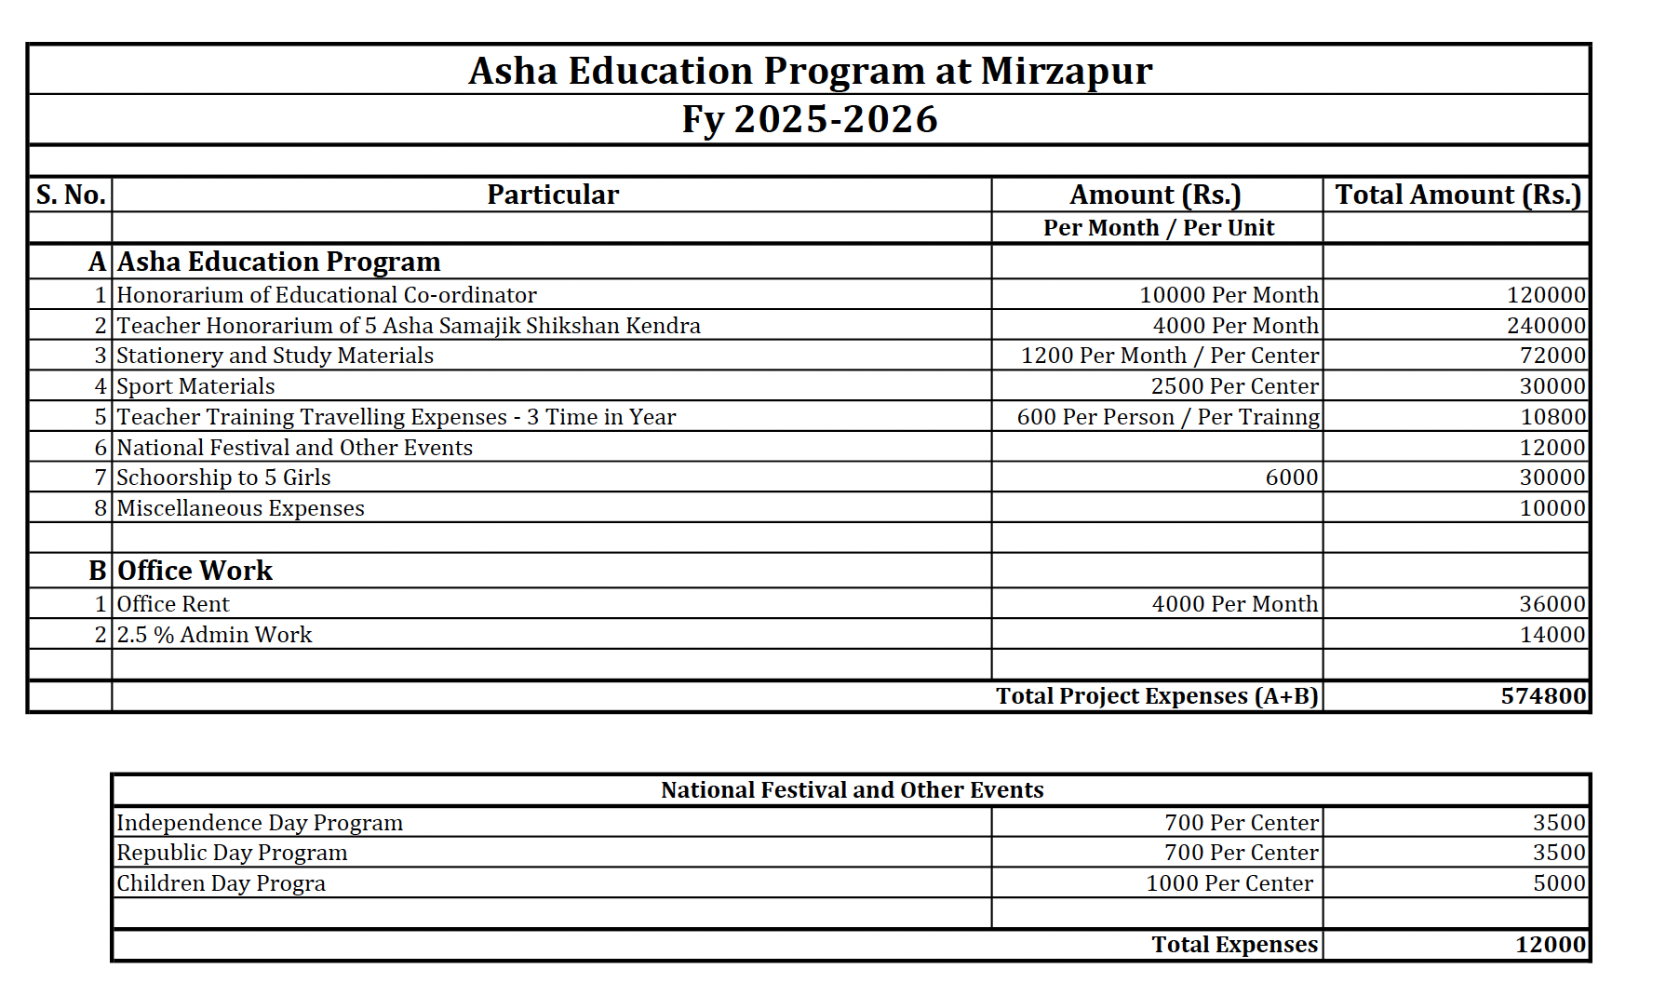
Request for Support
Seeking support from Asha for Education: Boston Chapter.
Aim: Ensure continuation of education centers and training programs.
Prevent disruption in the positive impact already achieved.
Contribute to long-term improvement in marginalized children's lives.
Annual Budget is about Six lakh rupees ~ $7k

Slide 6
Why We Should Support
Proven Partners – Asha Trust
Proven model – Many of the relationships have been developed, infrastructure and persons identified.
Modest budget – In the most recent proposal, they have reduced the salary of the coordinator from Rs 25k to Rs 10k.

