Slide 1
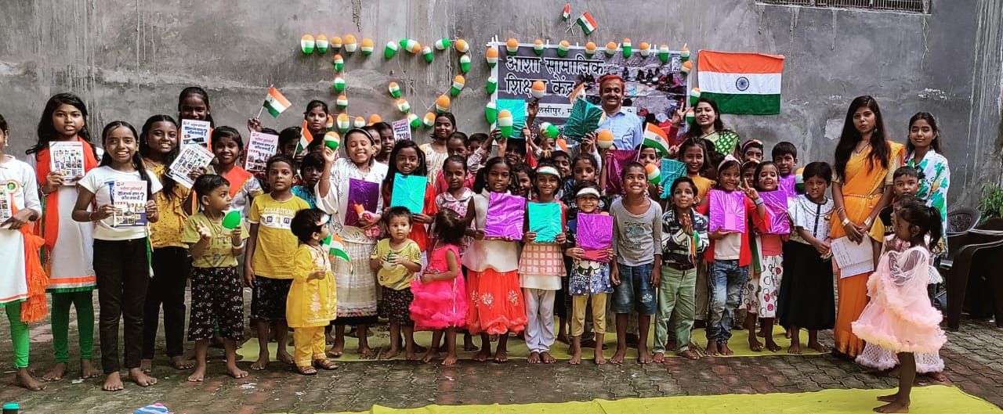
Asha Kaithi, Varanasi

Slide 2
Address :
Village – Bandhan Kala. Post Kaithi
District – Varanasi, U. P. – 221116
Contact Person:
Vallabhacharya Pandey
Mobile No. – 9415256848
E-mail – ashakashi@gmail.com
Deen Dayal Singh
Mobile No. – 8004804103
E.-mail – dd.knp16@gmail.com

Slide 3
Asha Trust admin work
Asha Audit Work.
Income tax return.
FCRA Return.
Communications with IT department and Home Ministry.

Slide 4
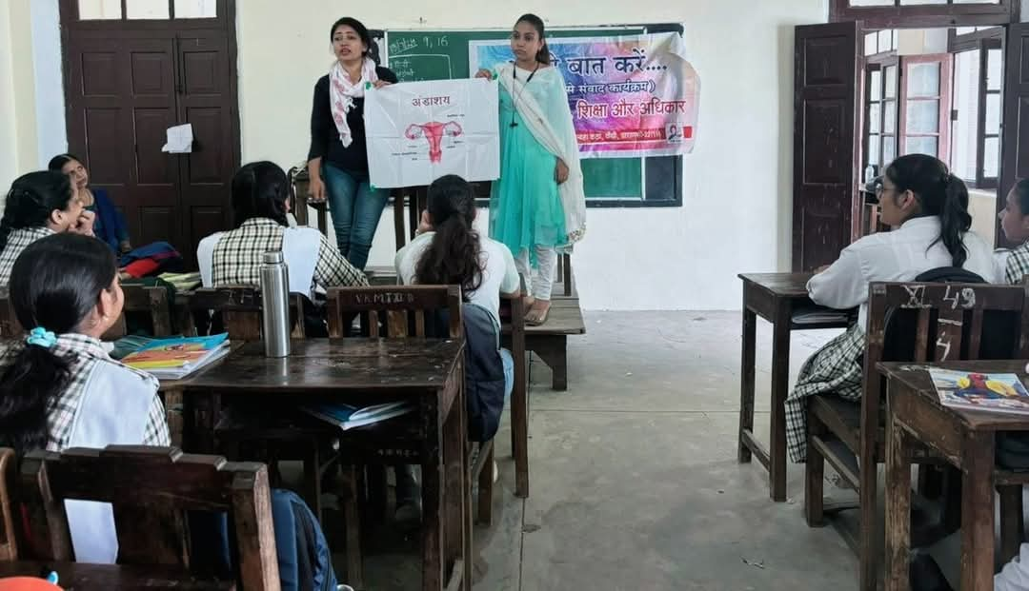
Aao Baat Karein
Dialogue with girl students
(on education, health, hygine, safety and respect)

Slide 5
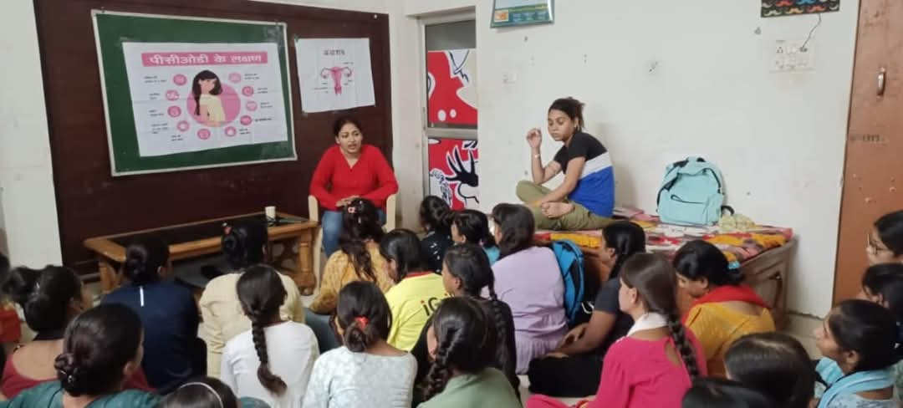
The objective of this program is to make girls and women aware of their body structure and topics like health, hygine, nutrition and rights.

Slide 6
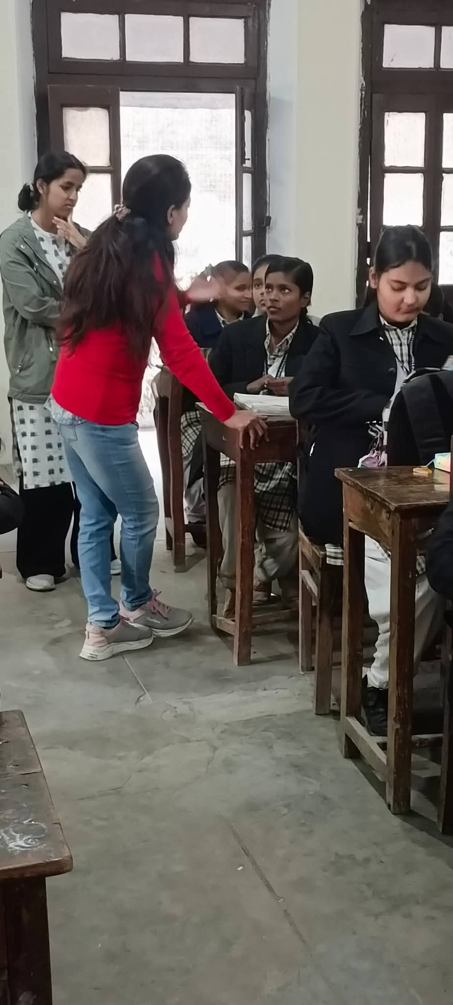
Dialogue sessions are conducted with girl students from class 6th to graduation on issues like their body structure, health, nutrition, problems and women's rights etc.

Slide 7
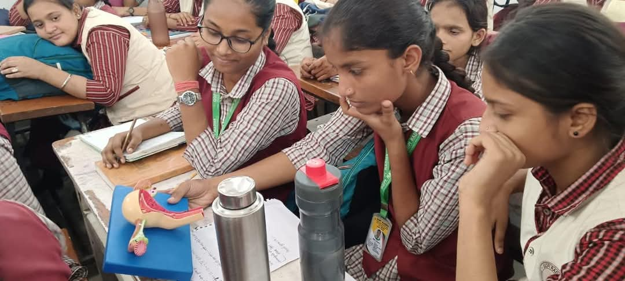
dialogue held with identified groups (of 40-50 girl students)
5-6 times at fixed intervals, in which mutual dialogue is held on the above topics.

Slide 8
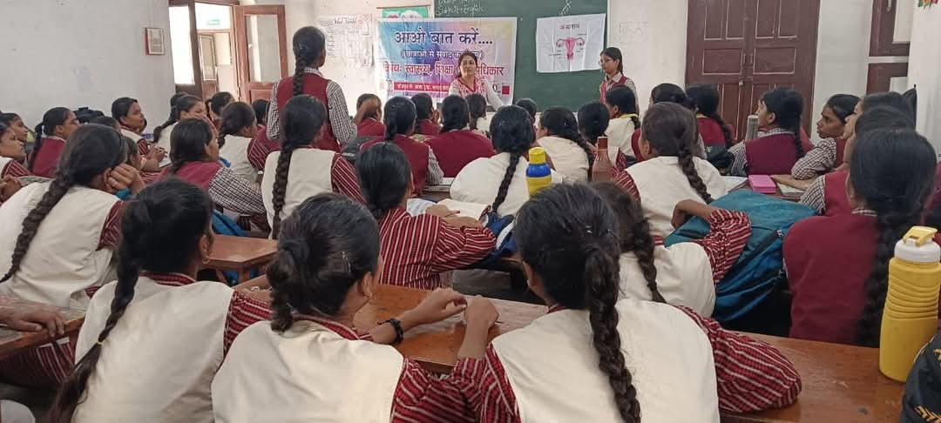
Girls now ask questions about which they could never talk to anyone.
She is coming out of the myths that have been created and becoming aware of her body, health and rights.

Slide 9
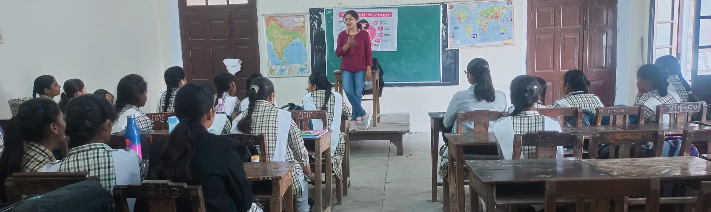
The target is to reach 1000 girls every year.

Slide 10
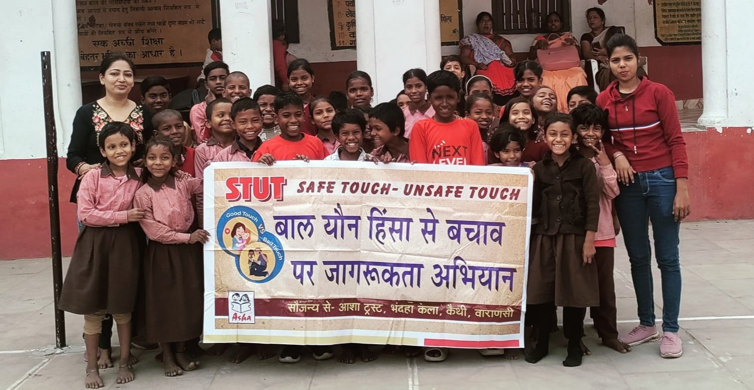
Safe Touch and Unsafe Touch
The objective of this program is to create awareness about violence and CSA among the little children.
Child violence and child sexual abuse (CSA) is increasing towards small children.
It is important to make children aware about child violence, child sexual abuse, exploitation, and the ways to keep oneself safe?

Slide 11
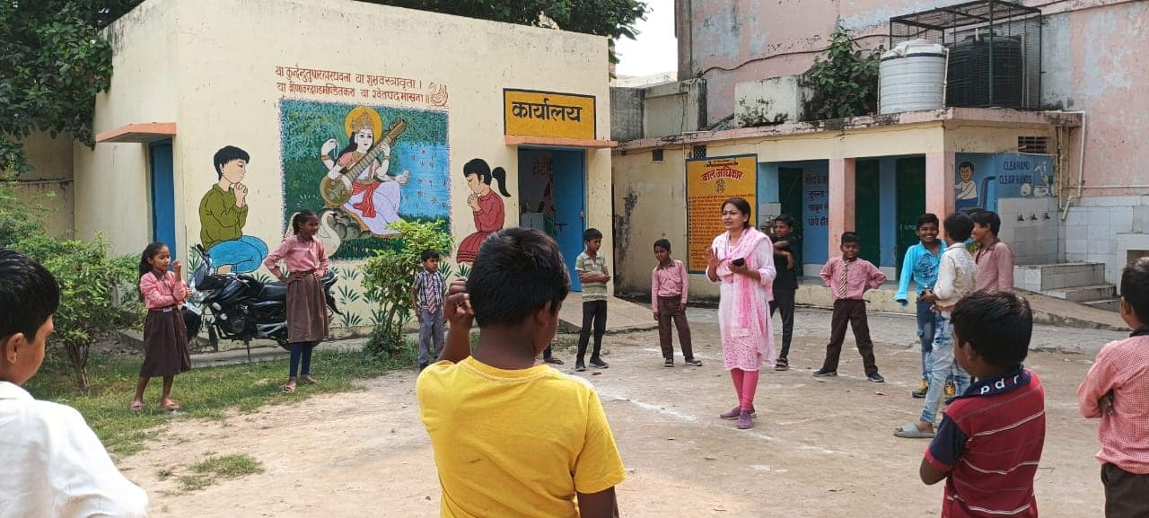
The children told how all this went wrong with them but they could not tell this to anyone.

Slide 12

Samvidhan Awareness Program
To Provide Basic Knowledge of Samvidhan to Children and Youth.
To know our rights.
To know our duties.
To start talk about rights and duties.
To know Preamble of constitution (Prastavana of Samvidhan).

Slide 13
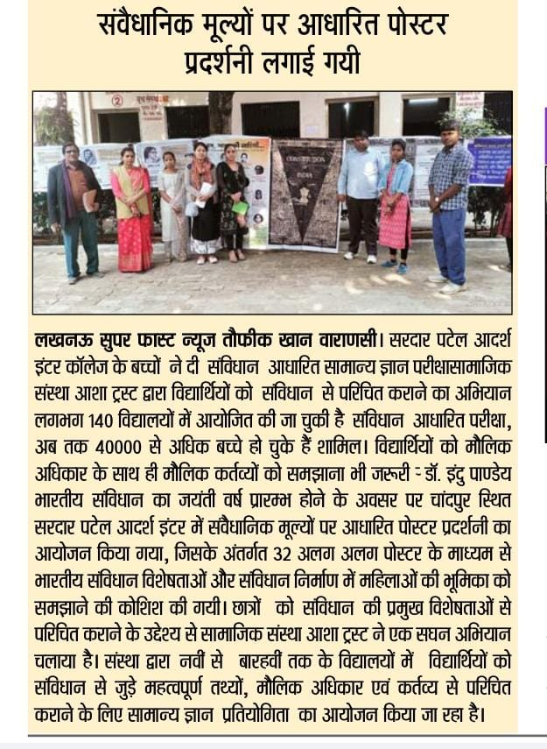
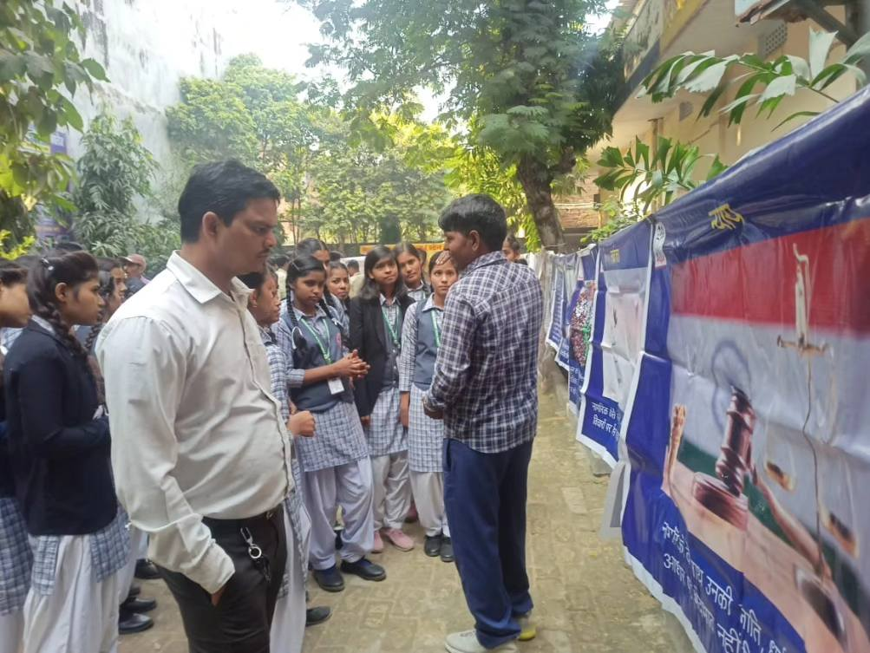
Samvidhan Poster Display
Display Samvidhan Poster.
Talk to children / youth about various world of Constitution Preamble.

Slide 14
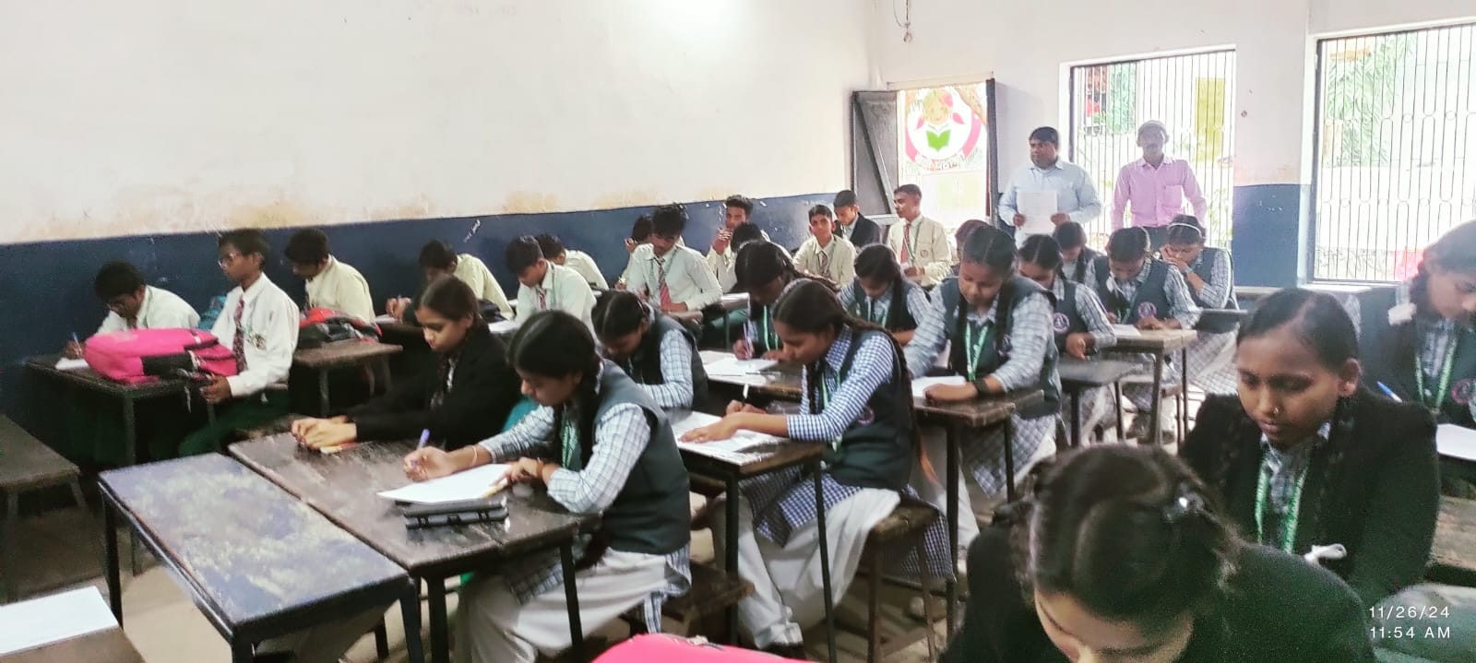
Samvidhan G. K. Competition
Distribute Pamphlets of Samvidhan.
Take a paper based on this pamphlets.
Give Prize to that student who do good and take rank in this paper.

Slide 15
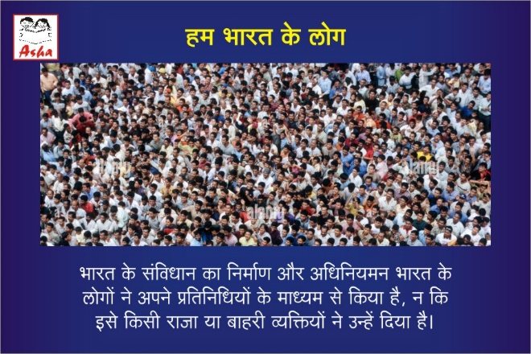
We cover 94 schools in Varanasi.
Two school in Maharajganj.
Five School in Azamgarh with the help of Asha Mumbai team members.
Around 42000 students appeared for the exam.
1400 children were given prizes and certificate.

Slide 16
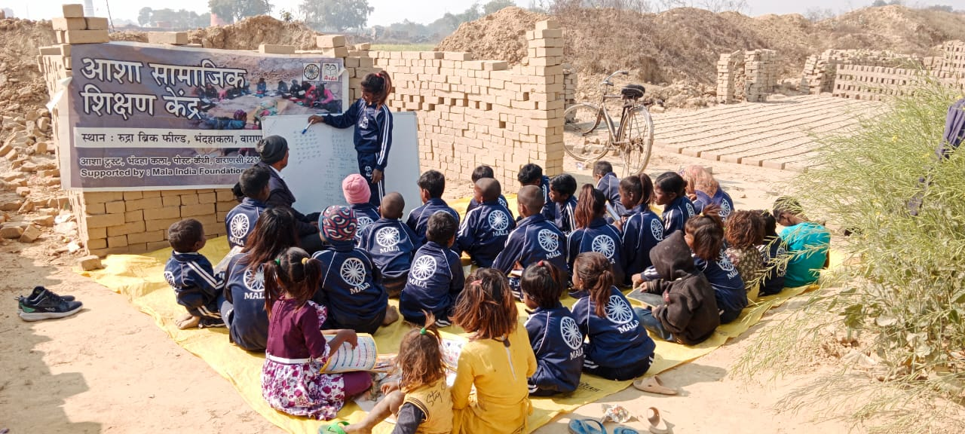
Asha Samajik Shikshan Kendra at Brick Field
In 2009 Right to Education passed, but no change in education of Migrant Labour.
Government school is far from brick field.
School, Teacher and Children of Village are not accept Bricklin children.

Slide 17
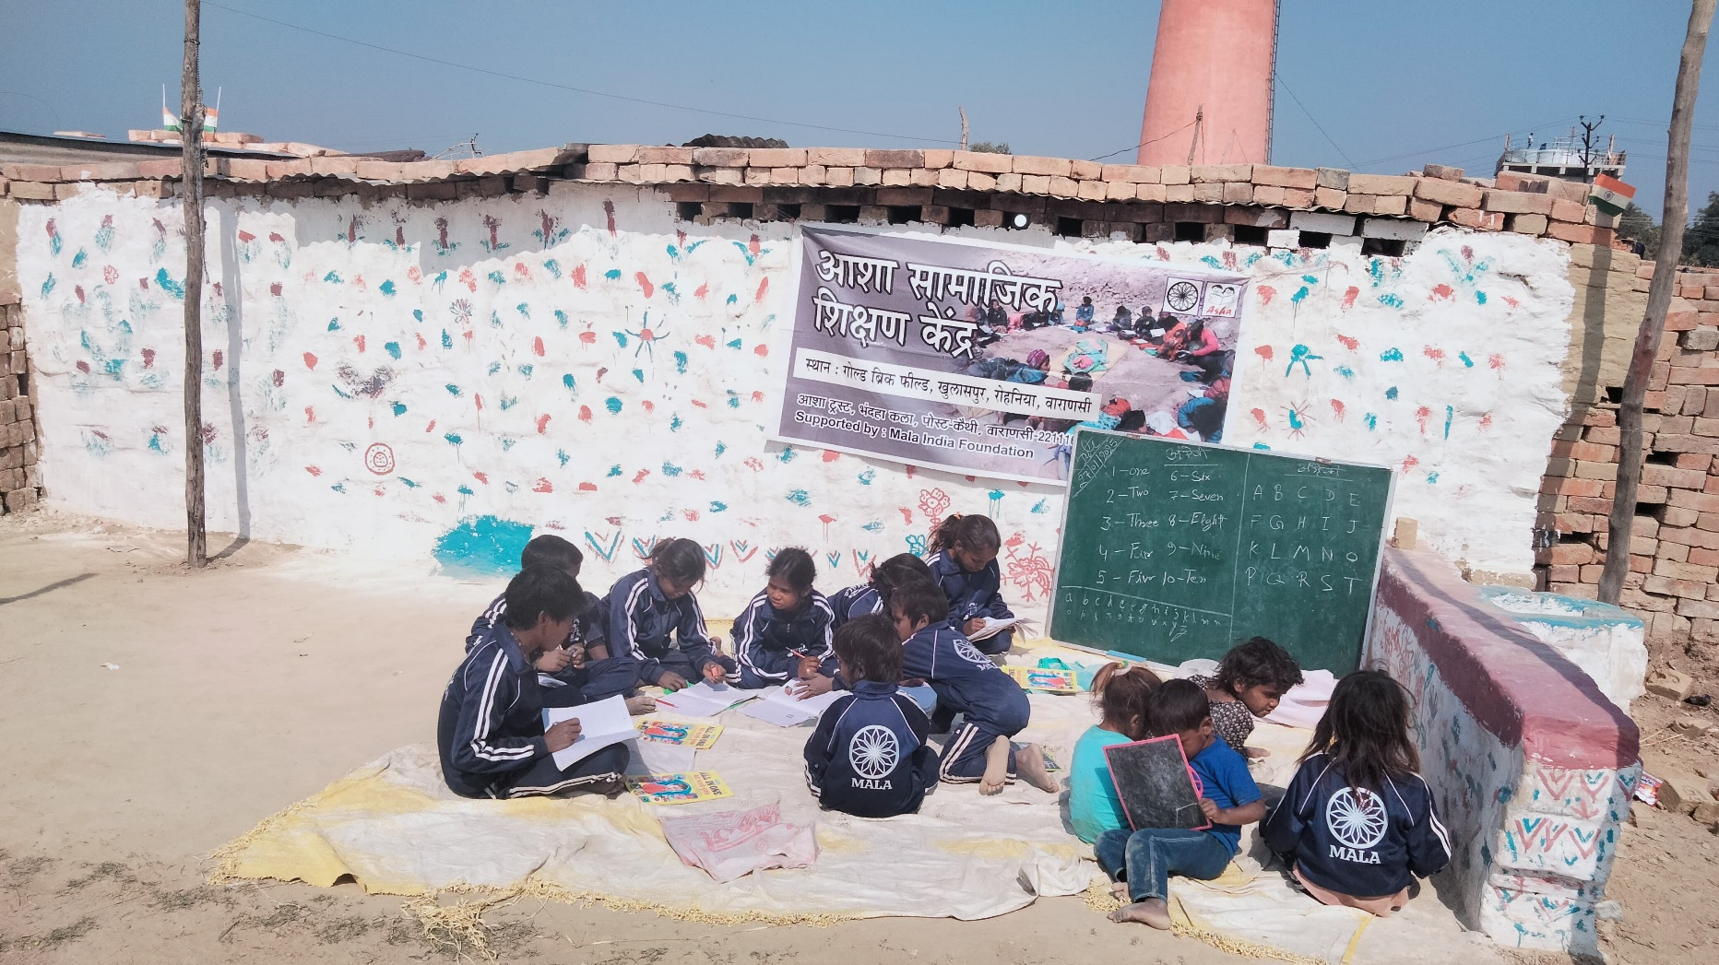
1. Motivate children for education and School.
2. Educate Society and people about migrant labour and their children education.
3. Provide Basic Knowledge of Math, Hindi and English.

Slide 18
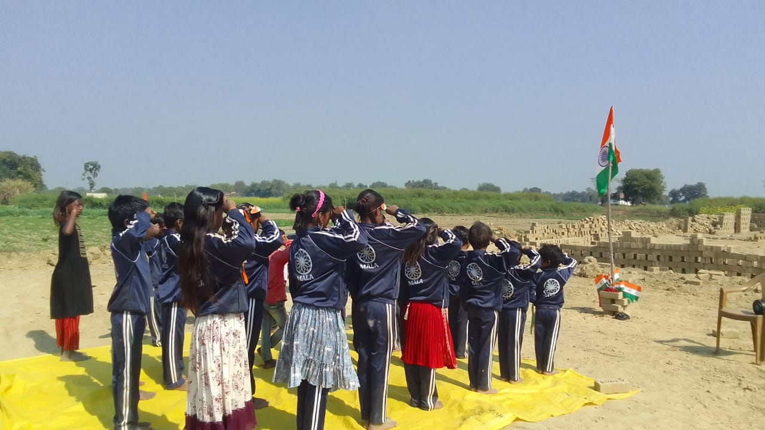
Run 11 Asha Samajik Shikshan Kendra at Brick Field in Varanasi.
Harsh Brick Field
Vijay Brick Field
Sagar Brick Field
Gold brick Field
Vimla Brick Field
Mahendra Brick Field
Krishna Brick Field
Rudra Brick Field
RIP Brick Field
Astha Brick Field
R. B. Brick Field.

Slide 19
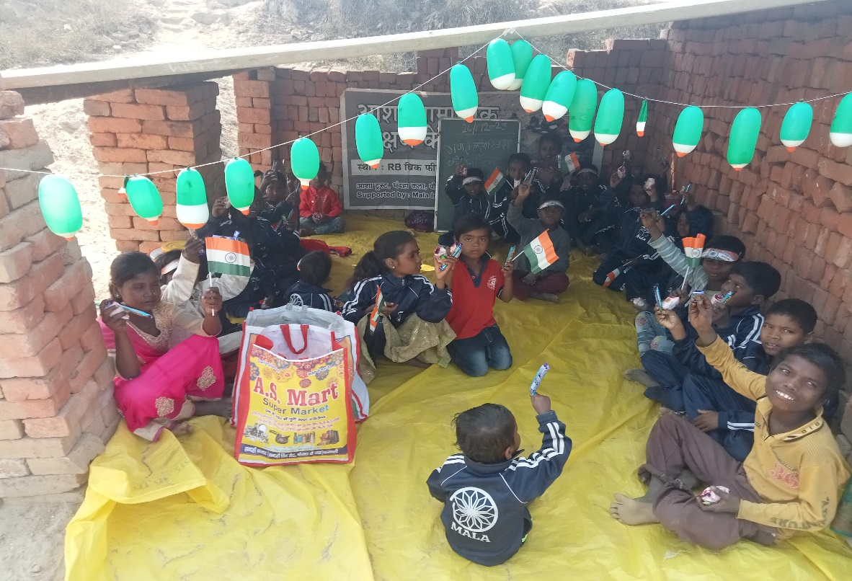
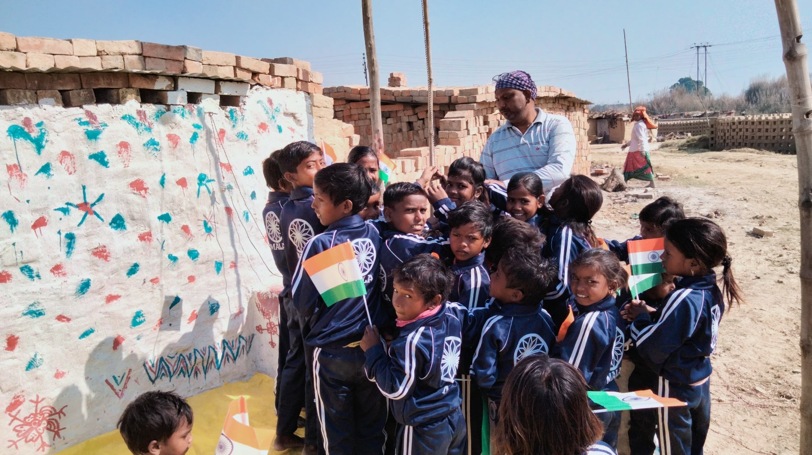
Total 283 Children learn in 11 education center.
These children is from Bihar, Jharkhand, Chhattisgarh and Uttar Pradesh.
Education center start from November and run till June. Migrant Labour come In Diwali and return to their home before raining season.

Slide 20
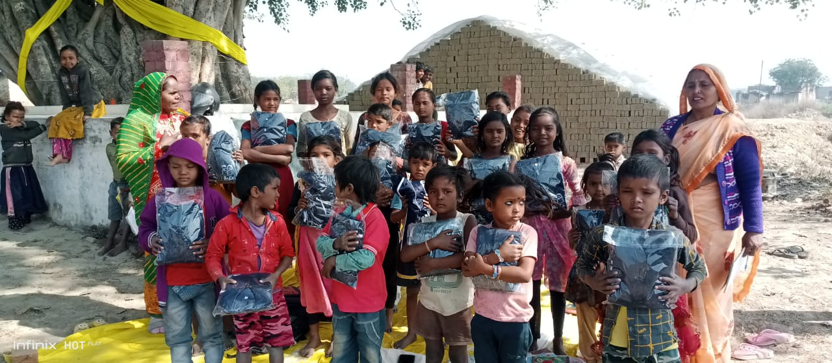
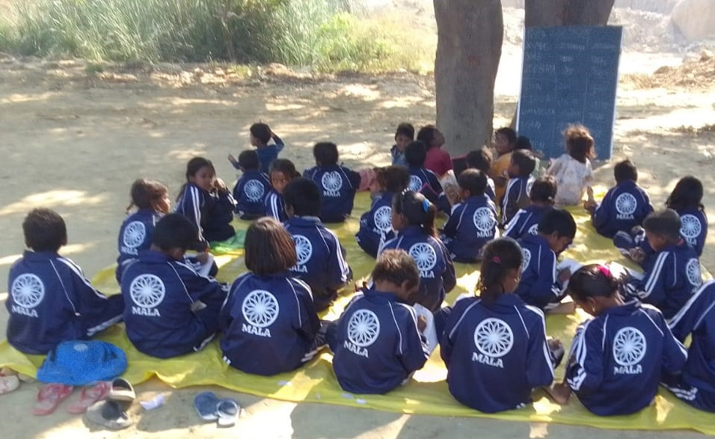
Winter Cloth Distribution to children

Slide 21
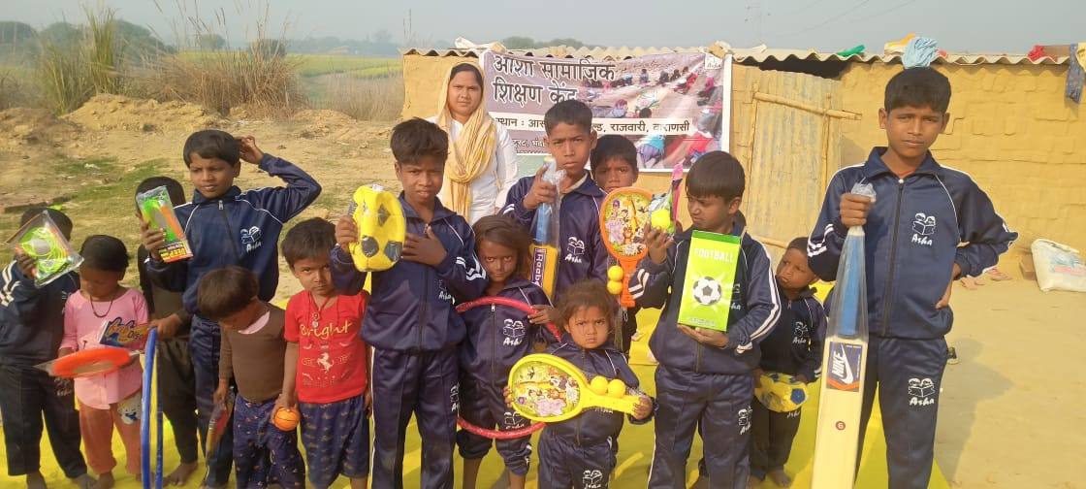
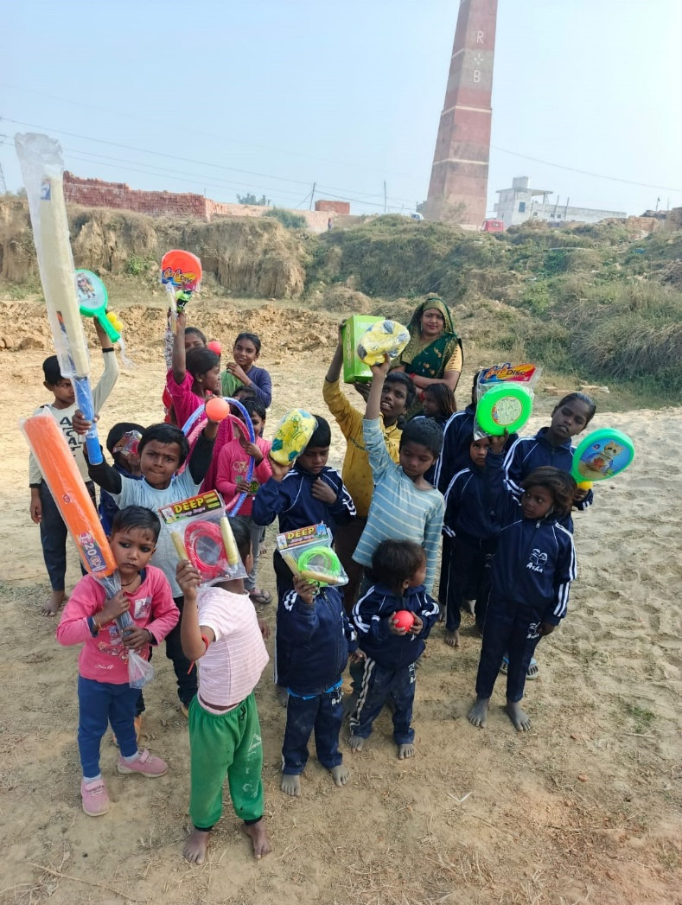
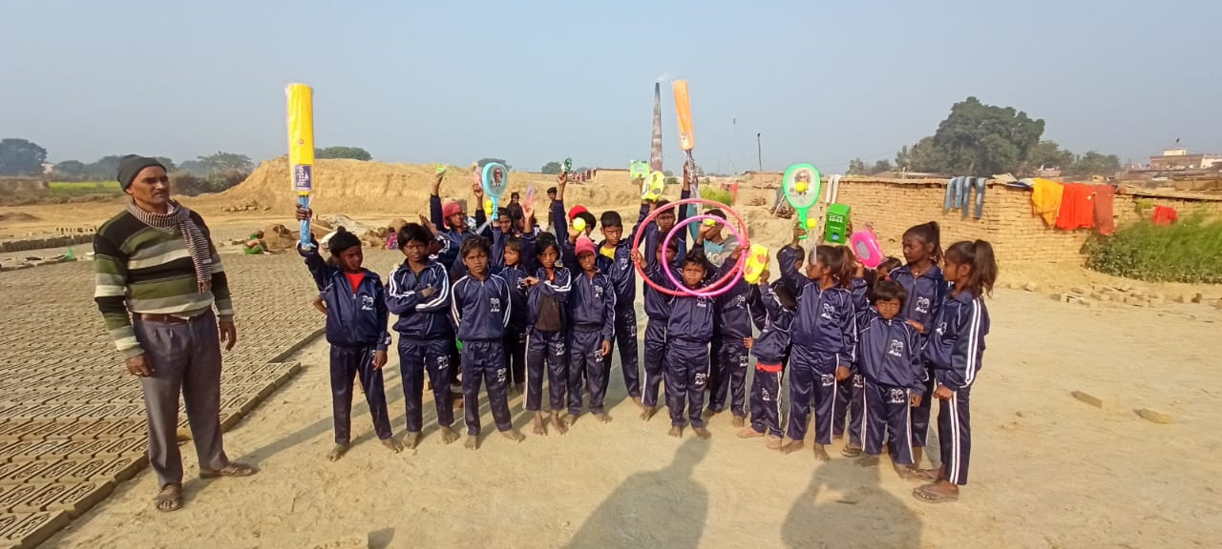
Sport Activities at Education Center

Slide 22
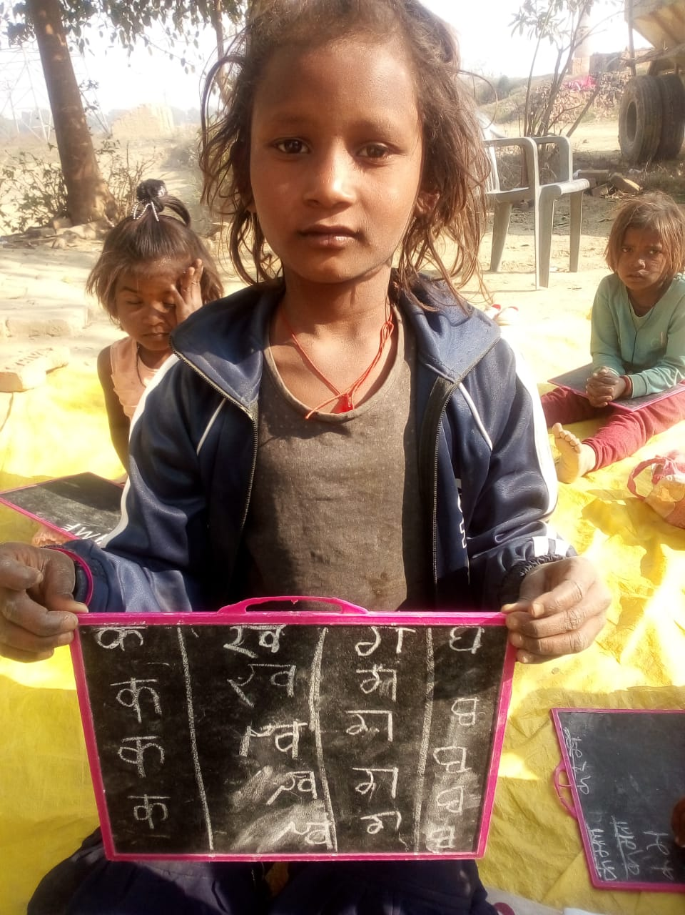
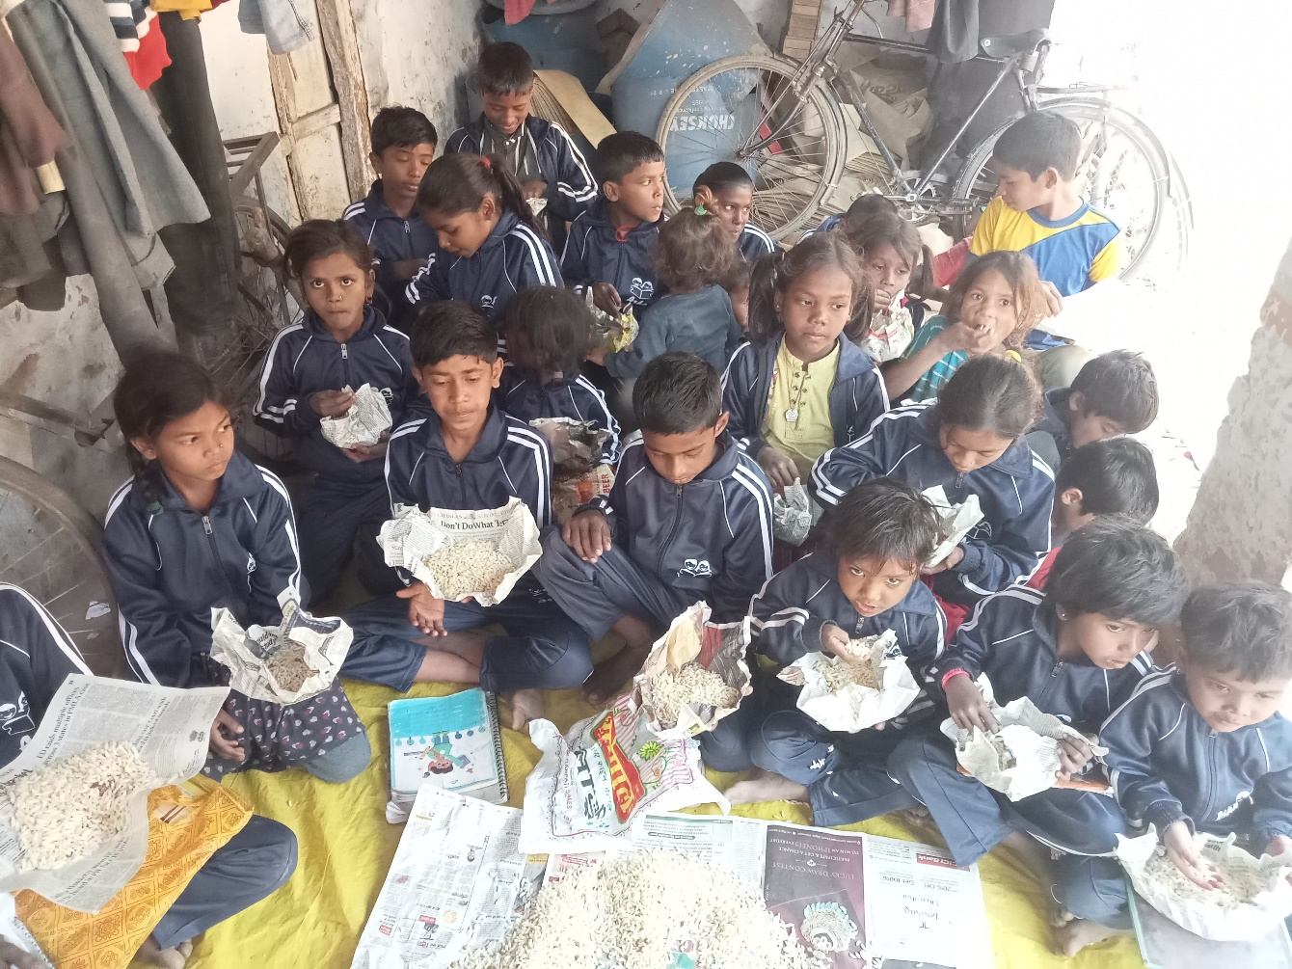
Some children came in same brick field and enjoy learning. They also enroll in village school.

Slide 23
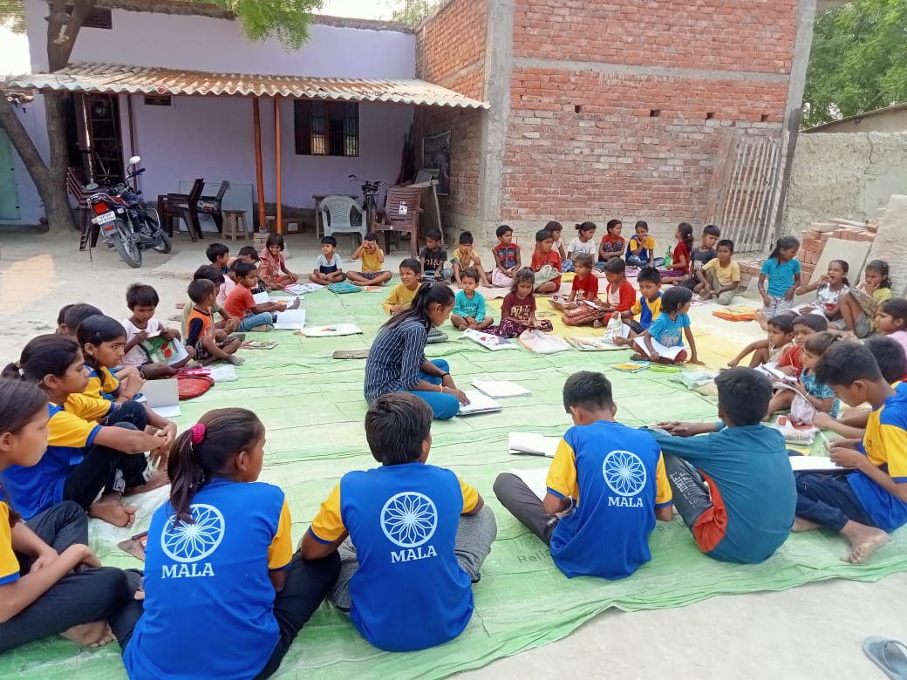
Asha Samajik Shikshan Kendra
Total 6 Asha Samajik Shikshan Kendra run by Asha in village and community.
To motivate children toward education.
To provide a tuition / educational help to children.

Slide 24
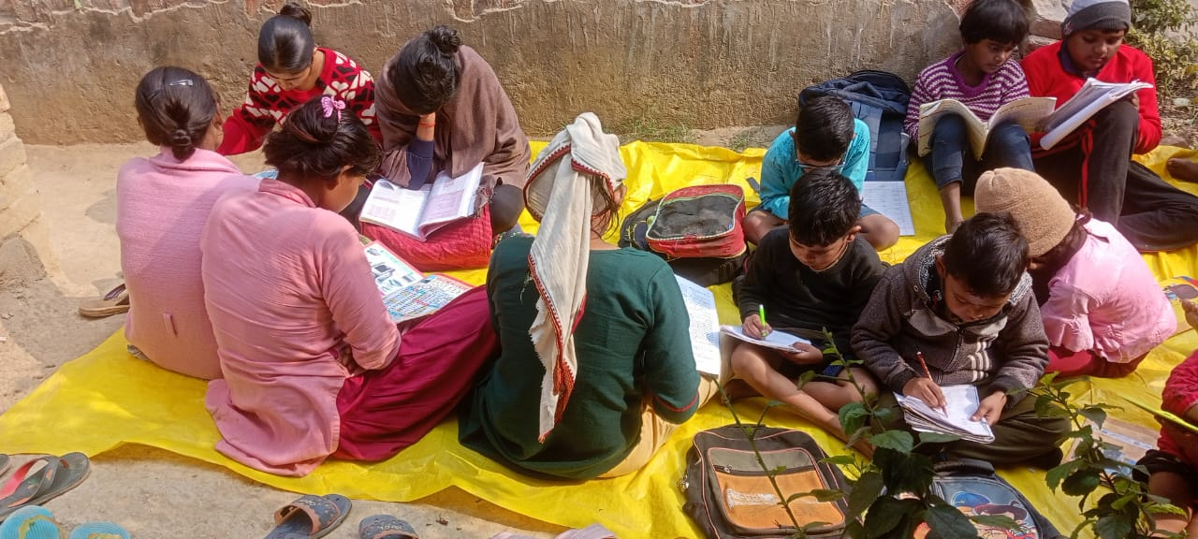
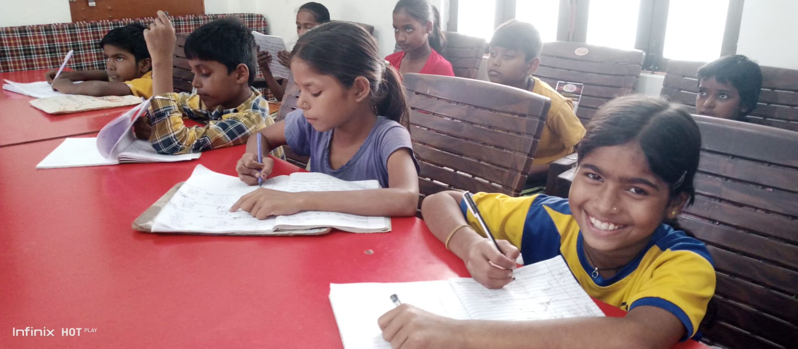
Asha Samajik Shikshan Kendra at Dhanapur, Varanasi.
Asha Samajik Shikshan Kendra at Chakrapanpur, Mirjamurad, Varanasi.
Asha Samajik Shikshan Kendra at Rohit Nagar, Varanasi.
Asha Samajik Shikshan Kendra at Tulsipur, Varanasi.
Asha Samajik Shikshan Kendra at Bhagwanpur, Varanasi
Asha Samajik Shikshan Kendra at Kaithi, Varanasi.

Slide 25
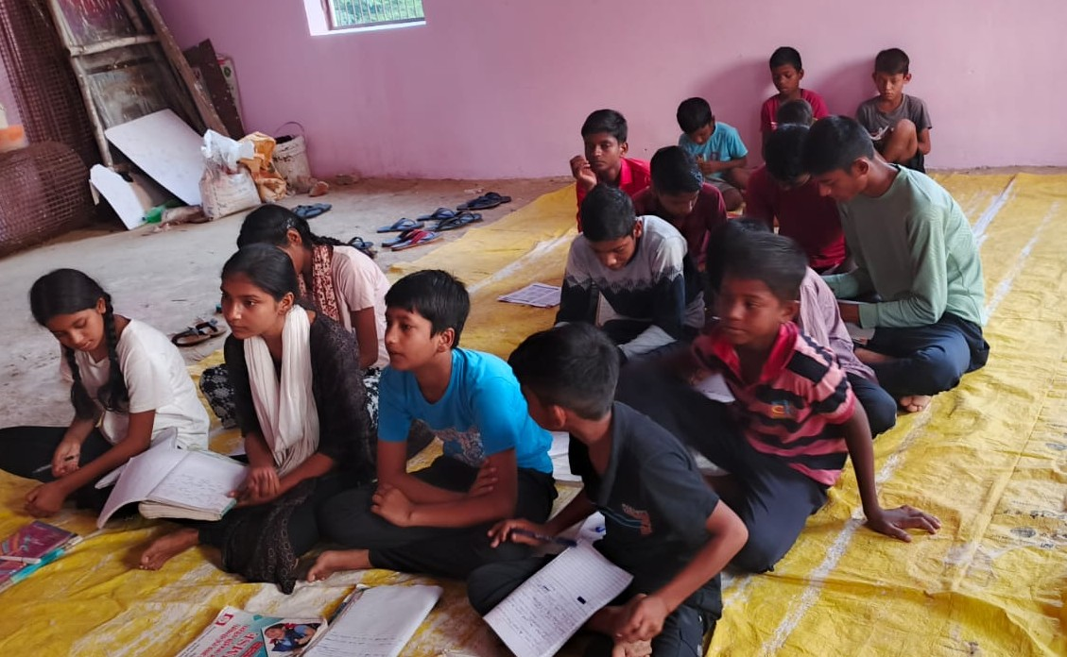
Asha Samajik Shikshan Kendra, Bhagwaanpur
Run in Bhagwanpur village.
Community offer panchayat bhawan for teaching
Run very early morning.
Math and Science teach by Saurbh sir and English class taken from CLE Trust.

Slide 26
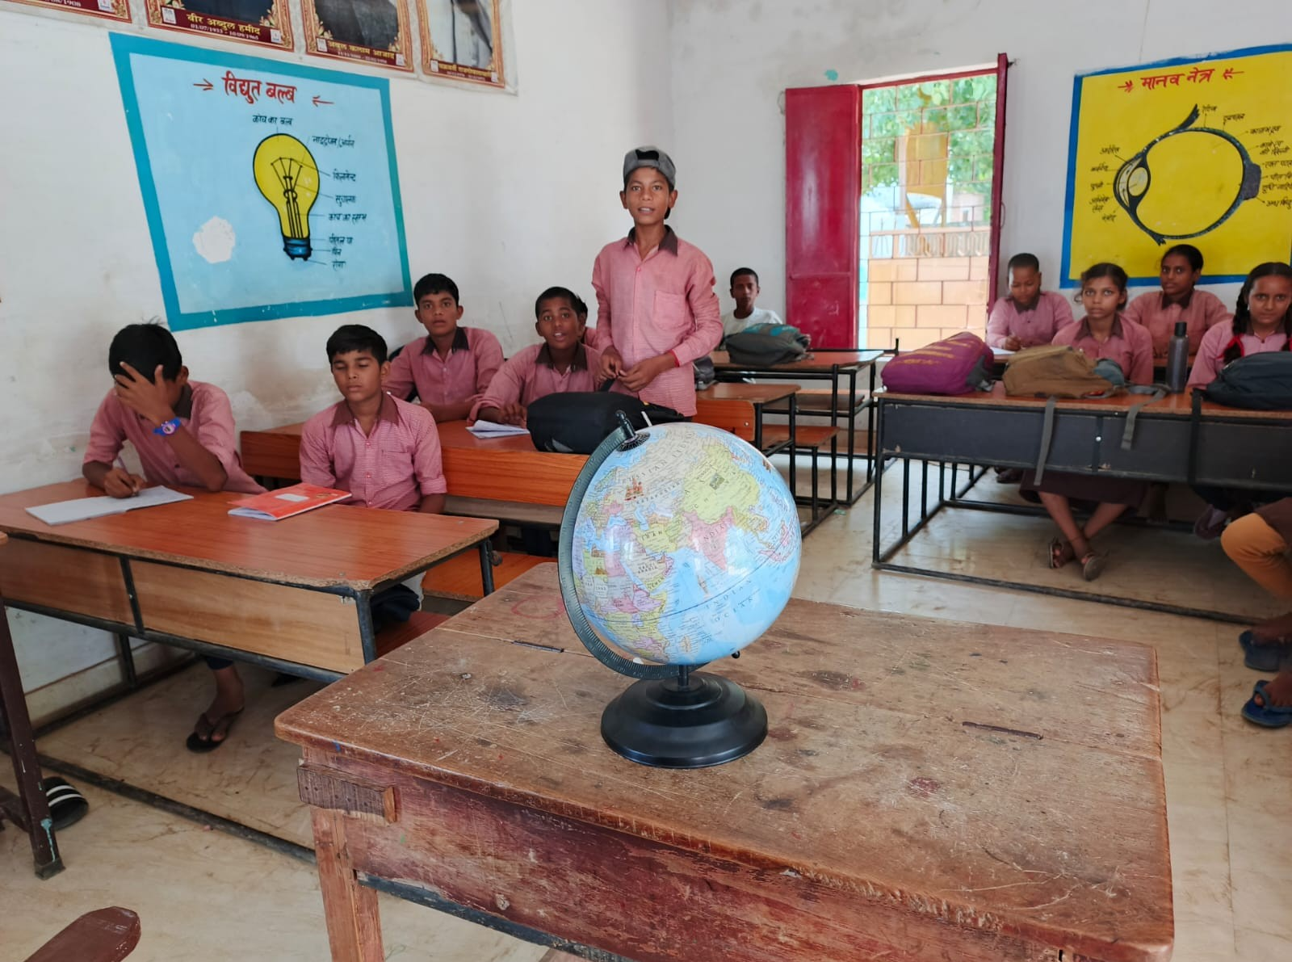
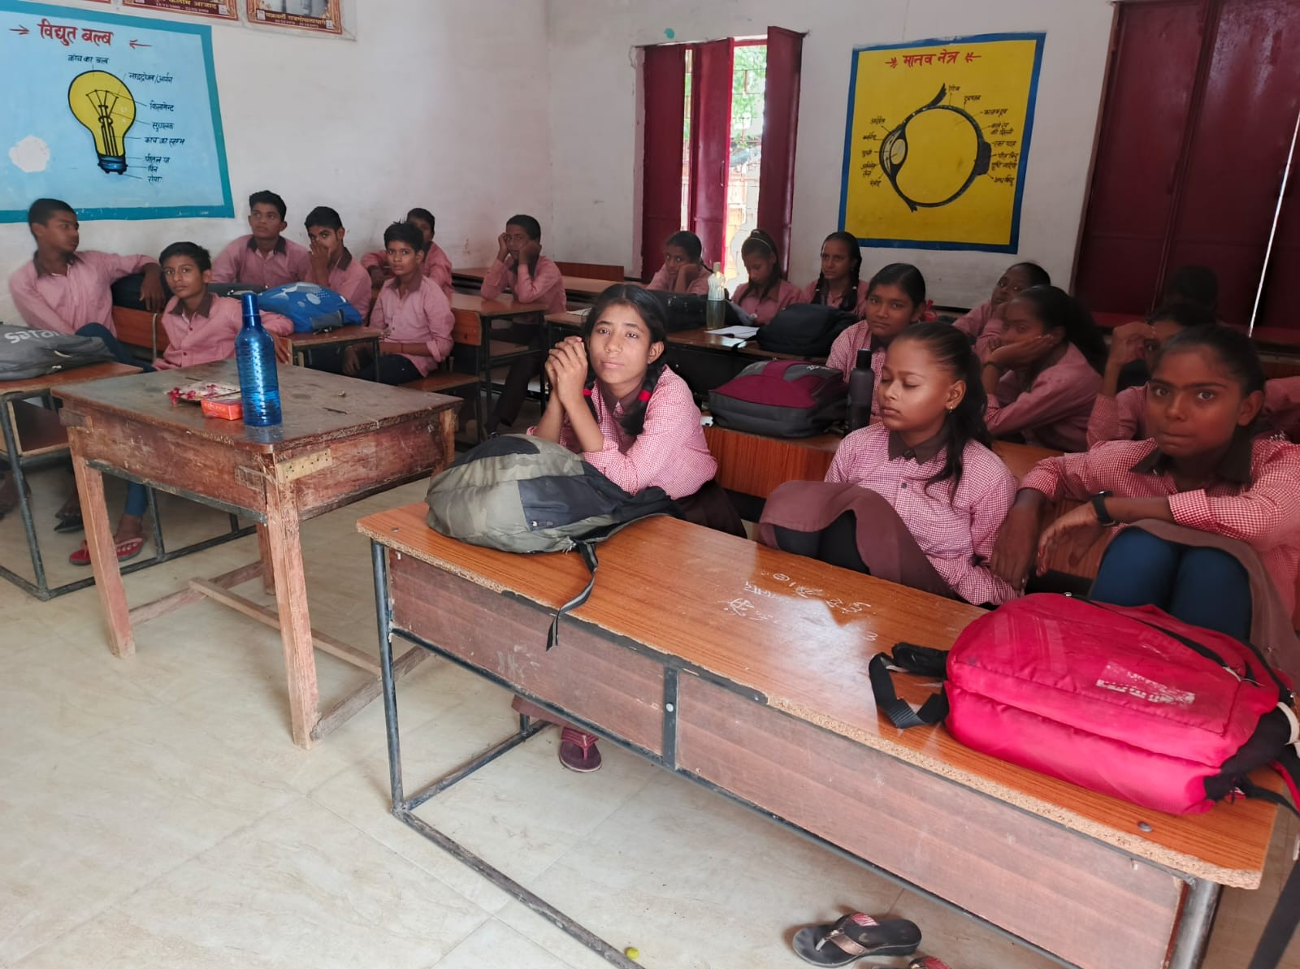
Activity on Maths, Science and Environment in
Government School

Slide 27
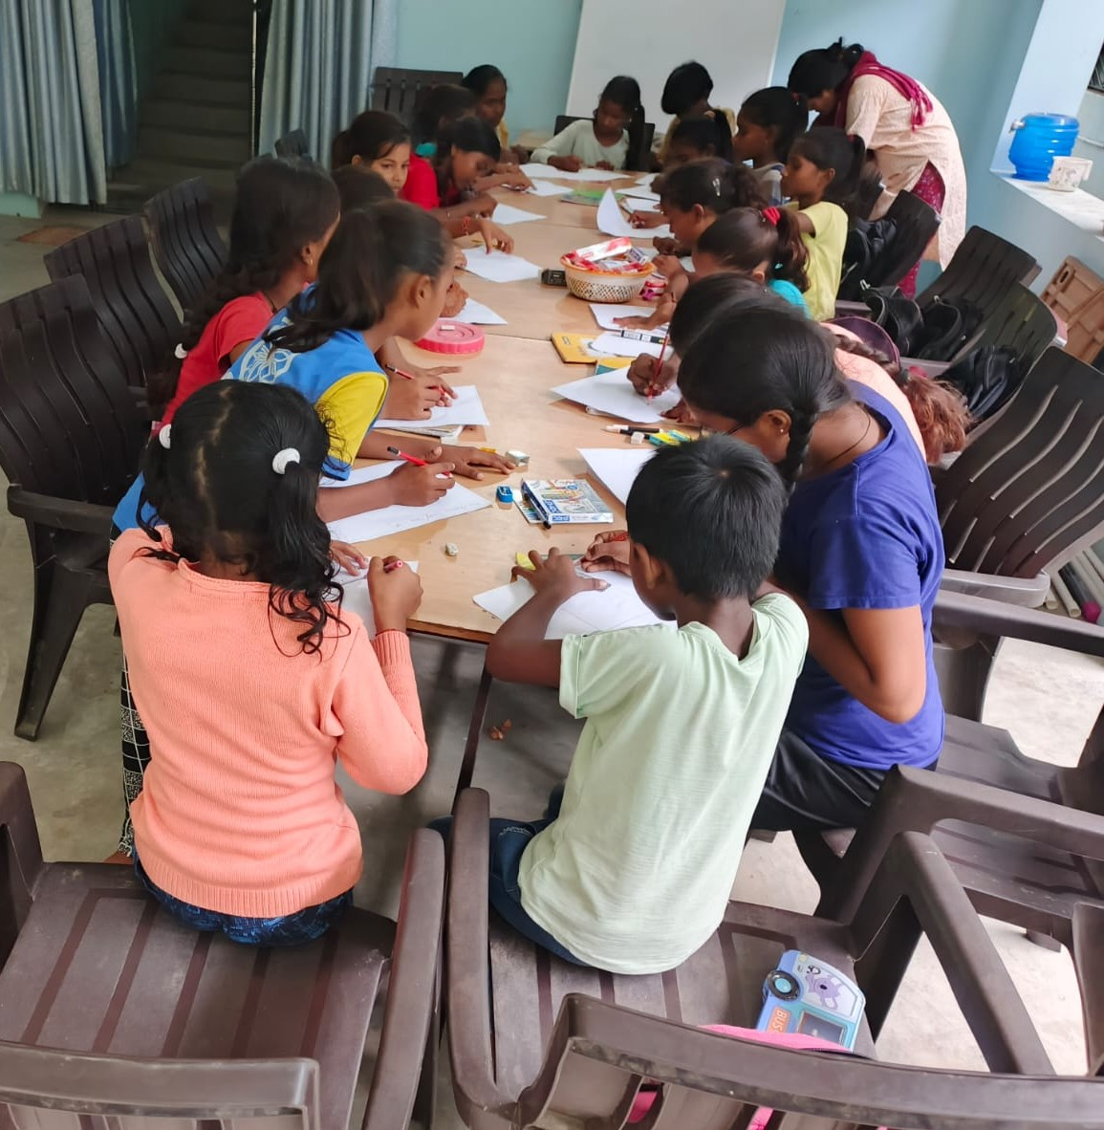
Asha Samajik Shikshan Kendra at Kaithi
Run Class for class 1 to 8 only for girls.
Run Class in two part.
One is Primary class and Second is secondary class.
CLE Trust takes online English class two Days a week for secondary class.
Girls play various game and enjoy jhula in park.

Slide 28
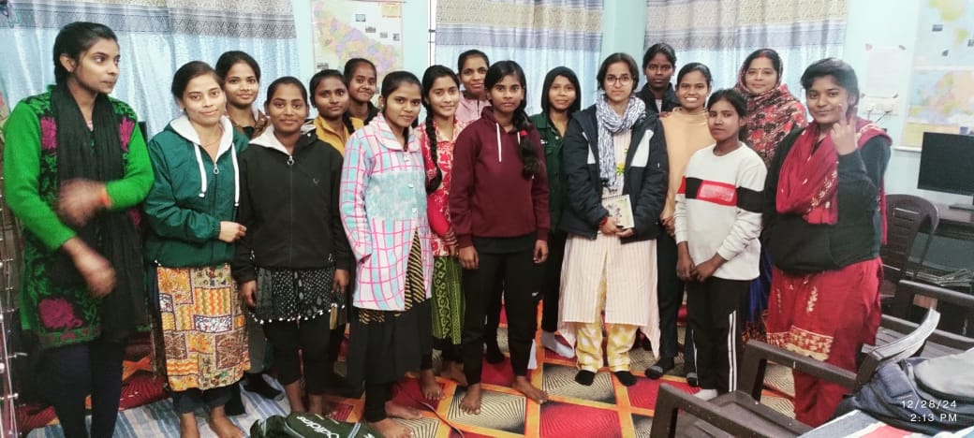
Asha E-Library, Learning Center and Library Program

Slide 29
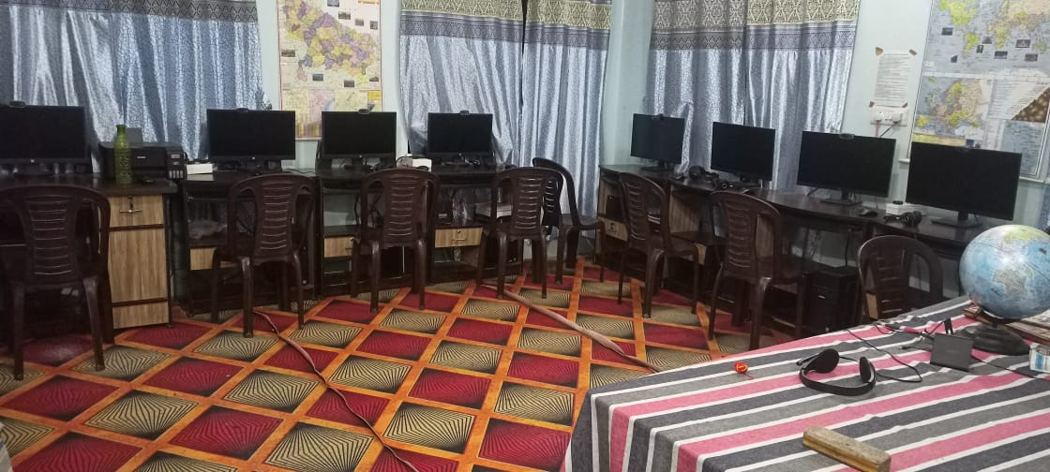
Aim and Objective of E – Library and Learning Center
Easy internet access to village girls
To provide books for various competition exams such as B.Ed, TET, UP police, UPPSC, SSC exam etc.
To provide learning atmosphere to girls.
To provide counselling and support from time to time whenever resource is available.

Slide 30
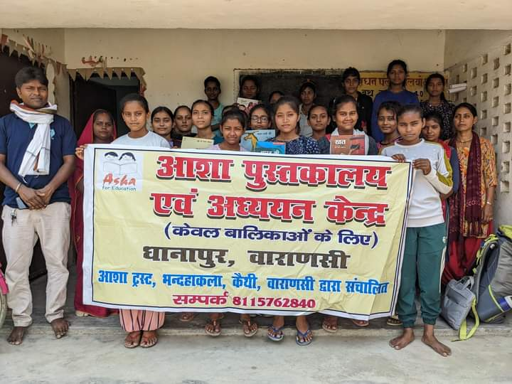
E-Library and Learning Center Run by Asha
1. Asha E – Library and Study Center at Asha Kaithi Center.
2. Asha E – Library and Study Center at Azamgarh.
3. Asha E – Library and Study Center at Reoti, Ballia.
4. Asha E-Library and Study Center at Dhanapur.
5. Asha E-Library and Study Center at Chakrapanpur.

Slide 31
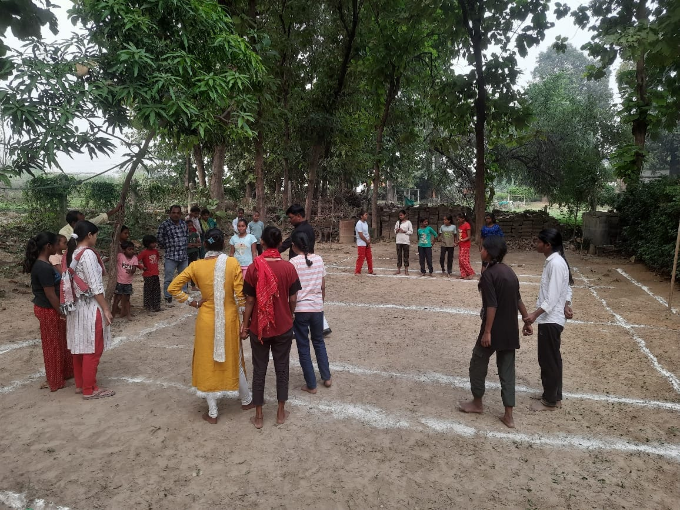
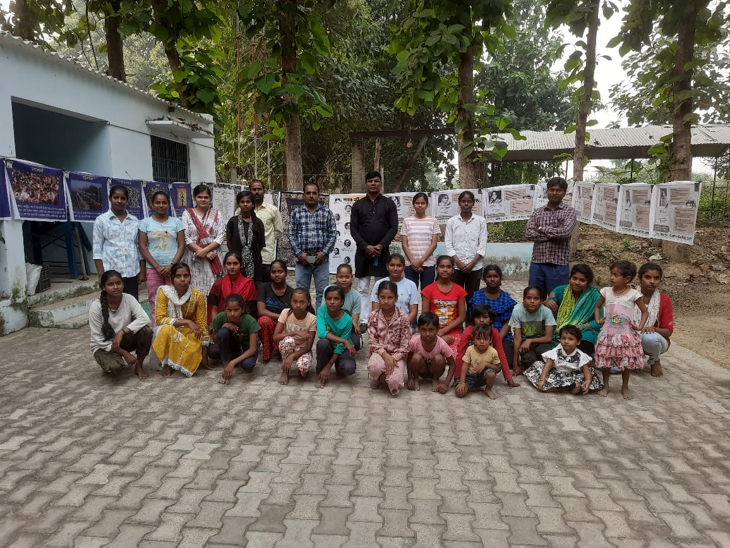
Kabaddi Team take tips from State Player

Slide 32
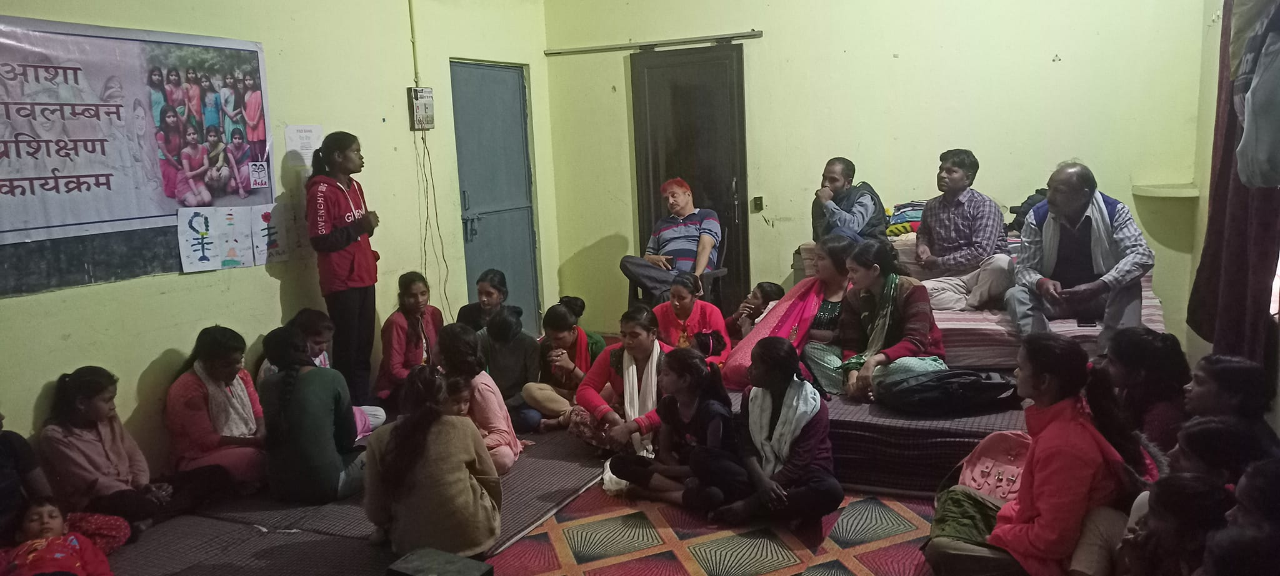
Flim and talk
Select flim on social isse, empowerment and other issues.
Flim Show.
Talk about flim and their issues.

Slide 33
Talk about flim and issues

Slide 34
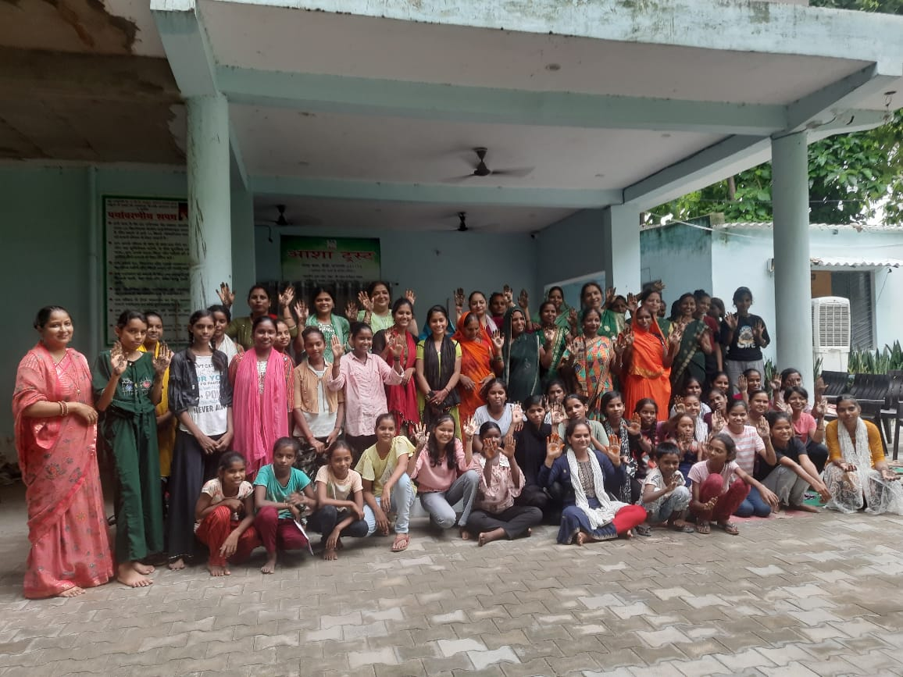
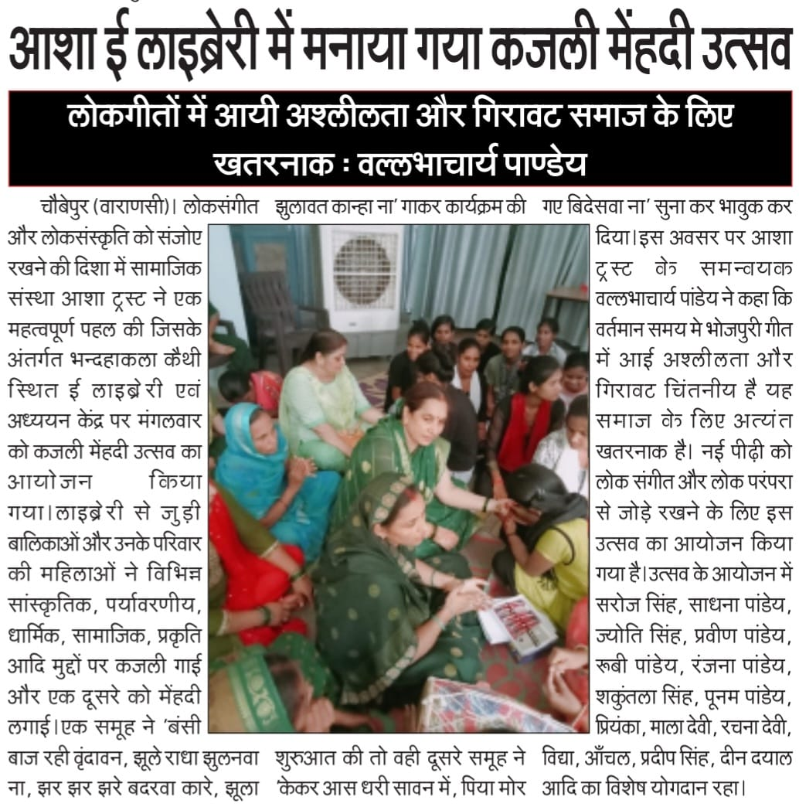
Kajali Program at Asha Kaithi Library

Slide 35
Future Program
Current Year we start two new E-library and Study center at Ballia and Mau
Enhance the system and facility at Kaithi and Chakrapanpur E-Library.

Slide 36
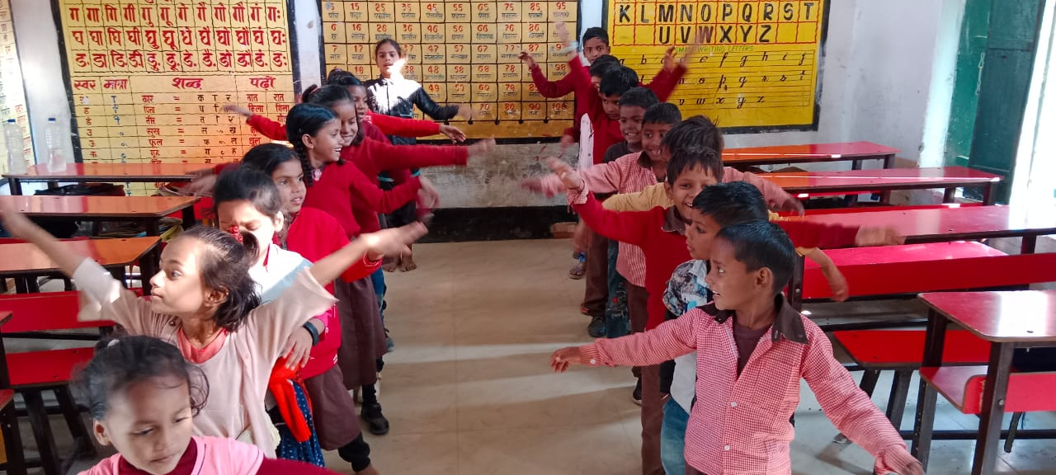
Asha Mobile Library and Library Program
Runs 10 Mobile / Jhola Library with Government School.
Runs 10 Mobile / Jhola Library in Community.
Our objective is to provide books (other then textbook) to children.
Learn with fun.

Slide 37
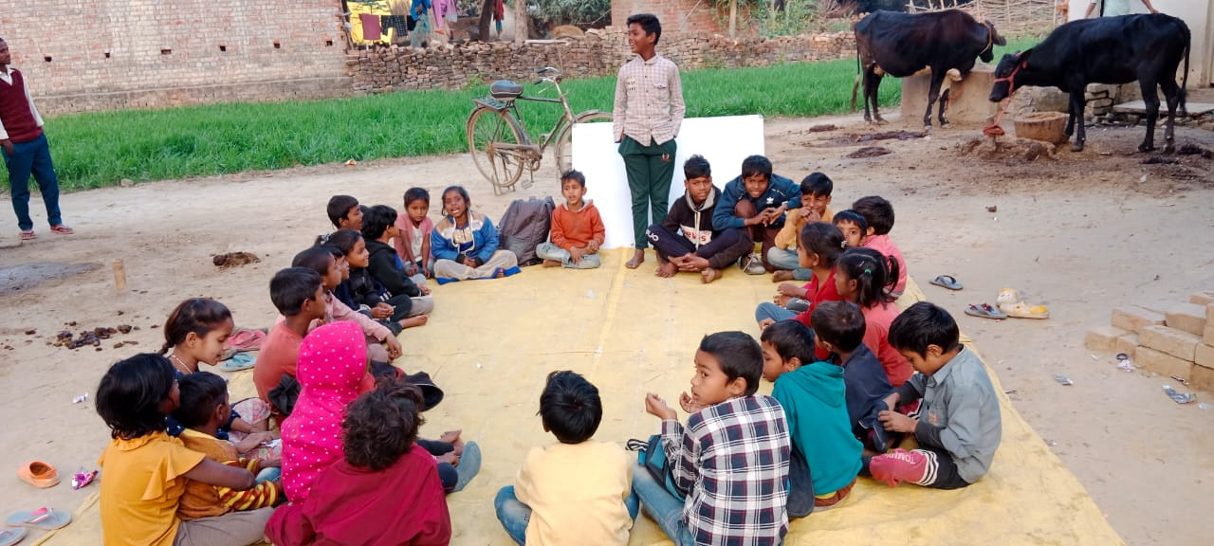
Activities in Library Program
Book Talk
Read Aloud.
Story Telling
Paper Reading

Slide 38
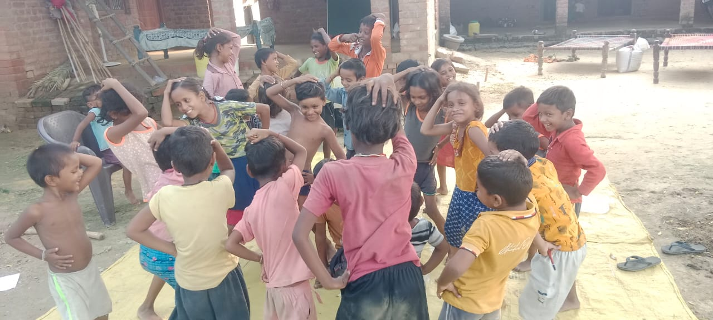
Share Reading
Writing
Speaking

Slide 39
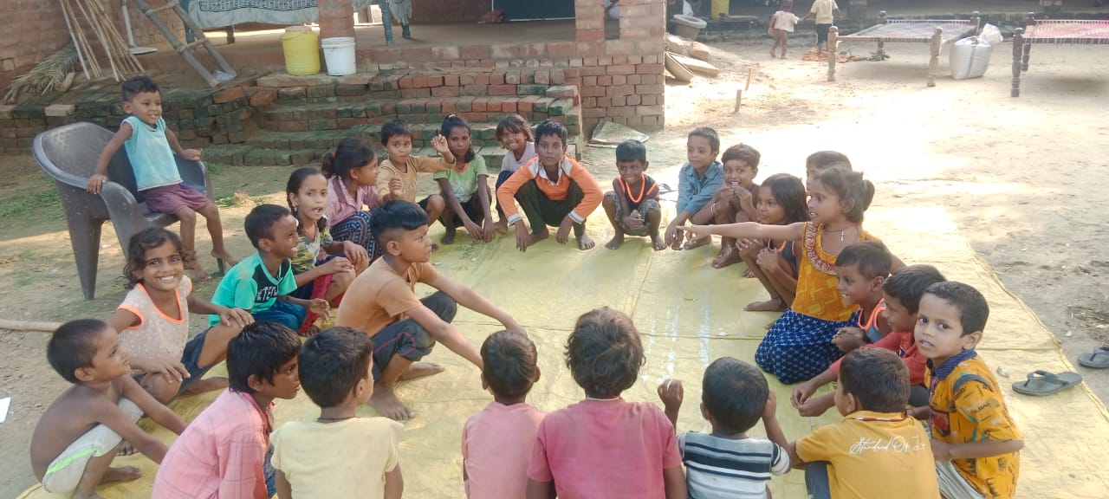
Achievement of this program
Children’s ability to read, write and speak ha develop.
Children write story in own words.
Children ask question.
Children wants to read new books.
Children will be able to be logical, imaginative and capable of solving problems that arise in life.

Slide 40
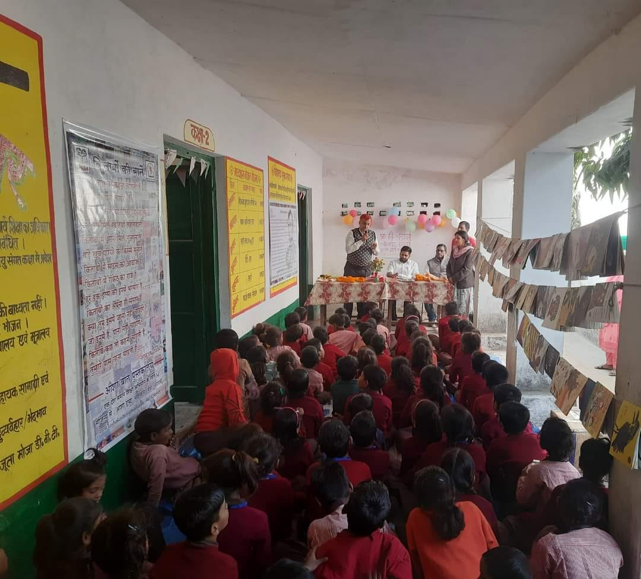
Runs 4 library center at Asha Kaithi, Rajwari, Mirazamurad in Varanasi and 1 Library in Dhangari village at Maharajganj.
Asha provided 4 set of library to government school in Varanasi.
Provide book set 100 books to 5 government school.
One set library at Mau.
Two library at Lucknow.

Slide 41
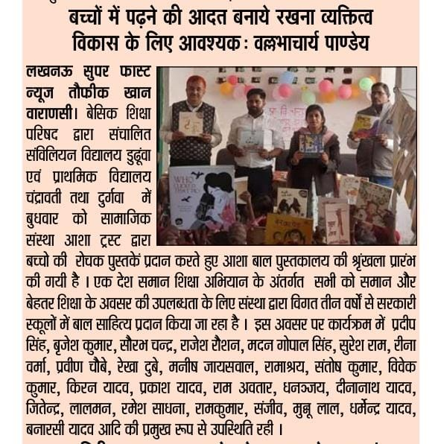
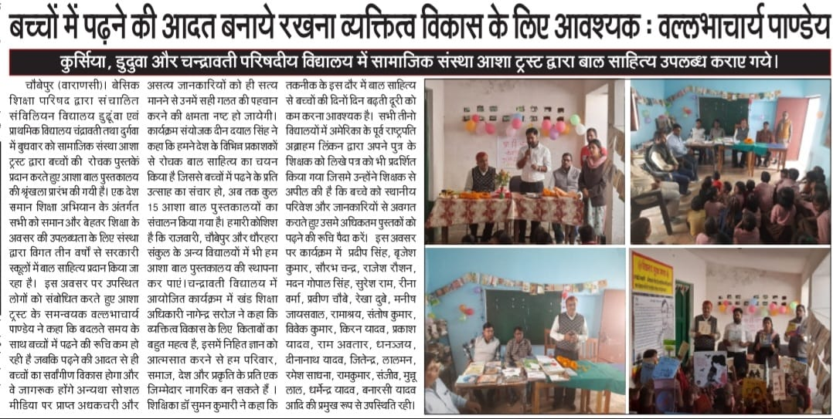
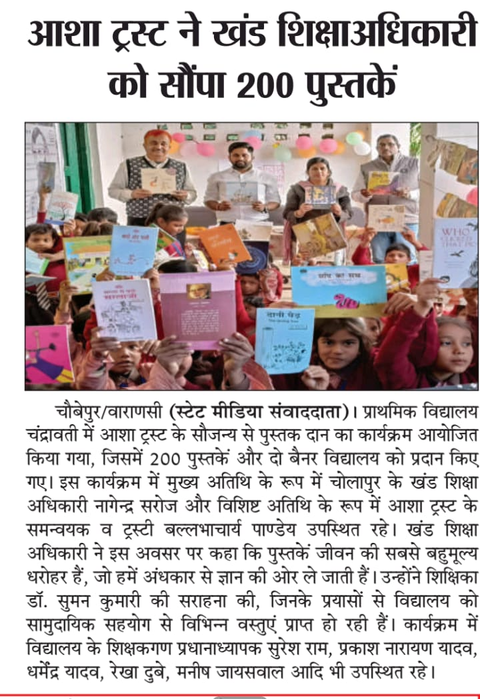
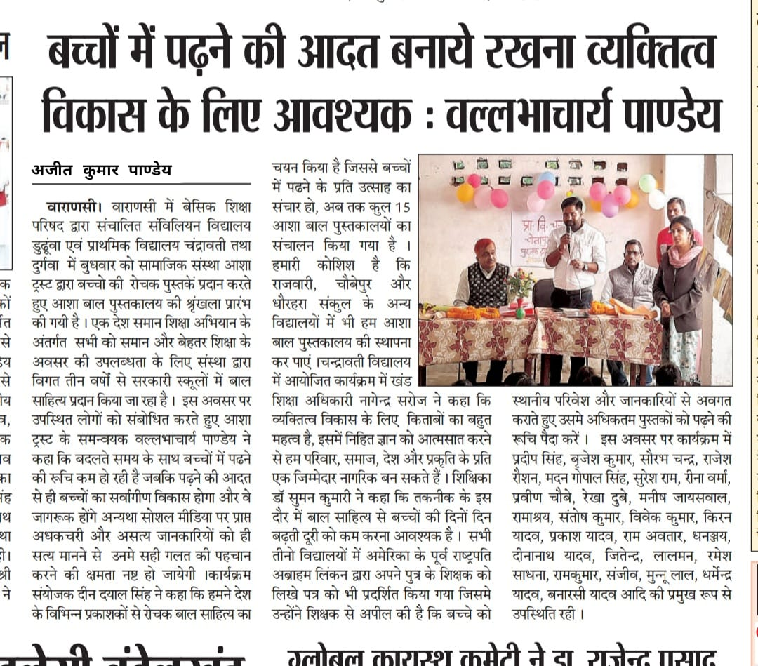
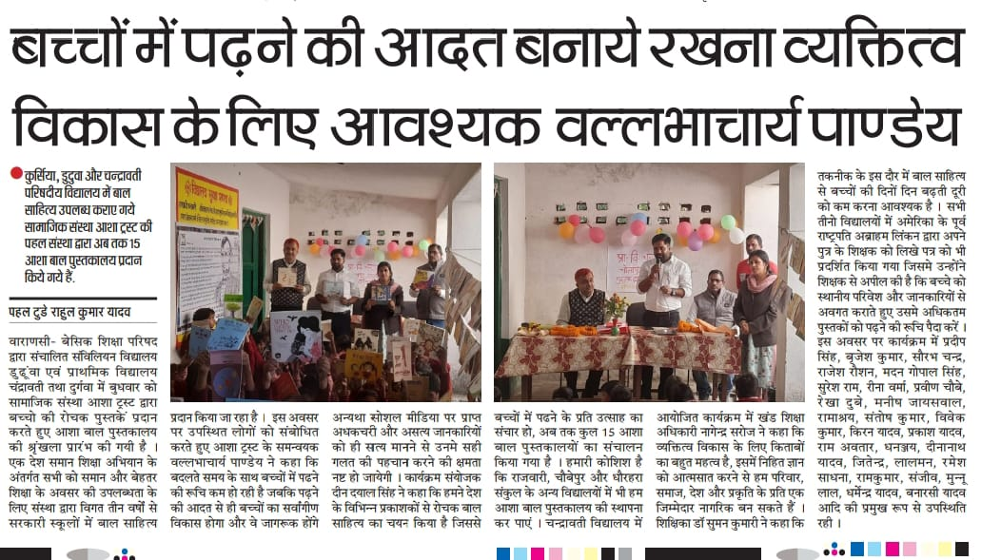


Slide 42

Asha Swawlabban Kendra
Run 3 Sewing Center
To Provide skill.
To motivate girls for self reliance.

Slide 43

Sewing center at Asha Kaithi, Varanasi.
Sewing center at Adarsh Nagar, Varanasi.
Sewing center at Mogalaveer, Varanasi.

Slide 44

Beautician Training Program at Adarsh Nagar

Slide 45

Pad Bank
Easily availability of sanitary pad.
45 girls are members in pad bank.
40 percent of cost bear by organization.

Slide 46


Samvidhan Ki baat Kathputali ke Sath
Organize program in school.
Kathputali play based on Samvidhan awareness.

Slide 47


Samvidhan Poster Display.

Slide 48


Discussion on play and Samvidhan

Slide 49

Jan Samvad Program for Health and Education
For better and free common school system.
For provide better and free health to all.
For provide employment to every person who want to work.

Slide 50

Poster of 50 Great Personalities
In 10 Government School Asha Provide and Display 50 Great Personalities Poster.
Our Aim that Children known these personalities and school also take step to provide knowledge about then on there birth and death anniversary Dates.

Slide 51


Slide 52

Workshop on Vishmukt Kheti / Organic Farming
To Aware Farmers.
Provide Better Food Materials.
Use Minimum fertilizer and pesticide in agriculture.
Minimize the cost of Farming.

Slide 53



In Newspaper

Slide 54

Eye Camp at Asha Kaithi Center
Eye Camp at Asha Kaithi Center with the help of R J Shankara Eye Hospital, Varanasi.
total of 217 people had their eyes checked.
41 People is registered for Motiyabind free operation.

Slide 55



In Newspaper

Slide 56

Blood Donation Camp
1. Blood donation camp organized on 23 march on the day of Shaheed Divas.
2. To Motivate young generation for blood donation.
3. Breaking the misconceptions related to blood donation

Slide 57

Labour Day Program at Asha Kaithi

Slide 58

for a better tomorrow

