Slide 1

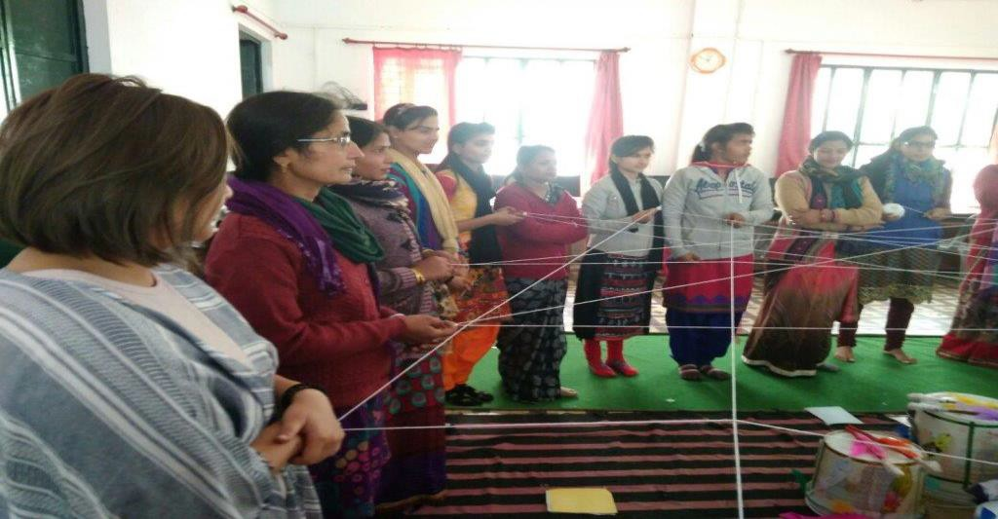
HOPE Girls Education Initiative
Gujarat
Maulik Nagri Project Steward October 2025

Slide 2
Site Visit in October 2025
Site Visit done by: Maulik Nagri on October 10, 2025, in Ahmedabad at the office of HOPE-GEI, on behalf of Asha for Education’s Boston Chapter.
For background, this project was reorganized as HOPE Girls Education Initiative (HOPE-GEI) from a prior project funded by the Boston Chapter since 2018. Additionally, the chapter volunteers would like to continue funding the project after the reorganization.
I was welcomed by 20+ girl students (ages 10-18). when I visited the GEI’s office in Narol area of Ahmedabad on 10th October, 2025,.
I met with Prasad Chacko, Meera Rafi, and 25 girl wards (including alumni), supported by HOPE-GEI.
GEI educates and provides life skills training to various girls. The girl wards used a presentation to share in their own words when they learn at GEI. These topics include:
Life Skills
Gender Equality
Reproductive Health
Menopause
Mental Health
Overcoming Superstitions
Constitution of India
Later the girl wards and I had open Q&A session where they shared stories and how GEI has given them not only education but also, motivation and courage to pursue their studies.
I noted the high confidence and high self-esteem of the girl wards, based on counselling and training provided by the HOPE-GEI staff. Certain girl wards stated that they have become role models and advocates in their communities for women's health projects.
Importantly, they learnt from the teachers and from each other.

Slide 3
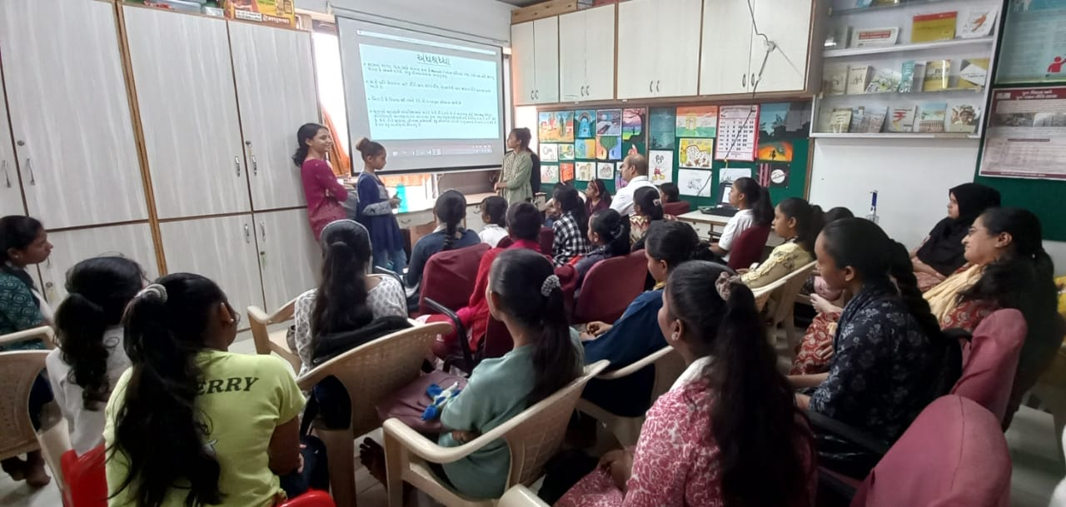
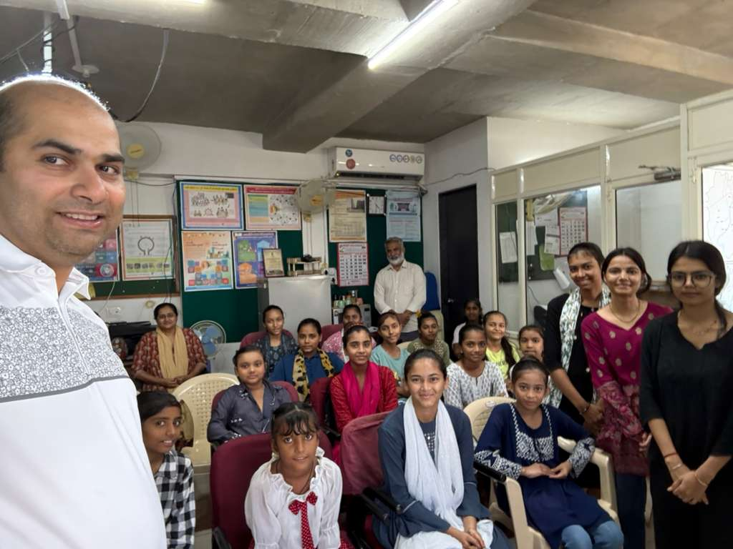
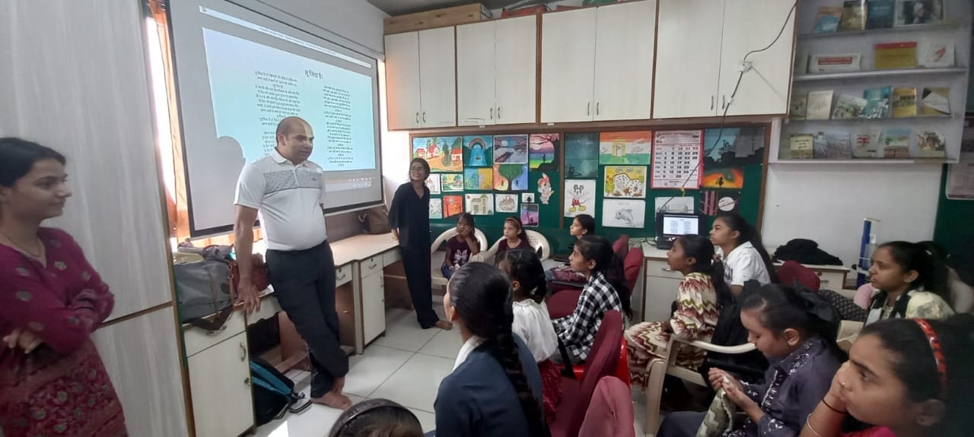
Photos from October 2025 Site Visit

Slide 4
Internal Presentation
Gujarati Presentation
English Translation

Slide 5
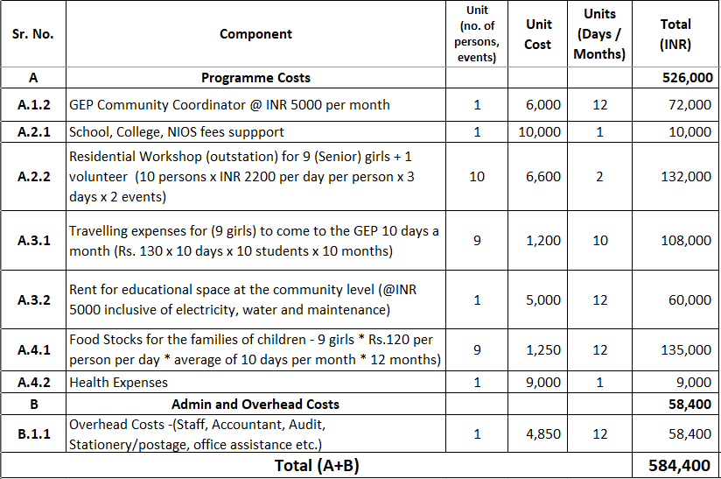
Proposal + Budget
Proposal is to fund INR 585,000 ~($6,500) for salaries, workshop, and rent, as detailed above.

Slide 6
Site Visit in April 2025
For background, this project was reorganized as HOPE Girls Education Initiative (HOPE-GEI) from a prior project funded by the Boston Chapter since 2018. Additionally, the chapter volunteers would like to continue funding the project after the reorganization.
HOPE Girls Education Initiative provides learning support, shelter, nutrition, and counseling to adolescent girls from vulnerable and impoverished backgrounds.
Site Visit done by: Dipal Patel on April 3, 2025, in Ahmedabad at the office of HOPE-GEI, on behalf of Asha for Education’s Boston Chapter.
Dipal met with Prasad Chacko, Meera Rafi, and 25 girl wards (including alumni), supported by HOPE-GEI.
Dipal noted the high confidence and high self-esteem of the girl wards, likely based on counselling and training provided by the HOPE-GEI staff.
Notably, certain girl wards stated that they have become role models and advocates in their communities for women's health projects.
Dipal observed that the 3 decentralized workspaces provided by HOPE-GEI provide a place where girl wards:
Provide a nurturing and encouraging environment
Study after school
Enable learning from each other
Learn counselling and personality development (including English speaking and computer classes)
Dipal noted that girl wards are selected based on single-parent families, impoverished backgrounds, and poor academic record. HOPE-GEI seeks a commitment from girl wards to pursue academic study diligently.
Dipal observed that the use of 3 decentralized workspaces reduces commute time and gains greater acceptance from parents and extended families.
Dipal noted that each of the 3 decentralized workspaces (geographically different from the space 2 years ago) has a senior student assisting the younger girls.

Slide 7
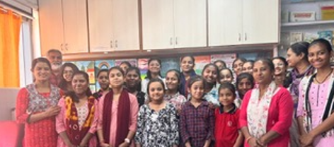
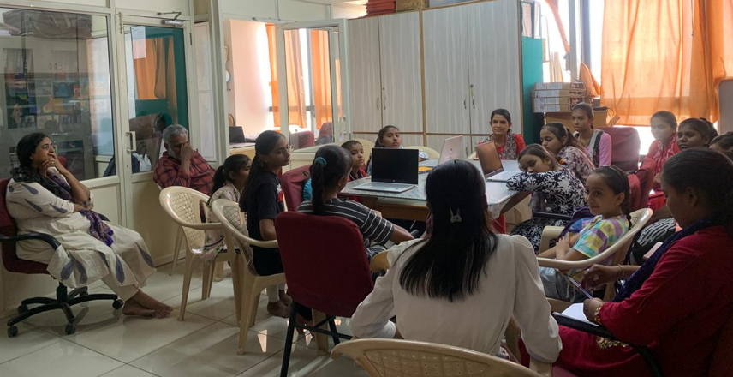
Photos from April 2025 Site Visit

