Slide 1
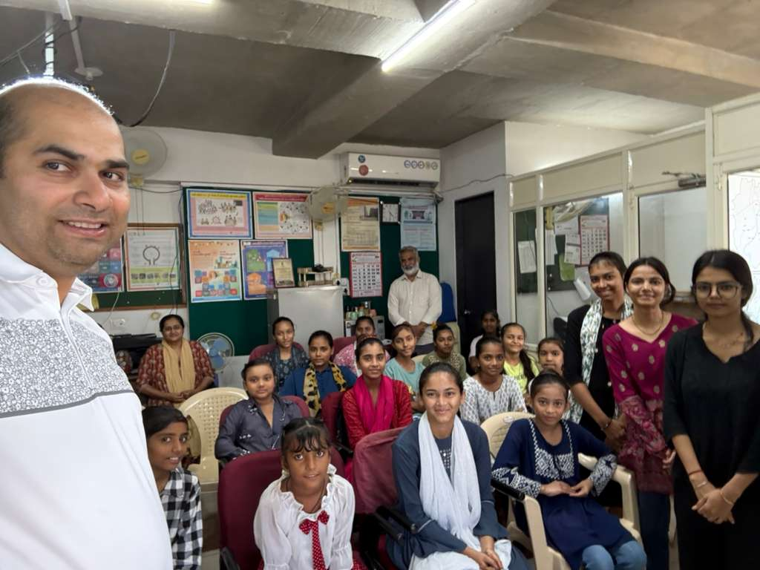
HOPE/GEI in Ahmedabad, Gujarat
The smiles and confidence of the students is our goal.
HOPE/GEI focuses on all-round development in addition to academic training.

Slide 2
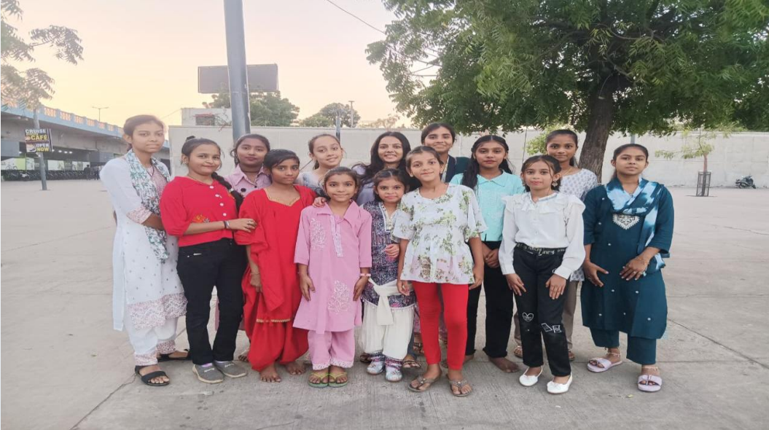
About HOPE/GEI
Supports ~30 girls from under-privileged single-parent backgrounds in Ahmedabad’s impoverished areas
To promote schooling , innovative means such as food security, healthcare support, peer coaching, counselling and life skills training are used
Site visits to police station, railway station, etc. banks, etc. are organized
Parent engagement is a key pillar; they agree not to get the girls married until education is complete
>98% of girls complete schooling and many even go on to study in college

Slide 3
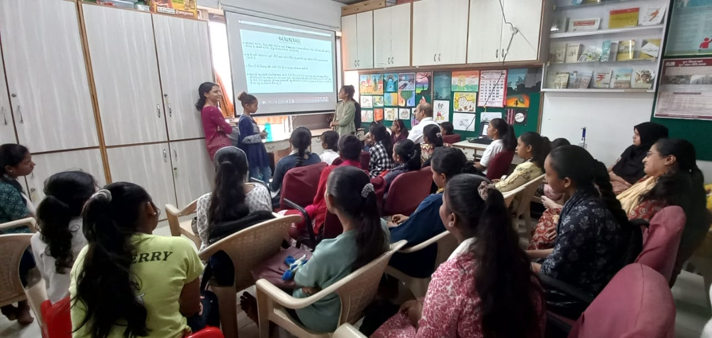
The Initiative
Key Areas of Support
School & Tuition Fees
Stationery
Counselling & Guidance
Food kit
Health education
Snacks
Places for Study
Hygiene Kit
Site Visits
Tarpaulin
Key Areas of Training
Life Skills
Gender Equality
Reproductive Health
Menopause
Mental Health
Superstitions
Constitution & Laws
Communication & Relationship Management
Interviewing Skills
Time Management

Slide 4
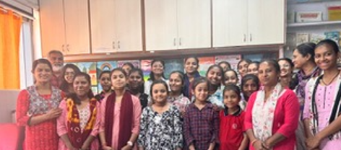
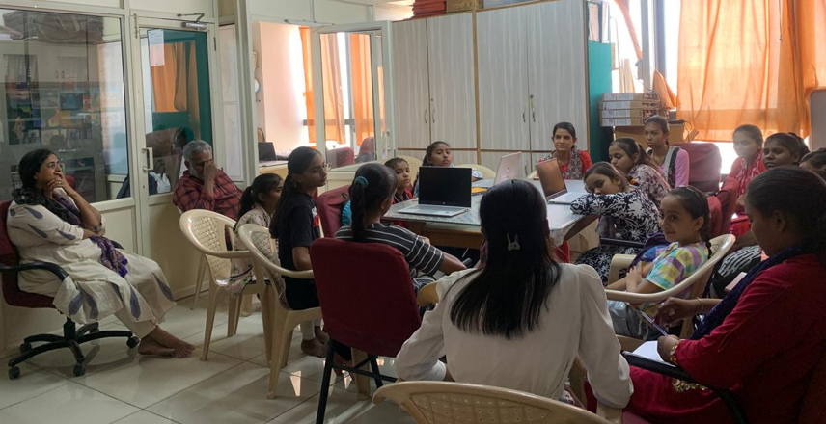
Asha For Education’s Role
Financial Support covering schooling, workshops, and healthcare with annual budget of ~$6,500 (~30% of total).
Site visit in October 2025 and various virtual check-ins
Sharing best practices from the Asha ecosystem
Support girls completing schooling and avoid early marriage

Slide 5
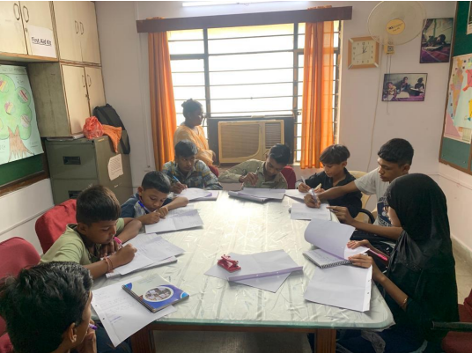
Next Steps
Coordinate with Asha Stanford Chapter to increase girl enrollment by ~10
Increase volunteer engagement

