Slide 1
Deenabandhu Trust
Science Chariot - Science to the door steps
New Project Proposal
-Suhas Satheesh
10/18/2017

Slide 2
Location & Activities
Based in Chamarajanagar, Karnataka sharing border with Kerala & TN
New district, highly under developed
Deep rooted caste and gender discrimination coupled with superstitions
Literacy rate [61%] lower than national average [74%]

Slide 3
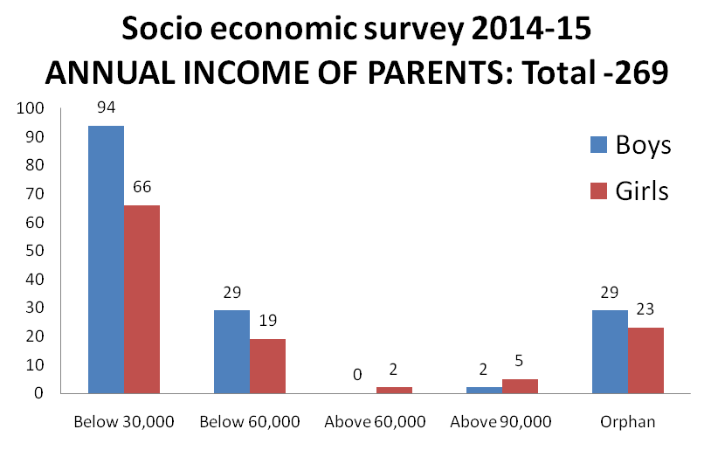
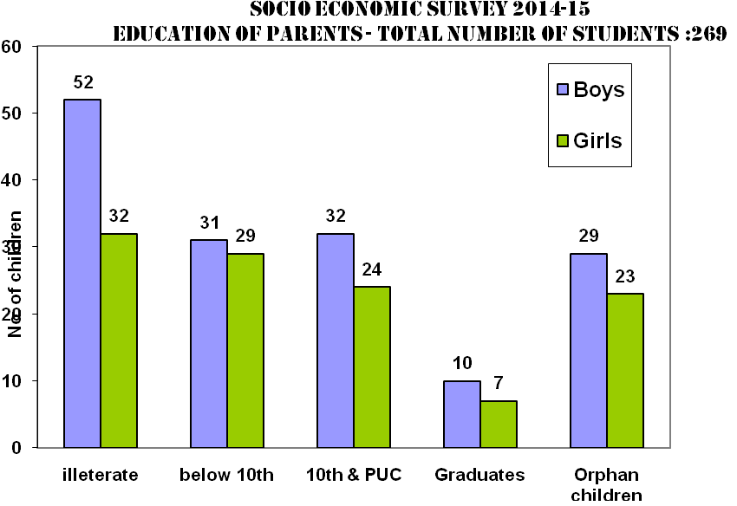
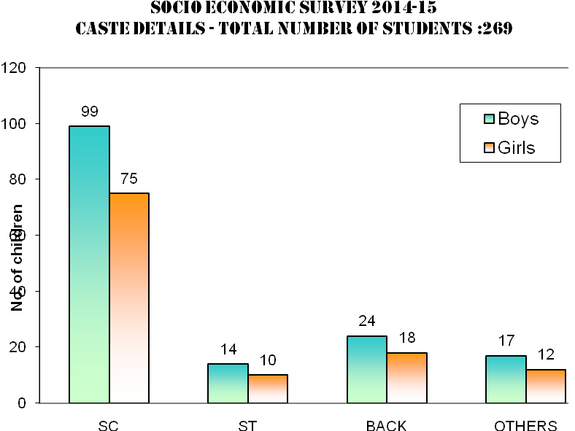
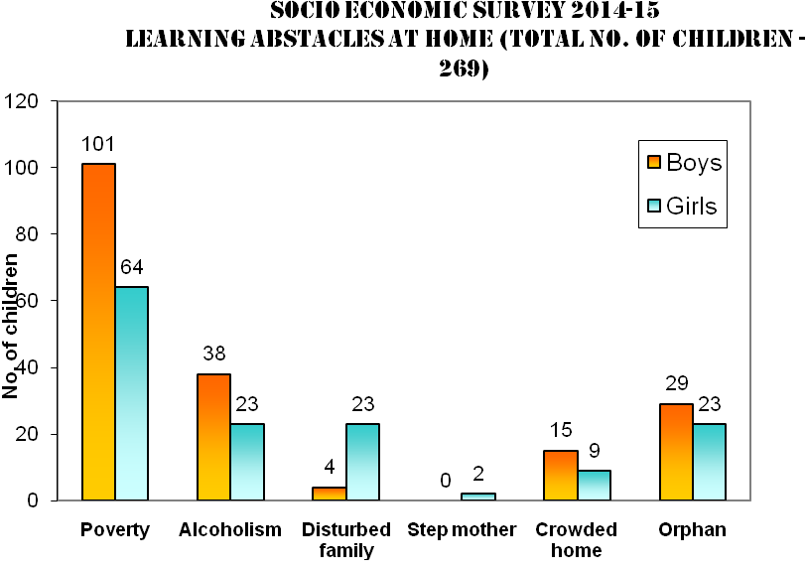

Slide 4
Trust Activities
Established in 1992 by Prof. G.S. Jayadev
Orphan home for 80 kids
Primary school for children
Teacher Training Center for 160 teachers from nearby 80 government schools
SHG for women

Slide 5
New Project
Science Chariot - Science to the door steps
Goal - To promote reason & science among school teachers & children through EBL*
Extension of existing Teacher Training Center
Appreciation of the model by TISS, Mumbai & DSERT, Karnataka
Scalable & sustainable [Need AfE funding for 1st year only]
*EBL: Experiment Based Learning

Slide 6
Words From Melli Annamali*
Science Chariot - Great model to generate a buzz around science & math among teachers & students
Such a mobile van is needed since many govt schools lack basic science labs in the area
One science van is not nearly enough to meet the needs
Similar science van has worked well with SVYM**
Prof. Jayadev - Very honest, reliable man who has spent his lifetime on child education
Ensure that the Trust is not underestimating the rolling costs after first year
*Melli is active volunteer at Asha Boston & ex-president of Asha. She knows Prof. Jayadev quite well. She also knows about the Science Chariot model as Asha Boston supported the same for SVYM, Mysore.
**SVYM: Swami Vivekananda Youth Movement, NGO based near Mysore, Karnataka.

Slide 7
Outcomes
The measure of interest created among children and teachers in understanding a concept of science through experimentation.
Reduction in levels of superstitions.
Improvement in comprehension after conducting experiment/viewing video film measure through a questionnaire.
Reduction in the common misconceptions prevailing in the understanding of science will be considered as a measure of our purposeful input to dispel misconceptions.

Slide 8
Numbers [OLD budget]
Particulars | Budget in INR
Vehicle chassis | 10,00,000/-
Fabrication of the chassis into Science Chariot | 8,00,000/-
Staff salary at INR 12,000/- per month (12x12,000) | 1,44,000/-
Driver salary at INR 10,000/- per month (12x10,000) | 1,20,000/-
Preparation of the exhibiting materials (science and mathematics models) | 2,00,000/-
Maintenance of vehicle at 2,000/- per month (12x2000) | 24,000/-
Diesel expenditure at 10,000/- per month (12x10,000) | 1,20,000/-
Food allowance | 40,000/-
TOTAL | 24,48,000/-
Budget requested: INR 24,48,000/-
One time funding
Subsequently self-funded

Slide 9
Numbers [Revised]
Particulars | Budget in INR
Vehicle chassis | 1,000,000/-
Fabrication of the chassis into Science Chariot | 800,000/-
Staff salary at INR 15,000/- per month (12x15,000) | 180,000/-
Driver/technical assistant salary at INR 13,000/- per month (12x13,000) | 156,000/-
Preparation of the exhibiting materials (science and mathematics models)(GST 18%) | 236,000/-
Maintenance of vehicle at 2,000/- per month (12x2000) | 24,000/-
Diesel expenditure at 13,000/- per month (12x13,000) | 156,000/-
Food allowance | 40,000/-
Administrative expenditure (5% of the total budget) | 129,600/-
TOTAL | 2,721,600/-
Budget requested: INR 27,21,600/-
~11.2% increase since 2016*
USD 42,065 [@64.7INR/$]
One time funding
Subsequently self-funded
*This project was approved in 2016. Ffor various reasons funds were not released. Renewed budget has ~11.2% increase due to inflation, GST, and added administrative expenditure.

Slide 10
Miscellaneous
Past/present donors: AfE, Oracle, Indo-MIM
Long association with AfE Boston & Arizona chapters
Pictures
Steward volunteer: Suhas Satheesh
QUESTIONS?

Slide 11
Questions for DT
1. What is the rough size of the van?
It is Swaraj Mazda, smaller than the usual bus and may measure 18 feet in length. You can google for exact details.
2. Can you broadly outline the kind of science & math material/experiments you plan to put in the bus? You could also add a broad breakdown of 2 lakh rupees involved in acquiring experiment materials.
Light kit to show about 12 light experiments, TLMs connected with magnets, friction model to demonstrate the impact of friction on motion,different pendulums, Kinetic- potential energy models, TLMs with electricity experiments, mobile chemistry expts to show the acids of kitchen with litmus papers, separation of solids and liquids by using density, size of the particles etc, biology models of human body parts, mathematical models geometrical and algebra models.
For more details you can see the range of TLMs prepared in TRC by our team in our web site <deenabandhutrc.org> and all these models will be taken in the van depending on the on going lessons of the given month. An LCD projector and screen will also be fitted to the van and we propose to show different science films that we have produced. You can view the films with Kannada narration in our web site linked to U tube.
3. It seems like there is a recurring cost of 5-6 lakh rupees per year. How exactly do you plan to fund that?
In the future years we propose to meet the part of this expenditure from profits earned by sales of the TLMs manufactured at our TLMs. The current experience is very encouraging and we have earned a profit of over 2.5 Lakhs during 2015-2016. We are sure to improve our sales as our TLMs are very popular.
4. How long will it take to fabricate the van & have it working?
U tube.It may take about 4 months to fabricate the van and inabout 5 month's time we start working.

Slide 12
Questions for DT
5. Where will you find the expertise to build the science van? Is it outsourced to another company?
Chamarajanagara is the border district of Tamilnadu and we have expert fabricators in Tirpur, and other districts of Tamilnadu. One of our Trustee is the owner of bus services and he is in the business for the past 40 years. He is helping us in this regard.
6. Can you give a breakdown of the 8 lakh rupees involved in fabricating the science van?
This is the rough estimate given by our Trustee who is in the business. For more details and breakups we need to give all the specific requirements and get the exact cost. However we are trying to see some existing science vans (like in the one in SVYM or Agasthya) and decide as which one suits our requirements and then decide.
7. SVYM has built a similar science van-Vigyana Vahini. What can you learn from them? How to make sure the same mistakes are not repeated?
Yes we will consult them.
8. Can you share with us the questionnaire you developed to evaluate the impact of Science Chariot?
I will share it in my next mail.

