Slide 1

SHED – Society for Health And Educational Development
(Rural)
Annual Review for April 2024 - March 2025
Budget Proposal for 2025-26
https://ashanet.org/project/?pid=1214
Asha Projects
May 18, 2025
Amit Rajkhowa Nabanita Majumdar

Slide 2
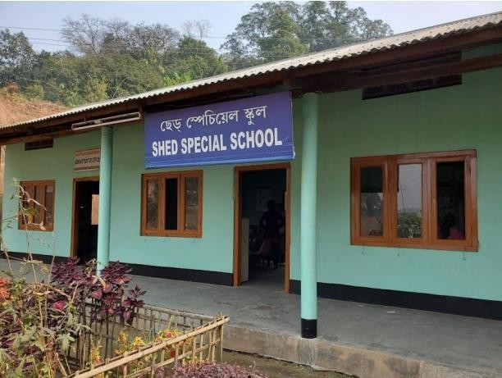
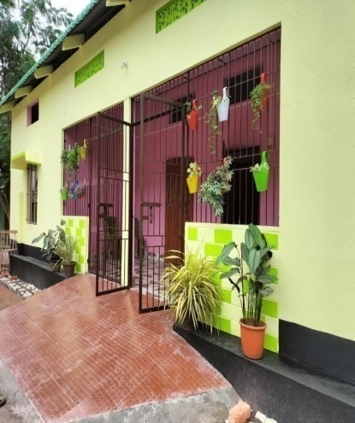
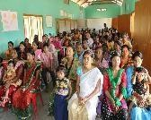
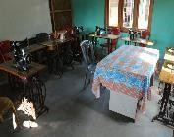
SHED
(Society for Health and Educational Development)
WHAT
IS SHED?
Integrated school
Facility for underprivileged children with special needs
Boarding
Facility for Children with disabilities
Day scholar and evening Students FROM NEARBY LOCALITIES
(WITH OR WITHOUT DISABILITIES)
Vocational and Teacher Training, Community Outreach

Slide 3
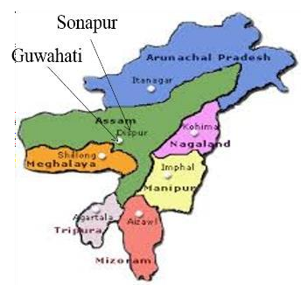
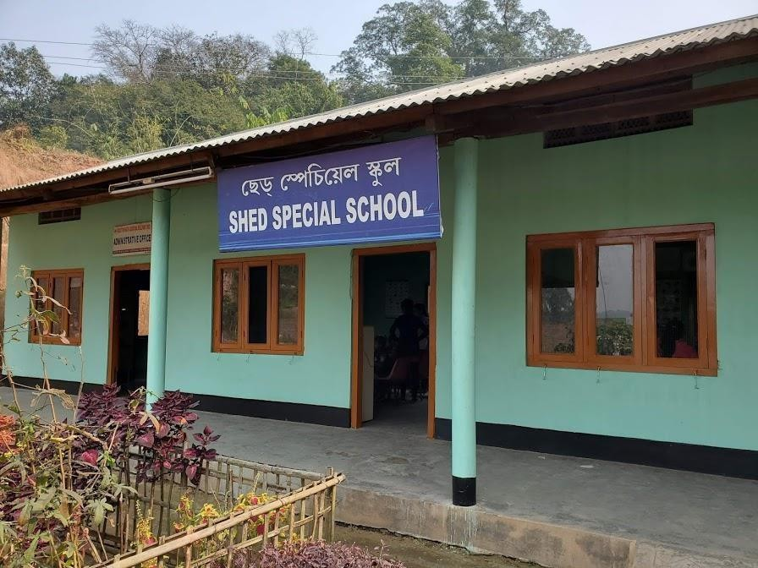
MISSION AND VISION
Founded by in 2007, SHED is currently run by Mr. Hiranya Saikia.
The school aims to provide a integrated and positive learning environment for children with disabilities. It offers:
            Boarding Facilities: For children with special needs/disabilities.
  Day Scholars and Evening Students: Students from nearby localities and govt. schools thereby promoting interactions between children with and without disabilities to help them become more productive citizens.
  Dedicated Team: Special education teachers and caregivers.
  Programs: Community outreach, vocational training for students, and partnerships with local organizations like Don Bosco University.

Slide 4
SHED HISTORY 2007-2024
2007-2012: Founded in 2007.Started as day school for special needs and underprivileged children in a suburb of Guwahati with 23 students by 2012.
2013: Acquired land in Sonapur.(~25 km from Guwahati.) and built school structure and limited hostel facility. Started with new students from local area – hostellers, day scholars(mostly special needs) and evening students
2014-2015: ASHA involvement started from 2014 - Yearly funding for teacher's salaries & one-time funding for Pukka classrooms, new kitchen cum dining hall, new hostel facility.
2016-2024:
  Current Student count 68 (25 hostellers, 43 day-scholars)
  Vocational activities expands every year with newer handicrafts - flower making, vases, jewelry, decorative items etc. using innovative recycled materials.
  Close partnership with local Universities supporting internships for Psychology and Social work students - Don Bosco University.
  Regular visits from District civil Hospital, Dept. of Psychiatry, Sonapur Govt. of Assam.
  Regular visits and in-kind donations from Dalmia Cement Employees Association (4 times), Air Force Women’s Association (multiple times per month), Rotary Club Guwahati Metro, (3 times donates grocery items), Robinhood NGO. (once per month)
  On Site Monthly community awareness program temporarily suspended since Covid. But they participate regularly in off-site awareness programs.
4

Slide 5
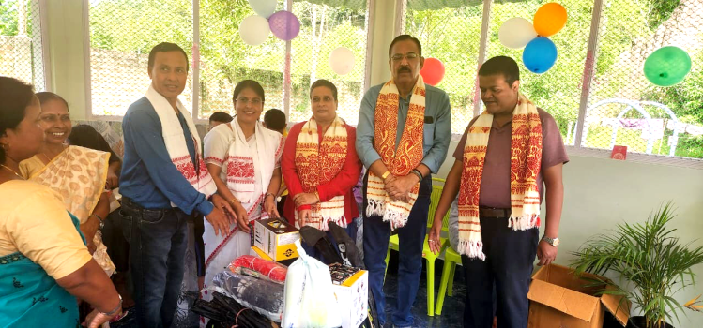
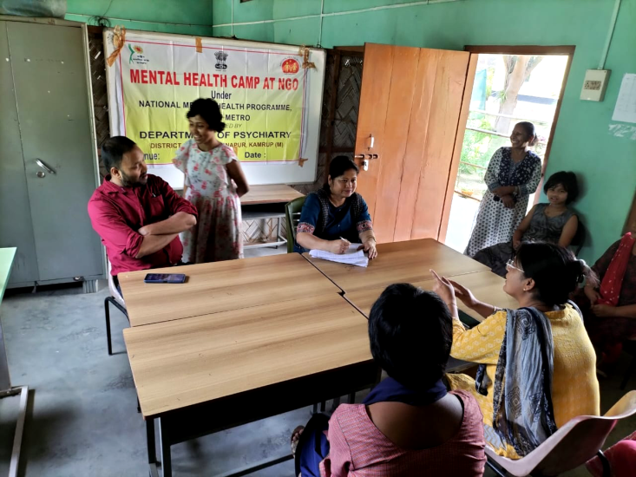
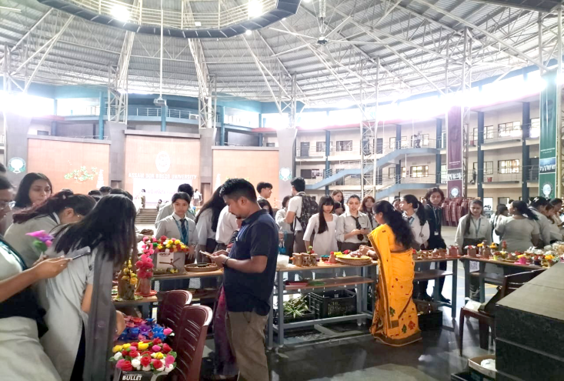
SHED HIGHLIGHTS 2024
A visitor room was constructed with the generous donation of Quther Saleh, son of Wahid Saleh, a resident of Holland who is a regular donor.
On November 5, 2024, the Director of Dalmiya Cement Authority donated sports equipment to SHED students.
SHED participated in a pre-Diwali function on October 29, 2024, at the invitation of Don Bosco University Sonapur, where they raised funds by displaying and selling handicrafts.
On December 30, 2024, Sonapur Civil Hospital Mental Health Department invited SHED to organize a disability awareness program, and our students actively participated in the event.
Robin Hood NGO members engage in various activities with our children twice a month, including playing sports, and have donated essential items to the students.
Wakif Isfaque from Belgium, and Joheb BorBorah from UK, are financially supporting the installation of tiles on the floor of the boys' dormitory.
Currently, five Master of Social Work students from Don Bosco University are interning at SHED Special School.
Regular visits from the Air Force Women's Association occur multiple times per month.
We receive food items from Rotary Club Guwahati Metro.
SHED's family including students and staff are also involved in growing vegetables and flowers which also serves as a mini nursery.
5

Slide 6
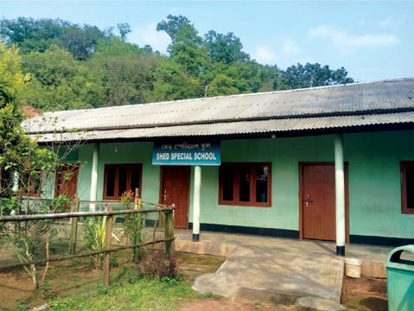
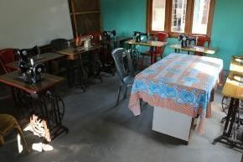
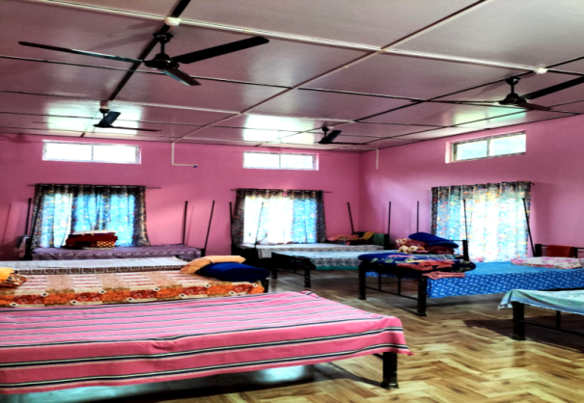
SHED Facilities and Student Update
Current Facilities:
  School Facilities – 5 pukka classrooms
  Hostel Facilities:
    2 Boys dormitory(with 2 attached bathrooms + toilet)
    2 Girls dormitory(with 2 attached bathrooms + toilet)
  Other Facilities:
    Kitchen cum Dining Hall
    Multi-purpose room (has vocational training/ sewing equipment)
    Office room with attached bathroom
    Additional boys and girls toilets for day school
    Visitors House
Students as of April 2025
68 Students Total (Hostellers + Day Scholars) Hostellers: 25 (Mental Retardation/Autistic/Hearing Impaired) 17 Boys and 8 Girls Full time (all day) Day Scholars: ~43(Mental Retardation/Autistic/Hearing Impaired) 25 Boys and 18 Girls Evening Day Scholars (3-6pm): 10~15(Students who attend local Govt. School can drop By SHED for tuition help)

Slide 7
SHED STAFF
Staff funded by ASHA (11)
  4 Special Ed (2 Specialized in Mental Retardation and 2 Speech Therapists for Hearing Impaired)
  1 Regular & computer teacher/office Asstt
  1 Community worker/ part time teacher
  4 Caregivers
  1 Caregiver & Cook
Staff funded from local funds
  1 Caregiver (hired for new girls' hostel)
  1 Part-time Music Teacher, Sumi Das (once a week)
  1 Part-time visiting doctor, Dr Abdul (once a month or on-call) - transportation costs provided
Future staff (to be supported via local funds)
  1 Special Ed/Regular Teacher to support additional girls once more girls are enrolled for the new hostel
8

Slide 8

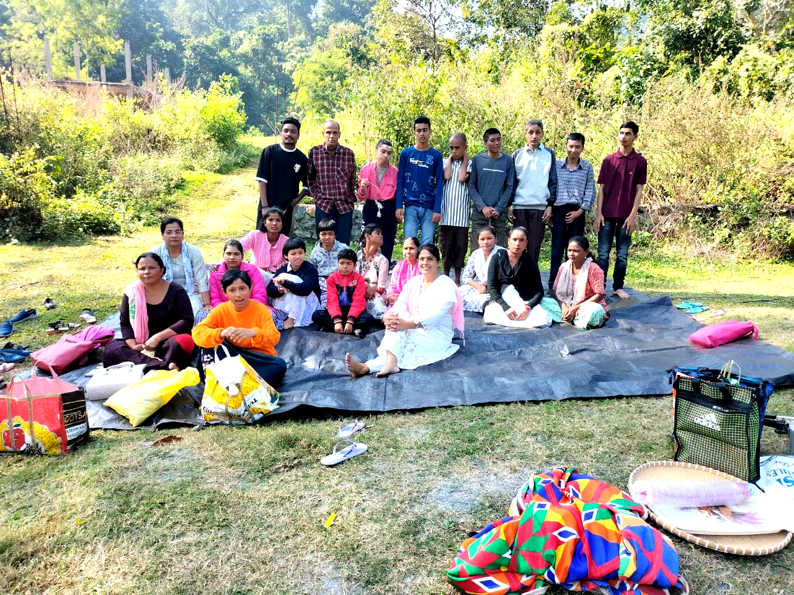
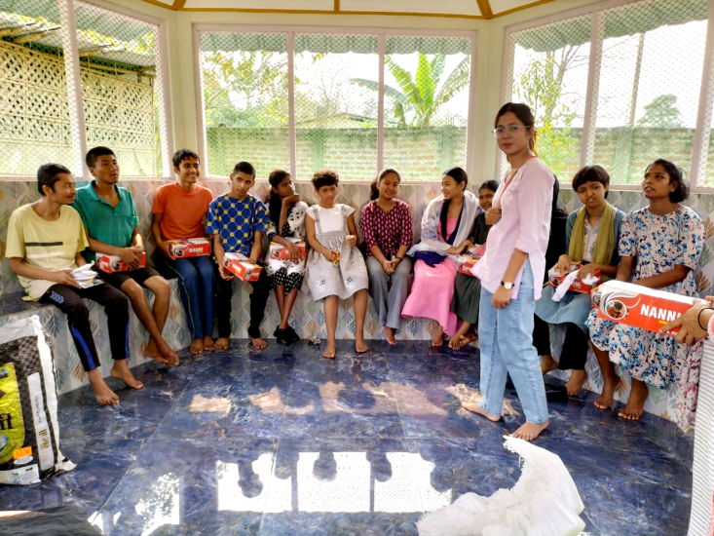
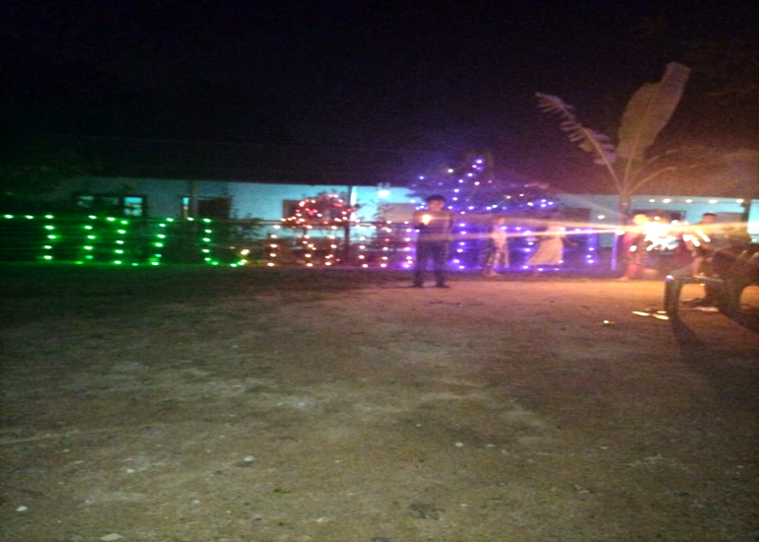
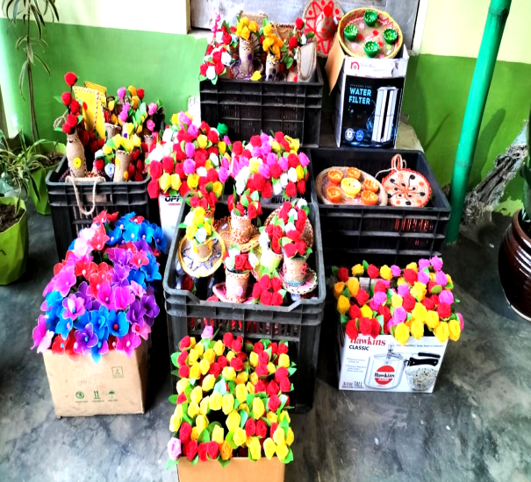
SHED PHOTO GALLERY
Front of new girl’s hostel
Pleasure Trips
Members of Robin hood NGO
Diwali Celebration
Handicrafts for Sale

Slide 9
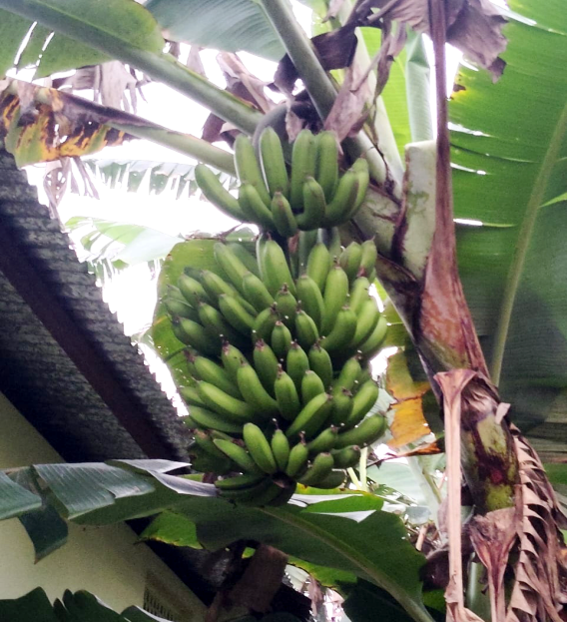
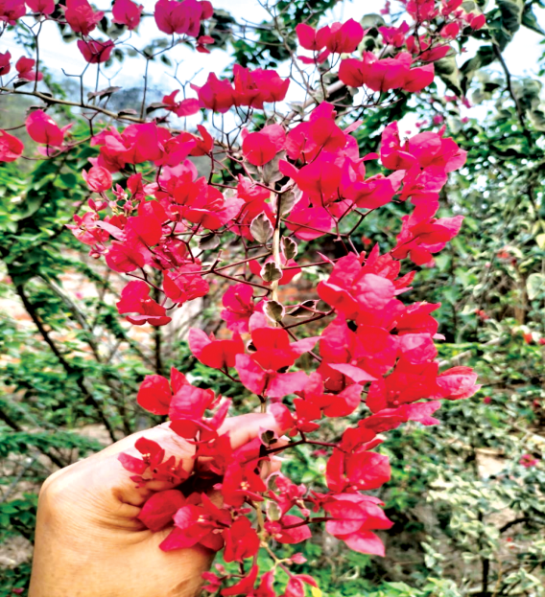
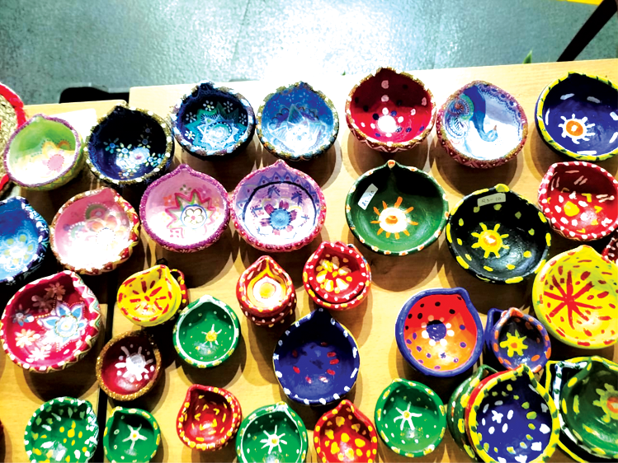
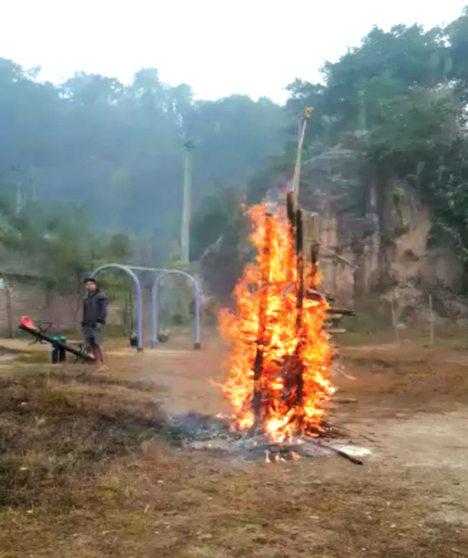
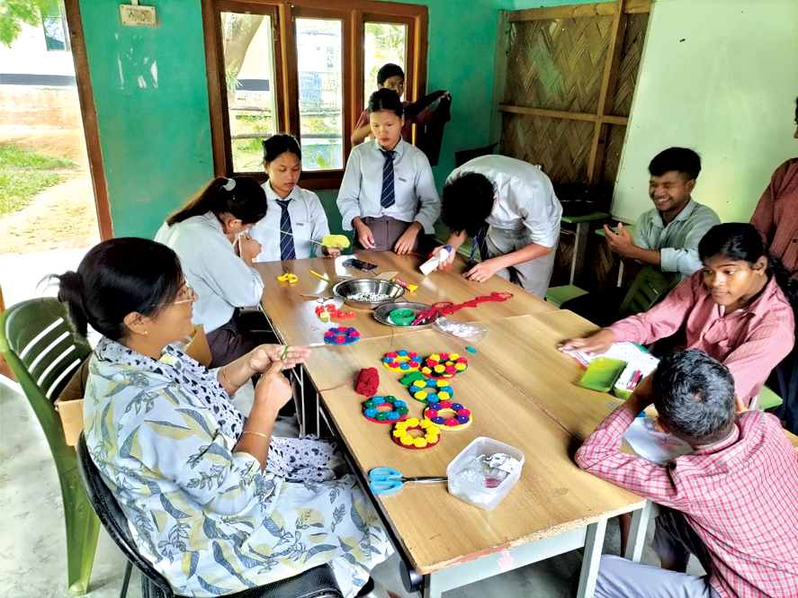
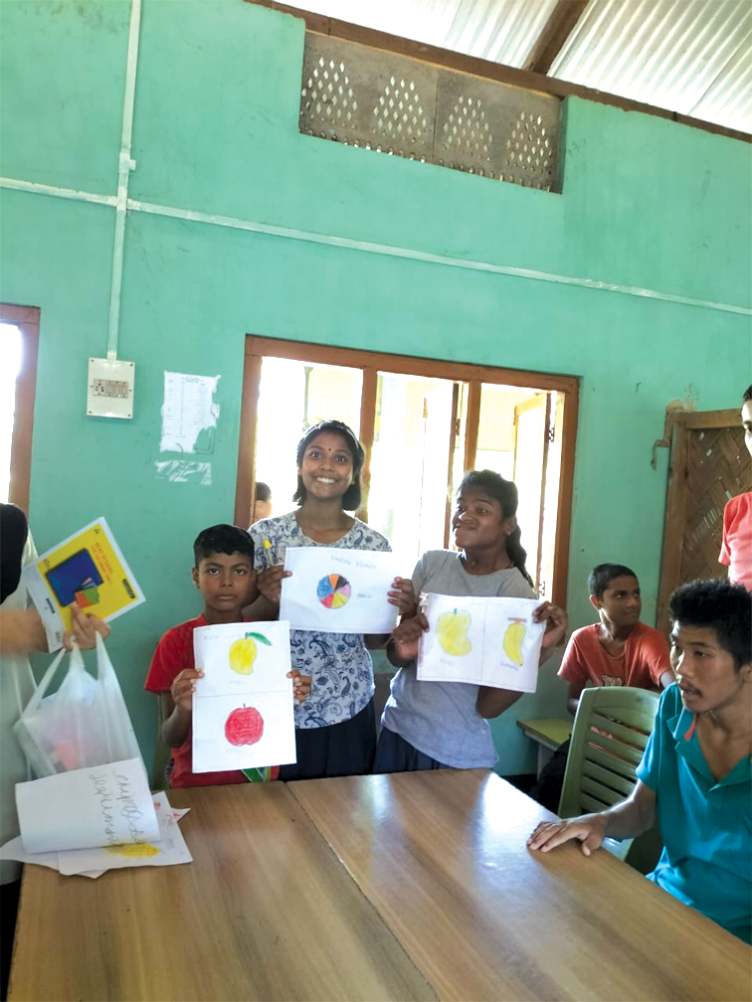
SOME MORE PHOTOS
Celebrating Magh bihu (Sankranti)
Students of donbosco university
Arts And diwali handicrafts

Slide 10
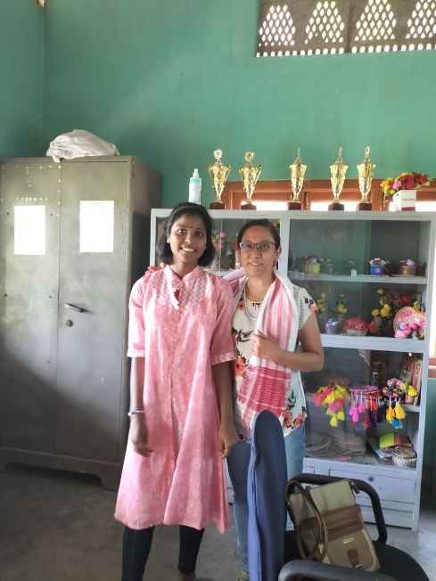
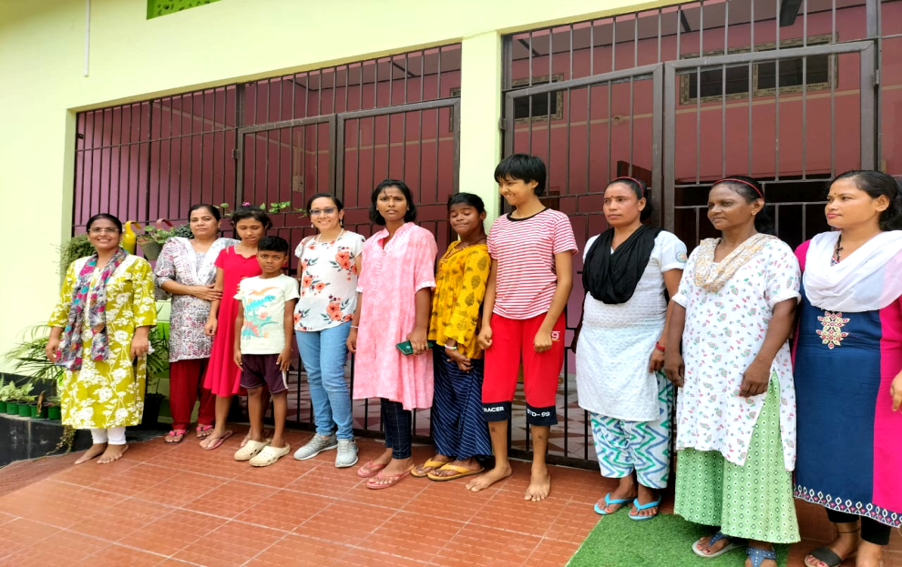
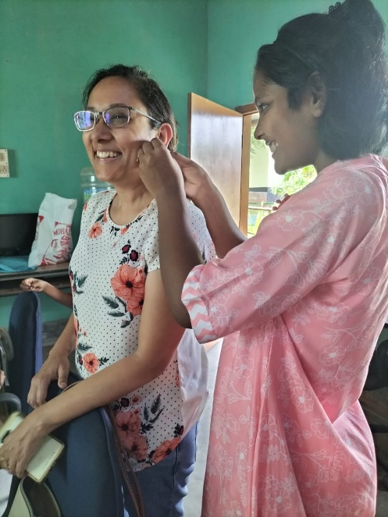
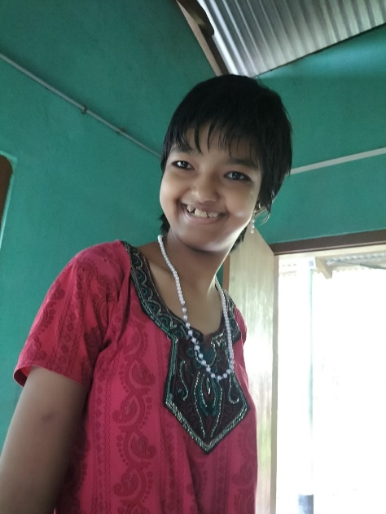
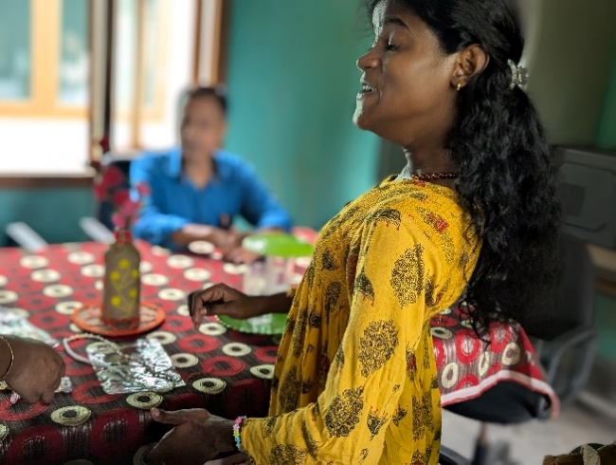
Site Visit - Sept. 14, 2024
Site Visit Report - Sept 2024
Highlight of the visit was the new girls hostel funded by Asha benefactor Anita Sra, meeting the enthusiastic hostel kids and seeing them thrive in the loving atmosphere.

Slide 11
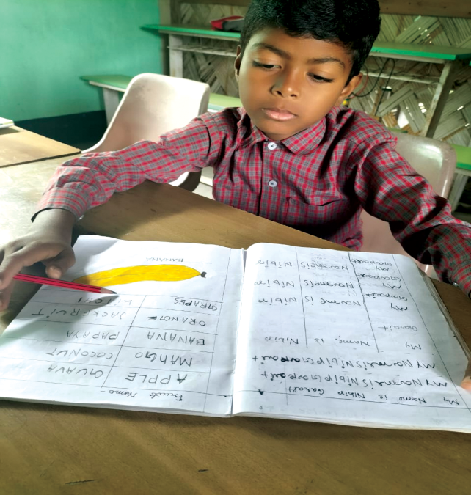
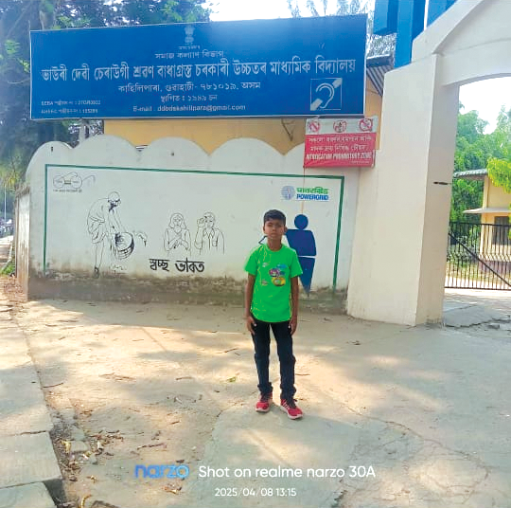
Success Stories of the Hostel Kids
NIBIR GARIET
          Nibir Gariet (age 10 yrs) was in SHED for 3 years, since 2021.
          Nibir could not write any letters when he entered SHED
          After 2 years he was able to write words and numbers and after 3 years he could write his name and father’s name.
          We are happy to announce that Nibir passed the selection examination of BHAURI DEVI DEAF AND DUMB HIGHER SECONDARY SCHOOL under the Government of Assam, Guwahati, and enrolled in Class 1. We hope he will be able to pursue higher education in the future.
          All of the following kids had significant challenges and behavioral issues before coming to SHED:
        CHINMOY SARMA
        Chinmoy Sarma, the son of a priest was also able to go home and help out with domestic chores.
      RANTU BORA
      Rantu Bora who has a small poultry farm at home is now able to help out his parents in the farm.
    JIVEN KATHAR
    Is now able to helps in the Jharu farm at home. Comes back as a day-scholar.
    BENU JYOTI KARMAKAR
    Is now able to helps his Dad with carpentry.
    OLYMPIKA TALUKDAR
    One of the first success stories from SHED who went on to a regular school was recently promoted to 8th grade.

Slide 12
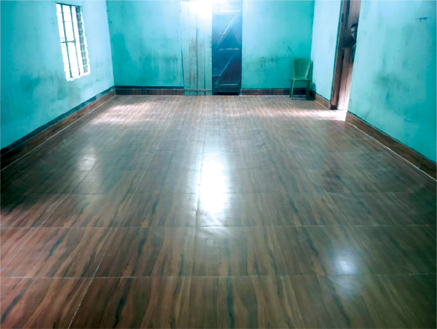
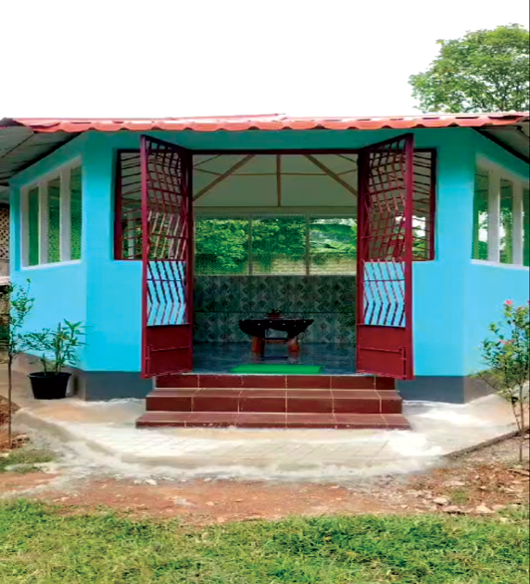
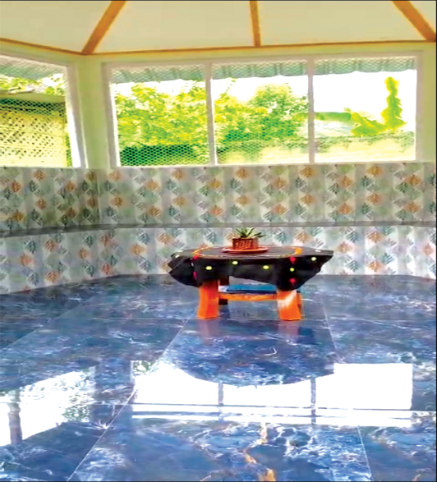
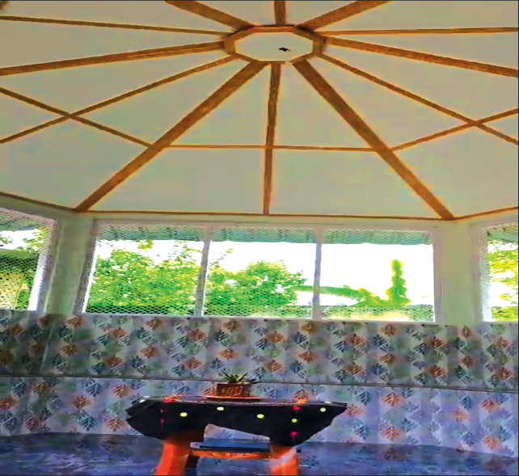
Currently, Wakif Isfaque from Belgium and Joheb BorBorah from UK are financially supporting the installation of tiles on the floor of the Boys dormitory.
INFRASTRUCTURE PROJECTS
A visitor room was built with the donation of Quther Saleh, Son of Wahid Saleh from Netherlands.
* Other improvements Needed Not Yet Funded: Septic Tank (About 2 lakhs)

Slide 13
Receipts and Expenses April 2023-March 2024 and estimated Receipts and Expenses for April 2024-March 2025
Receipts-April 2023-March 2024 |  | Estimated Receipts for April 2024-March 2025
Recurring Receipts | Rs | Rs
Foreign Funds:
Asha -Teachers & Staff Salaries | 894000 | 894000
AFNA-Support a Child-used for food | 238500 | 242000
Wahil Saleh Quther Saleh |  | 22105 55200
Local Funds: |  | -
Hostel fees | 729219 | 700000
Donations from well wishers & flower sales | 49702 | 40000
Yearly grant from Directorate of Social Justice and Empowerment | 420000 | 420000
Total Recurring Receipts | 2331421 | 2373305
Non-Recurring Receipts
One time funding for Girls Hostel from ASHA | 1016000
Donated by Quther Saleh for Visitor House Bank Interest | 221248 9501
Total receipts: April 2023-March2024 | 3578170
Expenses-April 2023-March 2024 |  | Estimated Expenses for April 2024-March 2025
 | Rs | Rs
Salary and wages (Asha funds) | 894000 | 894000
Salary and wages (Local funds) | 208000 | 300000
Boarding Expenses | 517980 | 800000
Medical Expenses | 12638 | 50000
Electricity and Water Expenses | 39413 | 50000
Study Materials | 10000 | 40000
Bank Charges | 2170 | 3000
Duty Taxes & General Expenses | 94428 | 80000
Total Recurring Expenses | 1850629 | 2217000
Building Construction | 1946607
Furniture | 51,000
Total One Time Expenses | 1997607
Total Expenses | 3848236
Excess Income over Expenditures transferred to General Funds A/c | 270066
40 % of the Budget supported by Asha

Slide 14
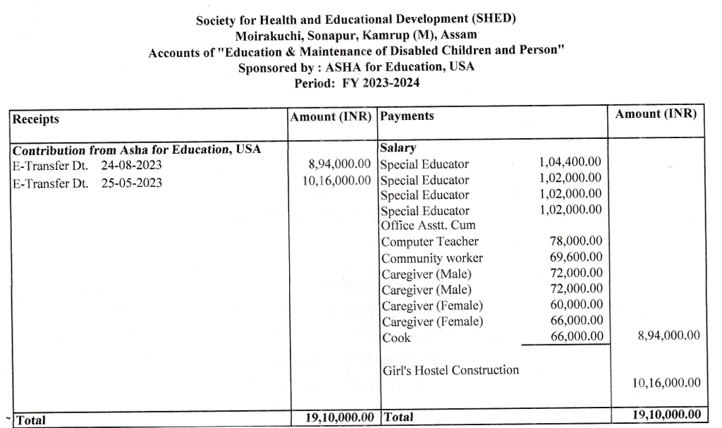
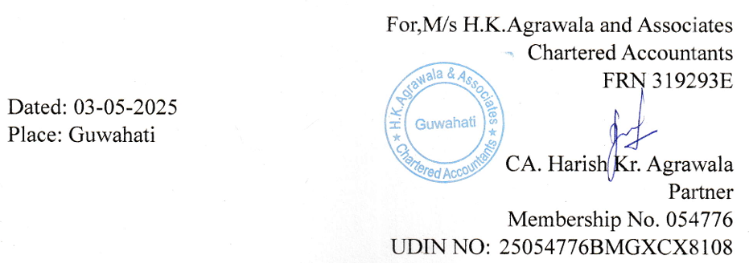
Funds Utilization Certificate

Slide 15
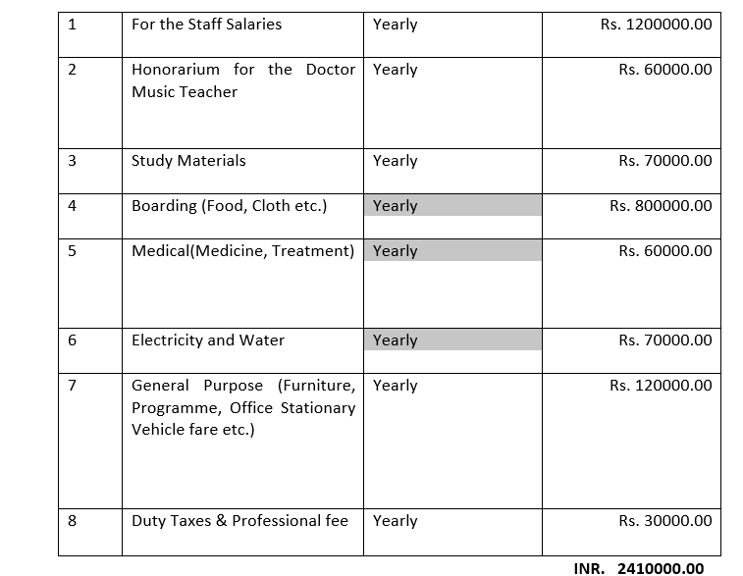
Budget 2025-2026

Slide 16
Teachers Monthly Salaries Proposal 2025-2026
Sl. No | Name | Designation | 2024-25 Monthly Salary Paid by Asha | 2024-25 Actual Monthly Salary | 2025-26 Salary to be Funded by ASHA
1 | Mrs. Madhumita Boruah | Special Ed Teacher & Head Mistress | 8700 | 9000
2 | Mrs. Runumi Talukdar | Special Ed Teacher | 8500 | 9000 | 9000
3 | Miss Rinuj Krishna Rajbongshi | Special Ed Teacher(H.I) | 8500 | 9000 | 9000
4 | Miss Babita Boro | Special Ed Teacher(H.I) | 8500 | 9000 | 9000
5 | Domiyon Nurzary | Regular & Computer Teacher | 6000 | 8500 | 8500
6 | Miss Rita Deka | Community Worker & Office Asst | 5800 | 6000 | 6000
7 | Chimon Bhumij | Caregiver | 6000 | 7000 | 7500
8 | Bhagirath Rabha | Caregiver | 6000 | 7000 | 6500
9 | Miss Nobabi Khatun | Caregiver | 5000 | 7000 | 6000
10 | Mrs. Rinku Lahkar | Caregiver | 5500 | 6000 | 6000
11 | Mrs. Haramoni Bhumij | Caregiver & Cook | 5500 | 7000 | 7000
12 | Sri Sujit Karketta | Caregiver | - | (Local Fund) 7000 | -
 | Monthly Total |  | 74500 | 91500 | 74500
 | Yearly(INR) |  | 8,94,000 | 10,98,000 | 8,94,000
Gap of Rs 2,04,000 paid from local funds.
FUNDING REQUEST: Funding for SHED’s teachers’ salaries of Rs 8,94,000 from April 1st 2025 to March 31st 2026

Slide 17


